Slide 1


Data-Rich Organic Chemistry:
Enabling and Innovating the Study of Chemical Reactions
A Workshop sponsored by the U.S. National Science Foundation Donna G. Blackmond, The Scripps Research Institute

Slide 2
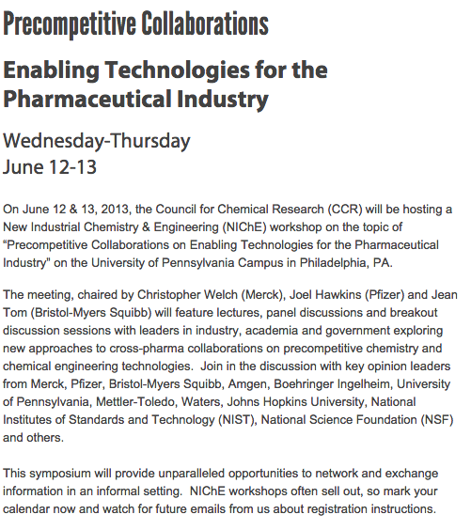
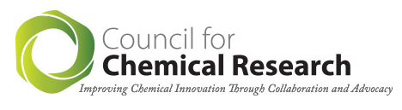
Genesis
June 2013: Council for Chemical Research (CCR) workshop, U Penn, Philadelphia
The growing need for rapid information collection in an era of shrinking resources provides a strong motivation for pre-competitive collaboration between companies themselves and between companies and academia.
Goal: an integrated approach to data capture and interpretation.

Slide 3

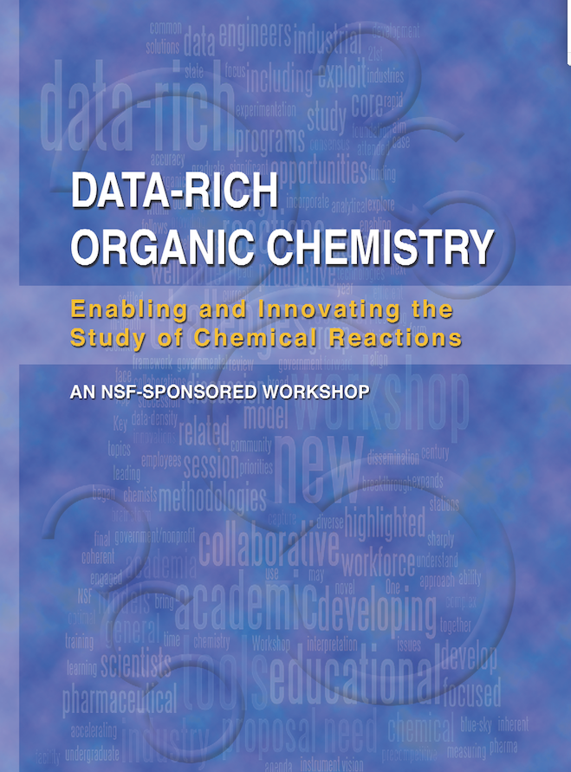
Genesis
September 2014: NSF sponsored workshop, DC
Broad aim of the workshop is to drive sustainability of the US economy and workforce through:
  dissemination of data-rich tools across industry and academia
  building of new collaborative funding models across academia, industry and government
  implementation of ideas for the further development of our workforce

Slide 4
The Current State
Models for Collaboration
  CCHF – Center for Selective C-H Functionalization
    Huw Davies, Emory
  3CS – Caltech Center for Catalysis and Chemical Synthesis
    Scott Virgil, Sarah Reisman, Caltech
  Merck NSF-GOALI Experience
    Shane Krska, Merck
  SSPC – Solid State Pharmaceutical Cluster
    Joe Hannon, Dynochem
  UK Pharmacat Model
    Mimi Hii, Imperial College

Slide 5
Recent Progress
Pharma Models for Collaboration
  Pfizer: Joel Hawkins
    Data needs to be transportable – across people, across time, across location. Broad utilization requires appropriate soft-ware, capable of facile data integration and visualization.
  BMS: Jean Tom
    Key problem is the integration of data into searchable architecture.
  Merck: Chris Welch
    Goal is to provide data-rich tools without data handling headaches. New enabling technologies need to be evaluated.

Slide 6
Transformative Pharma Solutions
Data-rich measures of quality can help to accelerate development and build in quality from the outset.
Concept of the “Lab of the Future”.
New skills will be required to prepare our workforce for this data-rich world of the Lab of the Future.

Slide 7
Key Challenges
Developing a Common Data Framework
  Sharing and mining of data: the Allotrope Framework was developed to address the issue of is lack of connectivity.
Developing New Technologies
  Identify the gaps that exist between ideas and execution that can be filled through collaborations between tech partners, industry, and academia.
Future Priorities: the IQ Consortium
  The IQ consortium is composed of 37 companies with the purpose to advance science-based and science-driven standards and regulations.

Slide 8
Key Challenges
The Allotrope Framework
  An innovative approach to improve data integrity, reduce waste, and realize the full value of analytical data.
Current Members:
  AbbVie
  Amgen
  Baxter
  Biogen Idec
  Boehringer Ingelheim
  Bristol-Myers Squibb
  Eisai
  Genentech/Roche
  GlaxoSmithKline
  Merck
  Pfizer
www.allotrope.org

Slide 9
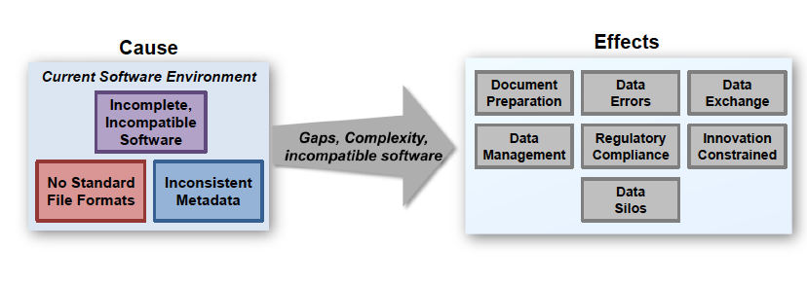
Key Challenges
The Allotrope Framework
www.allotrope.org

Slide 10
Key Challenges
Future Priorities: the IQ Consortium
  How can we share ideas related to enabling laboratory technologies while maintaining protection of intellectual property rights for others, so that incentives for commercialization and publication remain intact?
Advantages | Challenges
Introduces Efficiency: ability to influence potential solution providers to address needs | Logistical and Managerial complexity in management of consortia
Minimizes Financial Impact | Understand and align on cost structure
Opportunity to Share Best Practices | Managing IP to maintain incentives for commercialization or publication
Leverages broad SME Pool | Average (or sum) of group’s desires may not fit anyone’s requirements

Slide 11
“Blue Sky” Challenges
Brainstorming Session
  Grand Challenges and Holy Grails: organic chemistry beyond Morrison & Boyd.
  Prediction in science using big data:
    parameterization of organic chemistry
    use of experimental design
    development of complex models that relate back to reaction mechanism
  Development of robust kinetic models: “ab initio full kinetic modeling” as a goal.
  Real-time decision and control for smart manufacturing.
  Models for our reaction data to include ways to look at time-variant systems.

Slide 12
Educating Tomorrow’s Workforce
Defining the required workplace skill sets for future generations.
Bringing the Lab of the Future to the classroom.
Developing the significant opportunities for new teaching laboratories and new coursework that will enhance critical skills in data-rich science.
Making meaningful connections with industrial research.

Slide 13
The Path Forward
Development of new educational models
Development of a ‘Cal Tech like’ data rich experimentation hub
Development of new industrial/academic collaboration models
Development of future grand challenges to be addressed through data rich experimentation

Slide 14
Acknowledgments
Workshop Organizers:
  Donna Blackmond (Scripps) and Nick Thomson (Pfizer)
NSF Facilitators:
  Kathy Covert and Jackie Gervay-Hague
NSF Grant CHE-1447743, "Data-Driven Organic Chemistry: Enabling and Innovating the Study of Chemical Reactions"

Slide 15
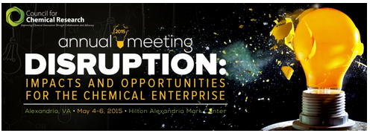
Coming Up: CCR Meeting, May 2015
Disruption in Biotechnology and Process Chemistry:
  The biotechnology sector, and process chemistry in general, have undergone significant radical changes in recent years and more is on the horizon. A wide variety of speakers will discuss these changes and their impacts on the chemical enterprise.
Speakers:
  Douglas Mans, GlaxoSmithKline
  Spencer Dreher, Merck
  Donna Blackmond, The Scripps Research Institute
  Sophie Vallon, Corning
  Mike Grady, DuPont

