Slide 1
Digital Disruption in the Laboratory: Joined-Up Science?
John Trigg
AAMG-RSC

Slide 2
Then…..

Slide 3
Then….. and Now

Slide 4
Evolution of digital technologies
User experience
Fixed character cell -> GUI -> Gesture-based
Connectivity
Central system / dumb terminal
Client – server / networks
WWW
WiFi
Bluetooth
Search tools
Social Networks
Mobile
Cloud / Smart Phones / Tablets
Big data / Data analytics
Wearables? Internet of Things?

Slide 5
A digital revolution in science?
Communications
Music
Movies/Video/TV
Publishing
Photography
Digital technologies are disruptive
They democratise industry sectors
They separate content from consumables & devices
They require that intellectual property be managed differently
They require different business models

Slide 6
Business constraints in the Laboratory
Regulatory (inc. Health, Safety, Environmental)
IP Protection, Legal, Patents, Corporate Governance
The Scientific Method
Data curation
Data provenance
Data integrity
Data preservation

Slide 7
Business/Scientific/Technology issues
Business Issues
Productivity
Hierarchies -> Networks (communication/collaboration)
Externalisation (low cost commodity services)
Innovation (geographically dispersed expertise)
Science
Chemistry -> Biology
More complex
More data
Less certainty
Technology
Cloud/Mobile/Modularity
Social Networks
Convergence (best of breed vs one size fits all)
Big data/Data analytics

Slide 8
The ‘Management’ Landscape
Mathematical
Complexity
Social
Complexity
Un-order
Ontology
Process
Engineering
Systems
Thinking
Order
Rules
Heuristics
Epistemology
Source : Multi-Ontology Sense Making, David Snowden, Management Today Yearbook 2005
Notes:
Ecology
Processes
Technology
Culture

Slide 9
Being a scientist…..
“Being a scientist requires having faith in uncertainty, finding pleasure in mystery, and learning to cultivate doubt.” *
“Science traffics in ignorance, cultivates it, and is driven by it. Mucking about in the unknown is an adventure; doing it for a living is something most scientists consider a privilege.” *
* “Ignorance: How it Drives Science”, Stuart Firestein, OUP USA, 2012
“Computers are incredibly fast, accurate, and stupid. Human beings are incredibly slow, inaccurate, and brilliant. Together they are powerful beyond imagination.” Albert Einstein
“…inefficient practices have become deeply ingrained by a highly risk averse and legalistic corporate culture, often at the expense of opportunities to co-develop early-stage technology tools, establish data standards, share disease target information, or pursue other forms of collaboration that could lift the productivity of the entire industry.”
Macrowikinomics, Don Tapscott & Anthony D.Williams, Atlantic Books, 2010

Slide 10
The ‘Management’ Landscape
Mathematical
Complexity
Social
Complexity
Un-order
Ontology
Process
Engineering
Systems
Thinking
Order
Rules
Heuristics
Epistemology
Source : Multi-Ontology Sense Making, David Snowden, Management Today Yearbook 2005
Notes:
Ecology
Processes
Technology
Culture

Slide 11
Do we have the right skill sets?
The nature of lab work changes as we move from manually executed processes to automated processes.
Algorithms, software, hardware and digital manufacturing are the new standards of product design.
Education (understanding) vs. training (doing)
What happens when cognitive skills are not required?
‘A routine is a number of stereotypical behaviours which can be performed without troubling the idling brain. Routines must always make sense, even if the only sense is to hamper constructive thought.’
‘Stickleback’, John M^{c}Cabe, Granta Books, London

Slide 12
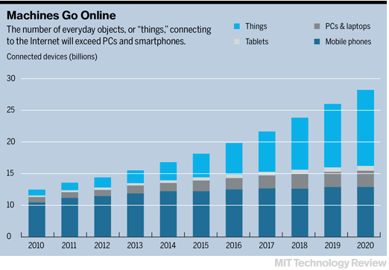
The Internet of Things
Industrial Internet (http://ieet.org/index.php/IEET/more/muzyka20140601)
Interconnected devices with machine-to-machine protocols
“Every industrial company will become a software company” Geoff Immelt, CEO General Electric

Slide 13
The digital transformation of science
Unprecedented opportunities for pre-competitive collaboration to support innovation
Establish business models that accommodate and support innovation
Enhance scientific collaboration by learning from consumer ‘social’ technologies (push instead of pull)
Better educational systems to help scientists handle converging scientific disciplines, technologies and analytics
Automation & productivity vs. creativity & innovation
Shifting the emphasis from throughput to better science
Extending ‘Laboratory Informatics’ tools to include/integrate with data analytics
Modular systems that separate data from applications and devices
Charles Darwin: "It is not the strongest of the species that survive,
nor the most intelligent, but the one most responsive to change.”

Slide 14
Big Data
2
Garbage in: (Garbage out) ??
Spurious Correlations: http://www.tylervigen.com

