Slide 1
Theoretical Chemistry for Electronic Excited States
Supplementary information for Theoretical Chemistry for Electronic Excited States© The Royal Society of Chemistry 2018
Supplementary File: Chapter 1

Slide 2
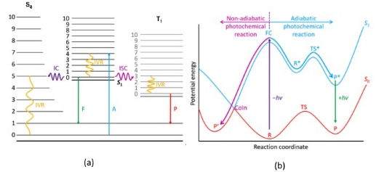
Supplementary information for Theoretical Chemistry for Electronic Excited States© The Royal Society of Chemistry 2018
Figure 1.1 (a) Jablonski diagram (A: absorption; F: fluorescence; P: phosphorescence; IVR: intramolecular vibrational redistribution; IC: internal conversion; ISC: intersystem crossing). The numbers from 0 to 10 indicate the quantum number of the photoactive vibrational mode in each of the three electronic states involved. Adapted from B. Lasorne, G. A. Worth and M. A. Robb, Excited state dynamics, Wiley Interdisciplinary Reviews: Computational Molecular Science, John Wiley and Sons, ©2011 John Wiley & Sons, Ltd. (b) One-dimensional cartoon of nonadiabatic and adiabatic reaction paths involving two potential surfaces. Adapted from M. Robb, M. Garavelli, M. Olivucci and F. Bernardi, A Computational Strategy for Organic Photochemistry, Rev Comp Ch,2 John Wiley and Sons, ©2000 by Wiley-VCH, Inc., and B. Lasorne, G. A. Worth and M. A. Robb, Excited-state dynamics, Wiley Interdisciplinary Reviews:
Computational Molecular Science, John Wiley and Sons, ©2011 John Wiley & Sons, Ltd.

Slide 3
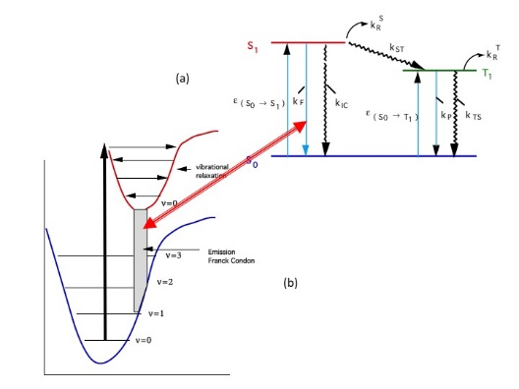
Supplementary information for Theoretical Chemistry for Electronic Excited States© The Royal Society of Chemistry 2018
Figure 1.2 Simplified Jablonski diagram (a), and a potential curve (b) for fluorescence. The extinction coefficients (e) correspond to the probability of the radiationless process, while the rate constants (kST) represent the rates for the radiationless processes.

Slide 4
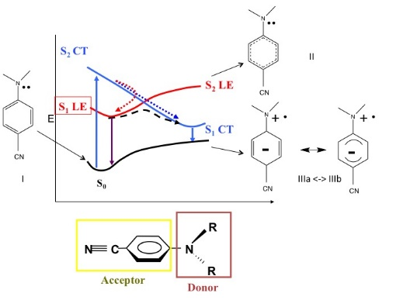
Supplementary information for Theoretical Chemistry for Electronic Excited States© The Royal Society of Chemistry 2018
Figure 1.3 Photophysical and photochemical transformation associated with adiabatic and nonadiabatic intramolecular charge transfer (ICT) in 4-aminobenzonitriles. The curve S2 CT-S1 CT corresponds to keeping the electronic structure fixed (III) as the geometry changes, as shown by the displacement vectors in Figure 1.4a. The dashed line curve S1 LE-S1 CT corresponds to adiabatic motion on S1 and this curve is displaced perpendicular, ‘‘out of the plane’’, to S2 CT-S1 CT, along a
co-ordinate shown in Figure 1.4b. The dotted line trajectory S2 CT-S1 CT is a nonadiabatic
transition along a diabatic state, CT, continuously. The dotted line trajectory S2 CT-S1 LE is
a nonadiabatic transition where the diabatic state changes from CT to LE. The
photoexcitation to S2 can yield both S1 LE and S1 CT states.

Slide 5
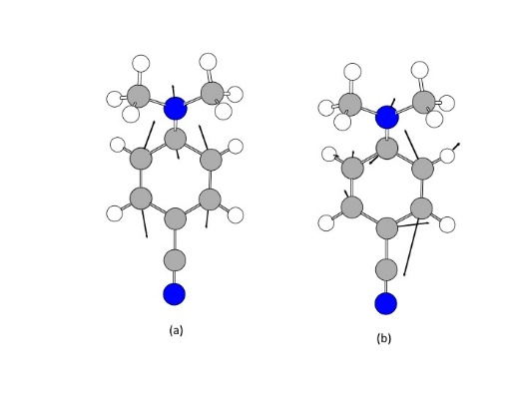
Supplementary information for Theoretical Chemistry for Electronic Excited States© The Royal Society of Chemistry 2018
Figure 1.4 Molecular changes, shown as displacement vectors, with the local origin on the atom to which the vector is attached, corresponding to the potential energy curves shown in Figure 1.3. (a) The main component of either the nonadiabatic reaction paths (Figure 1.3) S2 CT-S1 CT or
S2 CT-S1 LE7 or the transition vector for the S1 LE-S1 CT adiabatic path (dashed line curve), also shown in Figure 1.3, and (b) the displacement coordinate, perpendicular to the S2 CT-S1 CT path (a), which connects the avoided crossing (the dashed curve in Figure 1.3) to the S2 CT/S1 CT crossing point.
Adapted with permission from I. Gomez, M. Reguero, M. Boggio-Pasqua
and M. Robb, J. Am. Chem. Soc., 2005, 127, 7119–7129.5 Copyright 2005 American Chemical Society.

Slide 6
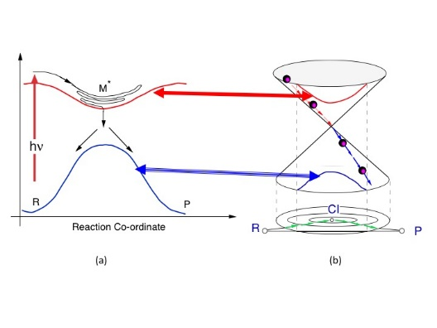
Supplementary information for Theoretical Chemistry for Electronic Excited States© The Royal Society of Chemistry 2018
Figure 1.5 (a) Avoided crossing, (b) conical intersection, true crossing. Adapted from M. Robb, M. Garavelli, M. Olivucci and F. Bernardi, A Computational Strategy for Organic Photochemistry, Rev. Comp. Ch.,15
John Wiley and Sons, ©2000 by Wiley-VCH, Inc.

Slide 7
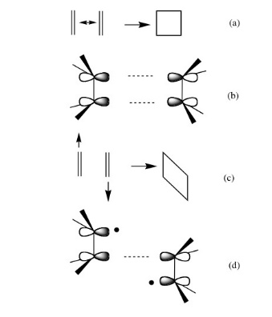
Supplementary information for Theoretical Chemistry for Electronic Excited States© The Royal Society of Chemistry 2018
Figure 1.6 (a) Face-to-face (2sþ2s) photochemical cycloaddition of two ethylenes. (b) The incipient s bonds formed from the p orbitals of the ethylenes. (c)
The rhomboid distortion from the D2h transition state to the conical intersection. (d) The incipient bi-radical.

Slide 8
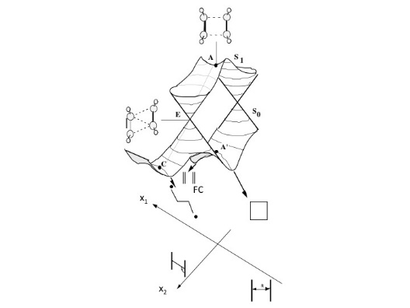
Supplementary information for Theoretical Chemistry for Electronic Excited States© The Royal Society of Chemistry 2018
Figure 1.7 Schematic ‘‘cartoon’’ for the ground and electronically excited state for the face-to-face (2s + 2s) photochemical cycloaddition of two ethylenes. Adapted from Chemical Physics Letters, 243, P. Celani, M. A. Robb, M. Garavelli, F. Bernardi and M. Olivucci, Geometry optimisation on a
hypersphere. Application to finding reaction paths from a conical intersection, 1–8,²⁸ Copyright 1995, with permission from Elsevier.

Slide 9
Supplementary information for Theoretical Chemistry for Electronic Excited States© The Royal Society of Chemistry 2018
Figure 1.8 Two VB structures for the face to face (2s + 2s) photochemical cycloaddition of two ethylenes. Structure I has π bonds while structure II has incipient σ bonds.

Slide 10
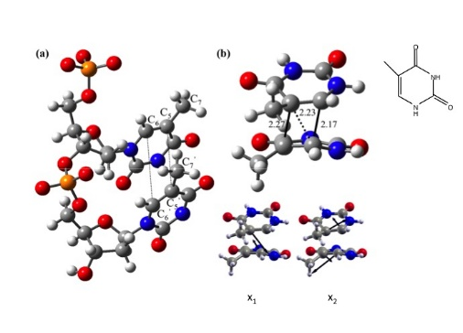
Supplementary information for Theoretical Chemistry for Electronic Excited States© The Royal Society of Chemistry 2018
Figure 1.9 (a) Stacked thymines in DNA. (b) Structure of the S₀/S₁ conical intersection, S₀/S₁–CI. Gradient difference (X₁) and derivative coupling (X₂) vectors forming the branching space. Interatomic distances are given in Å. Adapted with permission from M. Boggio-Pasqua, G. Groenhof, L. V. Schafer, H. Grubmuller and M. A. Robb, J. Am. Chem. Soc., 2007, 129, 10996.³⁹ Copyright 2007 American Chemical Society.

Slide 11
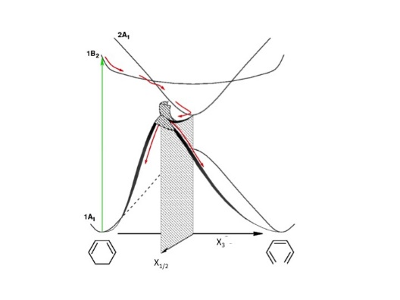
Supplementary information for Theoretical Chemistry for Electronic Excited States© The Royal Society of Chemistry 2018
Figure 1.10 A schematic picture for the ring opening of 1,3-cyclohexadiene (CHD) to cZc-hexatriene (HT). Adapted with permission from A. Nenov, P. Kolle, M. A. Robb and R. de Vivie-Riedle, J. Org. Chem., 2010, 75, 123–129.⁴¹ Copyright 2010 American Chemical Society.

Slide 12
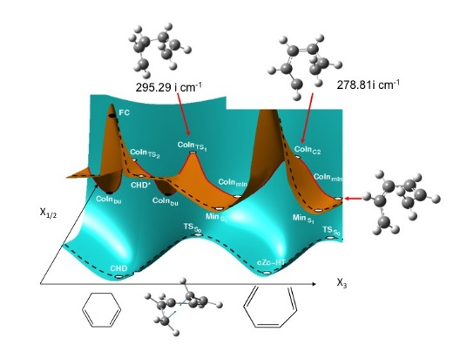
Supplementary information for Theoretical Chemistry for Electronic Excited States© The Royal Society of Chemistry 2018
Figure 1.11 A model potential surface for the ring opening, 3-cyclohexadiene (CHD) to cZc-hexatriene (HT) on the two covalent states 2A₁ and 1A₁ in Figure 1.10. Adapted with permission from A. Nenov, P. Kolle,
M. A. Robb and R. de Vivie-Riedle, J. Org. Chem., 2010, 75, 123–129.⁴¹ Copyright 2010 American Chemical Society.

Slide 13
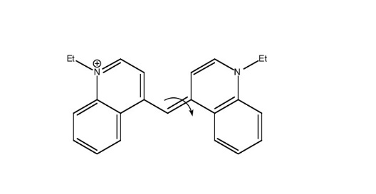
Supplementary information for Theoretical Chemistry for Electronic Excited States© The Royal Society of Chemistry 2018
Figure 1.12 1,1’-diethyl-4,4’-cyanine.

Slide 14
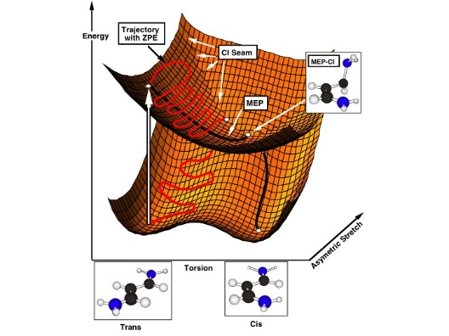
Supplementary information for Theoretical Chemistry for Electronic Excited States© The Royal Society of Chemistry 2018
Figure 1.13 Cartoon representation of the reaction mechanism for ultrafast decay during the trans–cis isomerization of trimethine. Depicted are a typical trajectory and the minimum energy path (MEP) trajectory. The reaction
coordinate is the rotation trans–cis angle X₃ (torsion), and the branching space coordinates X_{1/2} (for simplicity, only one, asymmetric stretch is included in this diagram) are dominated by symmetric and asymmetric
stretch of the terminal C–N bonds.
Adapted with permission from P. A. Hunt and M. A. Robb, J. Am. Chem. Soc., 2005, 127, 5720–5726.⁵⁹
Copyright 2005 American Chemical Society.

Slide 15
Supplementary information for Theoretical Chemistry for Electronic Excited States© The Royal Society of Chemistry 2018
Figure 1.14 Some potential energy curves for butadiene in its ground (S₀) and excited states (S₁). For simplicity we have ignored the zwitterionic B₁ that is also present and shown for hexatriene in Figure 1.10.

Slide 16
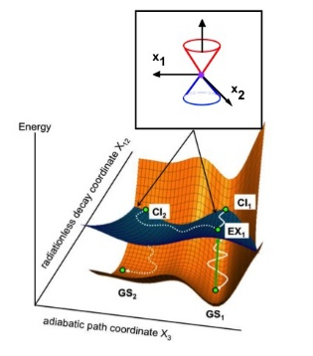
Supplementary information for Theoretical Chemistry for Electronic Excited States© The Royal Society of Chemistry 2018
Figure 1.15 Schematic representation of the photochemical reaction involving a conical intersection.
Adapted with permission from J. J. Serrano-Perez, F. de Vleeschouwer, F. de Proft,
D. Mendive-Tapia, M. J. Bearpark and M. A. Robb, J. Org.Chem., 2013, 78, 1874–1886.⁶³ Copyright 2013 American Chemical Society.

Slide 17
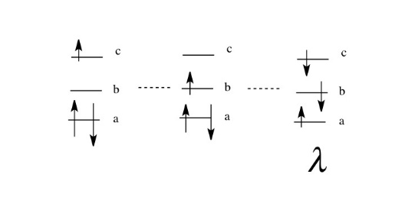
Supplementary information for Theoretical Chemistry for Electronic Excited States© The Royal Society of Chemistry 2018
Figure 1.16 Some configurations of three-orbitals and three-electrons (λ in eqn (1.1)).

Slide 18
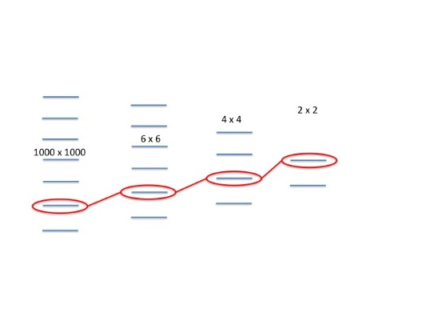
Supplementary information for Theoretical Chemistry for Electronic Excited States© The Royal Society of Chemistry 2018
Figure 1.17 Convergence of the CI as the space is increased.

