Slide 1
Theoretical Chemistry for Electronic Excited States
Supplementary information for Theoretical Chemistry for Electronic Excited States© The Royal Society of Chemistry 2018
Supplementary File: Chapter 2

Slide 2
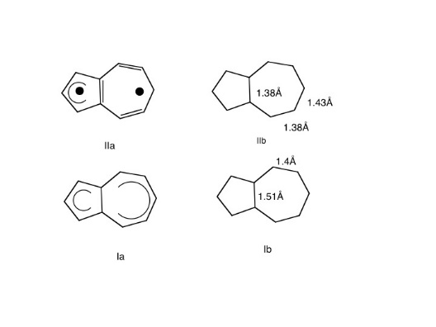
Supplementary information for Theoretical Chemistry for Electronic Excited States© The Royal Society of Chemistry 2018
Figure 2.1 VB structures and optimized geometries for ground and excited states of azulene.²

Slide 3
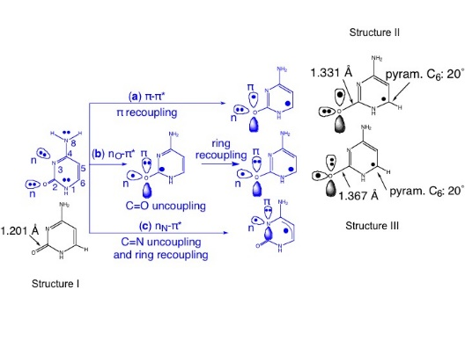
Supplementary information for Theoretical Chemistry for Electronic Excited States© The Royal Society of Chemistry 2018
Figure 2.2 VB structures and optimized geometries for various excited states of cytosine.

Slide 4
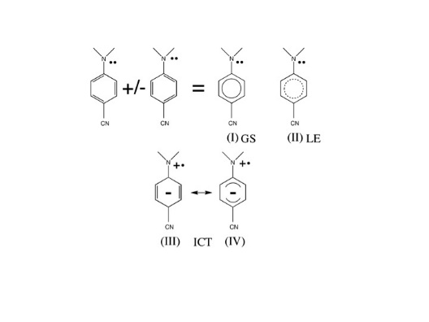
Supplementary information for Theoretical Chemistry for Electronic Excited States© The Royal Society of Chemistry 2018
Figure 2.3 VB structures for 4-(dimethylamino)benzonitrile (DMABN). Adapted with permission from I. Gomez, M. Reguero, M. Boggio-Pasqua and M. Robb, J. Am. Chem. Soc., 2005, 127, 7119–7129.⁵ Copyright 2005 American Chemical Society.

Slide 5
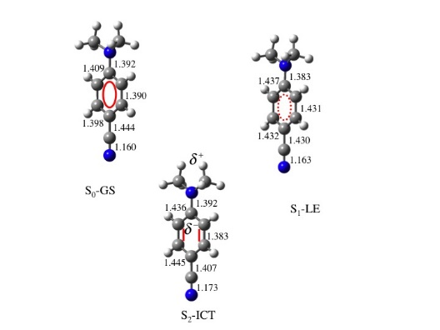
Supplementary information for Theoretical Chemistry for Electronic Excited States© The Royal Society of Chemistry 2018
Figure 2.4 Optimized geometries for 4-(dimethylamino)benzonitrile (DMABN). Adapted with permission from I. Gomez, M. Reguero, M. Boggio-Pasqua and M. Robb, J. Am. Chem. Soc., 2005, 127, 7119–7129.⁵ Copyright 2005 American Chemical Society.

Slide 6
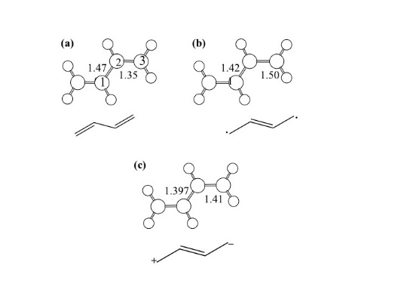
Supplementary information for Theoretical Chemistry for Electronic Excited States© The Royal Society of Chemistry 2018
Figure 2.5 Optimized geometries for trans butadiene: (a) 1A₁, (b) 2A₁ and (c) 1B₂. Adapted from M. Boggio-Pasqua, M. J. Bearpark, M. Klene and M. A. Robb, J. Chem. Phys., 2004, 120, 7849–7860⁷ with the permission of AIP publishing.

Slide 7
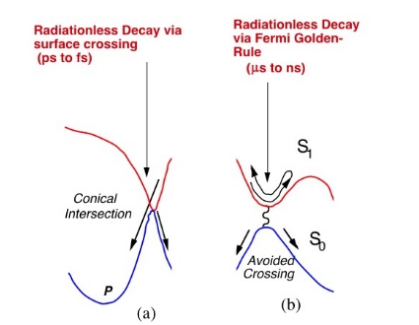
Supplementary information for Theoretical Chemistry for Electronic Excited States© The Royal Society of Chemistry 2018
Figure 2.6 Potential energy surface topology associated with radiationless decay: (a) conical intersection, (b) avoided crossing. Adapted from M. Robb, M. Garavelli, M. Olivucci and F. Bernardi, A Computational Strategy for Organic Photochemistry, Rev. Comp. Ch.,⁸ John Wiley and Sons, © 2000 by Wiley-VCH, Inc.

Slide 8
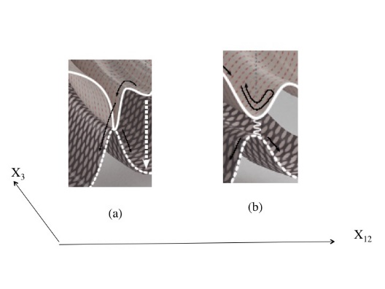
Supplementary information for Theoretical Chemistry for Electronic Excited States© The Royal Society of Chemistry 2018
Figure 2.7 Potential energy surface topology associated with radiationless decay shown in the space of X_{1/2} (some combination of X₁ and X₂) and a coordinate orthogonal to this space, which we will refer to as X₃. (a) Conical intersection, (b) avoided crossing.

Slide 9
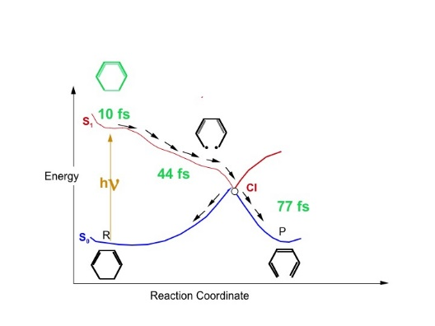
Supplementary information for Theoretical Chemistry for Electronic Excited States© The Royal Society of Chemistry 2018
Figure 2.8 Schematic illustration of the photochemical reaction of cyclohexadiene
(CHD) to 1,3,5 hexatriene (HT).²⁰

Slide 10
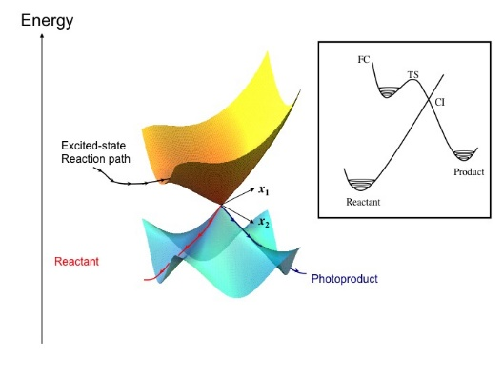
Supplementary information for Theoretical Chemistry for Electronic Excited States© The Royal Society of Chemistry 2018
Figure 2.9 A cartoon of a conical intersection together with an inset showing a one-dimensional
cross-section through the apex of the cone.
Adapted from Ref. 16 with permission from the PCCP owner Societies.

Slide 11
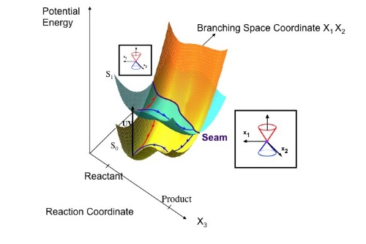
Supplementary information for Theoretical Chemistry for Electronic Excited States© The Royal Society of Chemistry 2018
Figure 2.10 The conical intersection seam traced out by a coordinate X₃ plotted in a space containing the coordinate X₃ and one coordinate from the degeneracy-lifting space X₁X₂.¹⁶ The double cone is shown in the inset. Two possible reaction paths are shown: one crosses the seam near the FC
region, the other traces out a reaction path on the excited state sheet before crossing to the
ground state in the region of the products. Adapted from Ref. 16 with permission from the
PCCP owner Societies.

Slide 12
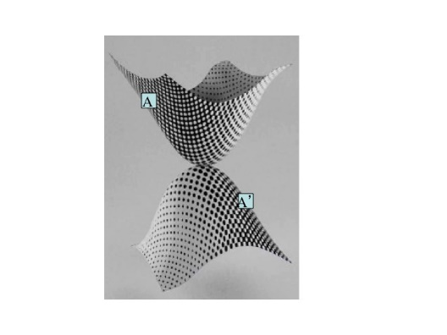
Supplementary information for Theoretical Chemistry for Electronic Excited States© The Royal Society of Chemistry 2018
Figure 2.11 Conical intersection surfaces showing the tessellation pattern of the wavefunctions corresponding to two diabatic electronic states A (white) and B (black). According to the phase rule discussions of Longuet–Higgins,³² if one takes any point A on the upper surface and performs a
rotation by 180° followed by reflection in the X₁X₂ plane, the point A is mapped onto A’ in Figure 2.11. The combination of the electronic states A and B is the same at points A and A’.

Slide 13
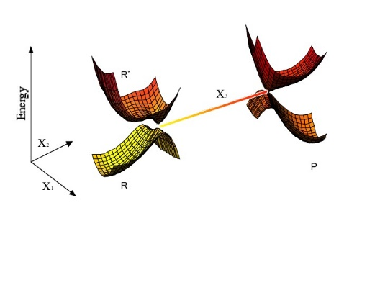
Supplementary information for Theoretical Chemistry for Electronic Excited States© The Royal Society of Chemistry 2018
Figure 2.12 A cartoon showing the conical intersection hyperline traced out by a degeneracy-preserving coordinate X₃. The system remains degenerate as one traverses the coordinate X₃, but the energy and the shape of the double cone must change in X₁X₂.
Adapted with permission from I. Gomez, M. Reguero, M. Boggio-Pasqua and M. Robb, J. Am. Chem. Soc., 2005, 127, 7119–7129.⁵ Copyright 2005 American Chemical Society.

Slide 14
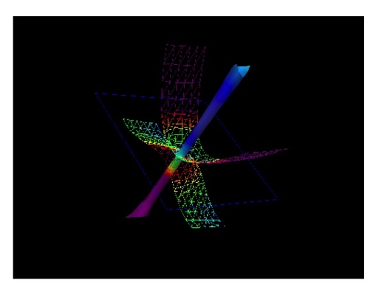
Supplementary information for Theoretical Chemistry for Electronic Excited States© The Royal Society of Chemistry 2018
Figure 2.13 Four-dimensional plot of the conical intersection line or seam for H₃. The axes correspond to the three (r₁, r₂ and r₃) H–H distances. The column or line running diagonally through the figure corresponds to a ‘‘seam’’ of degeneracy with r₁ = r₂ = r₃.

Slide 15
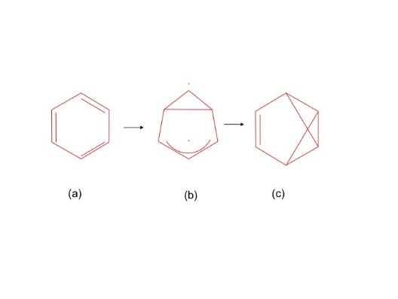
Supplementary information for Theoretical Chemistry for Electronic Excited States© The Royal Society of Chemistry 2018
Figure 2.14 Reaction intermediates in the photolysis of benzene.

Slide 16
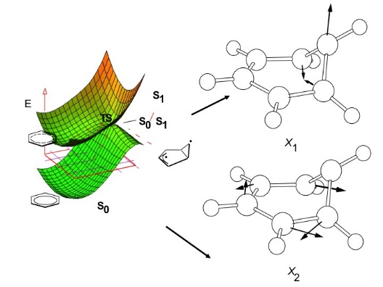
Supplementary information for Theoretical Chemistry for Electronic Excited States© The Royal Society of Chemistry 2018
Figure 2.15 The photochemistry benzene with a ‘‘sand in the funnel’’ type radiationless decay where X₁ and X₂ are the computed branching space vectors.
Adapted from M. Robb, M. Garavelli, M. Olivucci and F. Bernardi, A Computational Strategy for Organic Photochemistry, Rev. Comp. Ch.,⁸ John Wiley and Sons, © 2000 by Wiley-VCH, Inc.

Slide 17
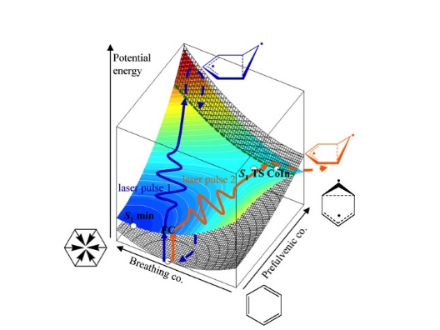
Supplementary information for Theoretical Chemistry for Electronic Excited States© The Royal Society of Chemistry 2018
Figure 2.16 Benzene potential surface in the space of one branching space coordinate X_{1/2}, in this case the prefulvene-like deformation X₁ and one coordinate X₃ orthogonal to the X₁X₂ plane. The variable X₃ was chosen, in this case, to be a ring expansion. One might seek to control reactivity
by forcing the system (by laser pulse 1) to a ring compressed geometry, which would yield benzene, or to a ring expanded geometry (by laser pulse 2), which would yield prefulvene.
Adapted from B. Lasorne, F. Sicilia, M. J. Bearpark, M. A. Robb, G. A. Worth and L. Blancafort,
J. Chem. Phys., 2008, 128, 12430746 with the permission of AIP Publishing.

Slide 18
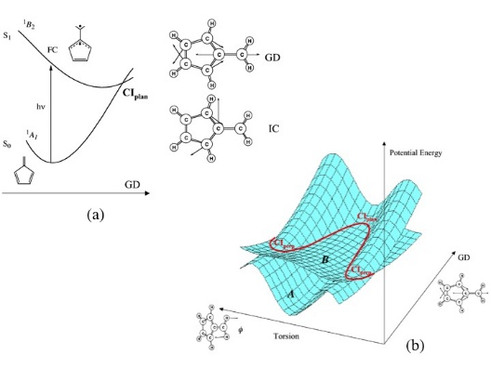
Supplementary information for Theoretical Chemistry for Electronic Excited States© The Royal Society of Chemistry 2018
Figure 2.17 Fulvene radiationless decay: (a) cross section along X₂ (GD), (b) intersection along a torsional coordinate (X₃) plotted in the space containing X₂ and X₃ (torsion).⁴⁷

Slide 19
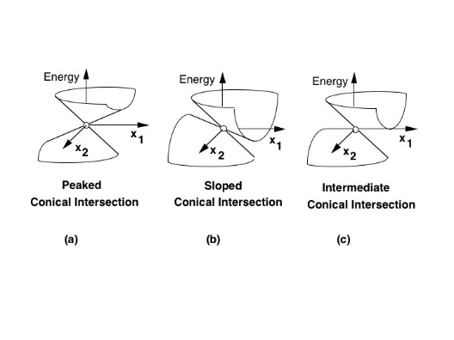
Supplementary information for Theoretical Chemistry for Electronic Excited States© The Royal Society of Chemistry 2018
Figure 2.18 The slope of the conical intersection.³⁸
Adapted from M. Robb, M. Garavelli, M. Olivucci and F. Bernardi, A Computational Strategy for Organic Photochemistry, Rev. Comp. Ch.,⁸ John Wiley and Sons, © 2000 by Wiley-VCH, Inc.

Slide 20
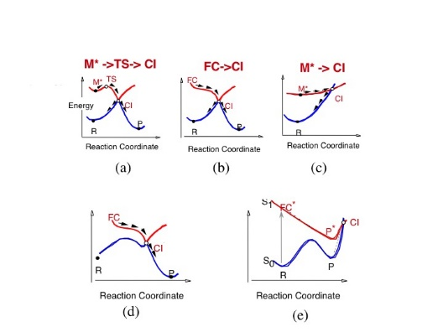
Supplementary information for Theoretical Chemistry for Electronic Excited States© The Royal Society of Chemistry 2018
Figure 2.19 Shapes of reaction profiles passing through conical intersections.
Adapted from M. Robb, M. Garavelli, M. Olivucci and F. Bernardi, A Computational Strategy for Organic Photochemistry, Rev. Comp. Ch.,⁸ John Wiley and Sons, © 2000 by Wiley-VCH, Inc.

Slide 21
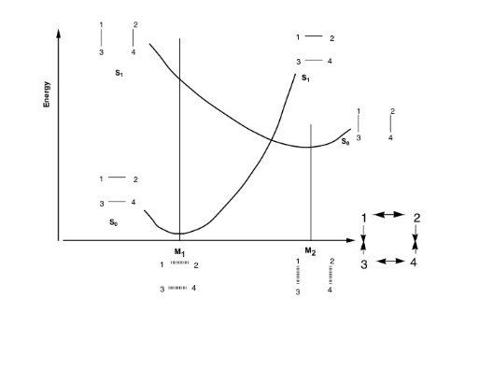
Supplementary information for Theoretical Chemistry for Electronic Excited States© The Royal Society of Chemistry 2018
Figure 2.20 Description of the surface crossing associated with 1–2 and 3–4 to 1–3 and 2–4 nonadiabatic bond exchange.

Slide 22
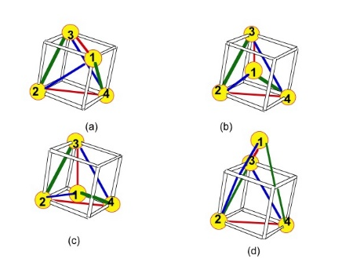
Supplementary information for Theoretical Chemistry for Electronic Excited States© The Royal Society of Chemistry 2018
Figure 2.21 Abstract geometries, for four electrons in four 1s orbitals, where a conical intersection occurs. Possible arrangements of four orbitals and four electrons where K_{R} = (K₁₂ + K₃₄) = K_{p} = (K₁₃ + K₂₄) = K_{X} = (K₁₄ + K₂₃).
Adapted from F. Bernardi, M. Olivucci, M. A. Robb and G. Tonachini, J. Am. Chem. Soc., 1992, 114, 5805–5812.54 Copyright 1992 American Chemical Society.

Slide 23
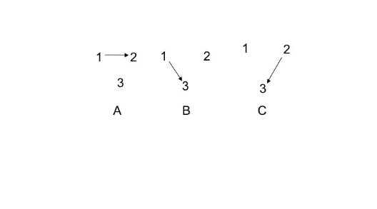
Supplementary information for Theoretical Chemistry for Electronic Excited States© The Royal Society of Chemistry 2018
Figure 2.22 VB structures for three orbitals and three electrons.⁶⁴

Slide 24
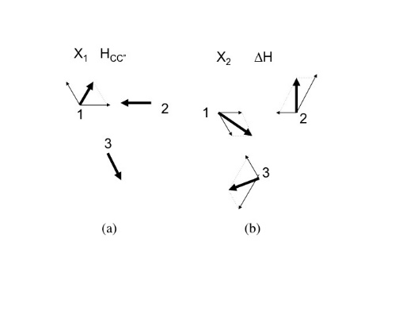
Supplementary information for Theoretical Chemistry for Electronic Excited States© The Royal Society of Chemistry 2018
Figure 2.23 Derivative coupling and gradient difference for three orbital three electron systems: (a) X₁ derived from VB analysis, (b) X₂ derived from VB analysis.
Adapted from Chemical Physics, 347, S. Vanni, M. Garavelli and M. A. Robb, A new formulation of the phase change approach in the theory of conical intersections, 46–56,⁶⁴ Copyright 2008, with
permission from Elsevier.

Slide 25
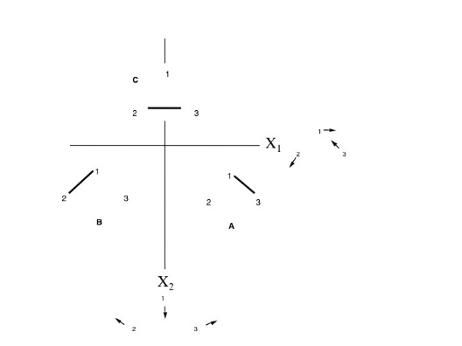
Supplementary information for Theoretical Chemistry for Electronic Excited States© The Royal Society of Chemistry 2018
Figure 2.24 The loop in nuclear configuration space showing VB structures for the three orbital three electron problem and the branching plane vectors X₁ and X₂.
Adapted from Chemical Physics, 347, S. Vanni, M. Garavelli and M. A. Robb, A new formulation of the phase change approach in the theory of conical intersections, 46–56,⁶⁴ Copyright 2008, with permission
from Elsevier.

Slide 26
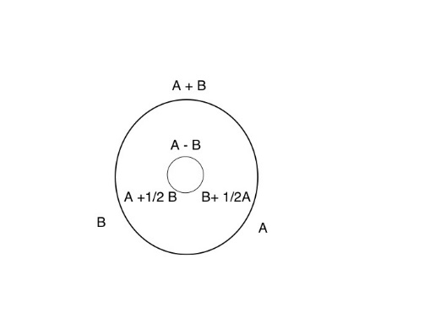
Supplementary information for Theoretical Chemistry for Electronic Excited States© The Royal Society of Chemistry 2018
Figure 2.25 Loop in the VB structure space for the three orbital three electron problem. The outer loop corresponds to the ground state VB structures while the inner loop corresponds to the excited state VB structures that have been Schmidt orthogonalized but not normalized.
Adapted from Chemical Physics, 347, S. Vanni, M. Garavelli and M. A. Robb, A new formulation of the phase change approach in the theory of conical intersections, 46–56,⁶⁴ Copyright 2008, with permission from Elsevier.

Slide 27
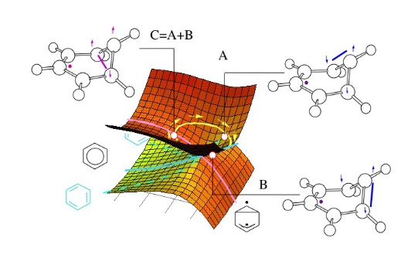
Supplementary information for Theoretical Chemistry for Electronic Excited States© The Royal Society of Chemistry 2018
Figure 2.26 A ‘‘cartoon’’ for the S₁ ‘‘channel 3’’ conical intersection in benzene.⁶⁰ A, B and C correspond to the VB structures in the reaction path for benzene.
Adapted from M. Robb, M. Garavelli, M. Olivucci and F. Bernardi, A Computational Strategy for Organic Photochemistry, Rev. Comp. Ch.,⁸ John Wiley and Sons, © 2000 by Wiley-VCH, Inc.

Slide 28
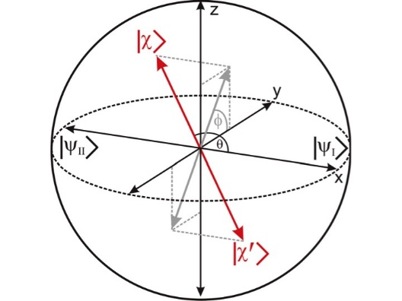
Supplementary information for Theoretical Chemistry for Electronic Excited States© The Royal Society of Chemistry 2018
Figure 2.27 Representation of the two orthogonal superpositions and of two electronic diabatic states as vectors on the Bloch sphere. The mixing angle θ determines the weight of both basis states; the angle φ determines the relative phase between them.
Adapted from J. Meisner, M. Vacher, M. J. Bearpark and M. A. Robb, J. Chem. Theory Comput., 2015, 11, 3115–3122.⁶⁸ Copyright 2015 American Chemical Society.

Slide 29
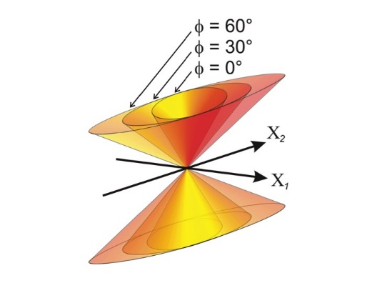
Supplementary information for Theoretical Chemistry for Electronic Excited States© The Royal Society of Chemistry 2018
Figure 2.28 The effective potential energy surfaces of the superpositions |I〉 and |II〉 (eqn (2.19)) while changing Φ. For Φ = 0, the effective potentials correspond to the adiabatic potential surfaces. The shading indicates the value of θ: light for the pure |I〉 state, dark for the pure |II〉 state.
Adapted from J. Meisner, M. Vacher, M. J. Bearpark and M. A. Robb, J. Chem. Theory
Comput., 2015, 11, 3115–3122.⁶⁸ Copyright 2015 American Chemical Society.

Slide 30
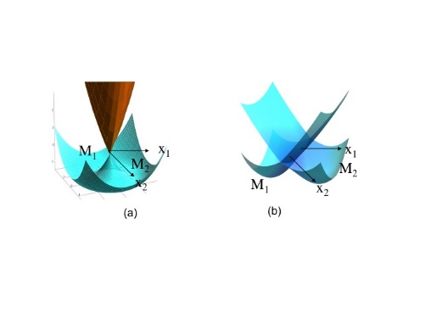
Supplementary information for Theoretical Chemistry for Electronic Excited States© The Royal Society of Chemistry 2018
Figure 2.29 Reducing X₂ to zero length to make an (n - 1)-dimensional surface crossing. The (n - 2)-dimensional conical
intersection (a) is reduced to n - 1 (b) and the apex point becomes a line.

Slide 31
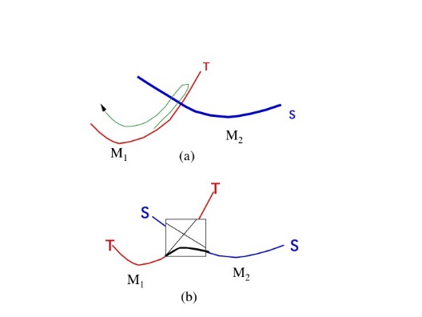
Supplementary information for Theoretical Chemistry for Electronic Excited States© The Royal Society of Chemistry 2018
Figure 2.30 (a) Crossing of singlet–triplet surfaces without spin–orbit coupling and (b) the avoided crossing in the presence of spin–orbit coupling.

Slide 32
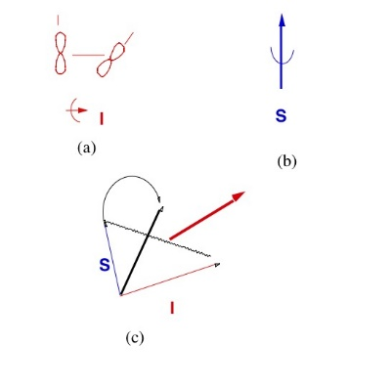
Supplementary information for Theoretical Chemistry for Electronic Excited States© The Royal Society of Chemistry 2018
Figure 2.31 A cartoon to rationalize the magnitude of the spin orbit coupling: (a) orbital angular momentum for two orbitals, (b) spin angular momentum and (c) coupling of spin and orbital angular momentum.

Slide 33
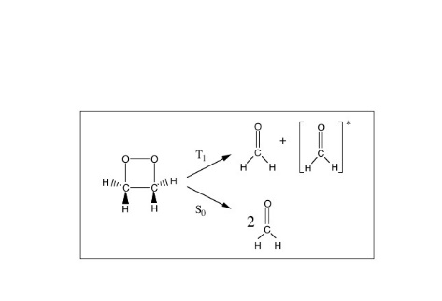
Supplementary information for Theoretical Chemistry for Electronic Excited States© The Royal Society of Chemistry 2018
Figure 2.32 Chemiluminescence of dioxetane. The triplet species [..]* is created from the ground state dioxetane and emits light.
Adapted from S. Wilsey, F. Bernardi, M. Olivucci, M. Robb, S. Murphy and W. Adam, J. Phys. Chem. A, 1999, 103, 1669–1677.⁷⁵ Copyright 1999 American Chemical Society.

Slide 34
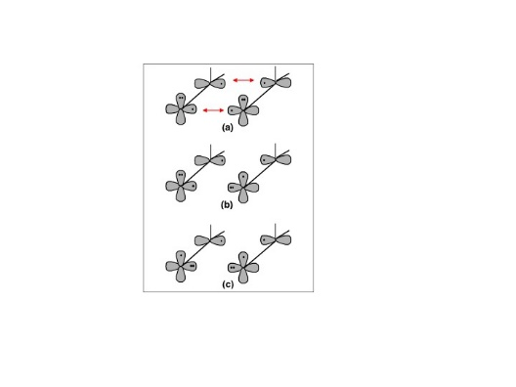
Supplementary information for Theoretical Chemistry for Electronic Excited States© The Royal Society of Chemistry 2018
Figure 2.33 VB states of two formaldehyde molecules: (a) ground states in a face-to-face arrangement, (b), (c) a singlet or triplet n→π* state and a pair of singlet or triplet n→π* states.
Adapted from S. Wilsey, F. Bernardi, M. Olivucci, M. Robb, S. Murphy and W. Adam, J. Phys. Chem. A, 1999, 103, 1669–1677.⁷⁵ Copyright 1999 American Chemical Society.

Slide 35
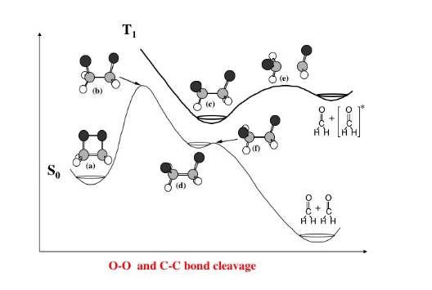
Supplementary information for Theoretical Chemistry for Electronic Excited States© The Royal Society of Chemistry 2018
Figure 2.34 A cross section along the bond dissociation coordinate for the ground state and the corresponding first excited triplet (VB structure in Figure 2.33b).
Adapted from S. Wilsey, F. Bernardi, M. Olivucci, M. Robb, S. Murphy and W. Adam, J. Phys. Chem. A, 1999, 103, 1669–1677.⁷⁵ Copyright 1999 American Chemical Society.

Slide 36
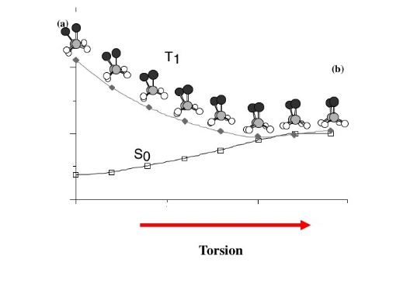
Supplementary information for Theoretical Chemistry for Electronic Excited States© The Royal Society of Chemistry 2018
Figure 2.35 Torsion about the C–C bond leads to S/T crossing in dioxetane.
Adapted from S. Wilsey, F. Bernardi, M. Olivucci, M. Robb, S. Murphy and W. Adam, J. Phys. Chem. A, 1999, 103, 1669–1677.⁷⁵ Copyright 1999 American Chemical Society.

Slide 37
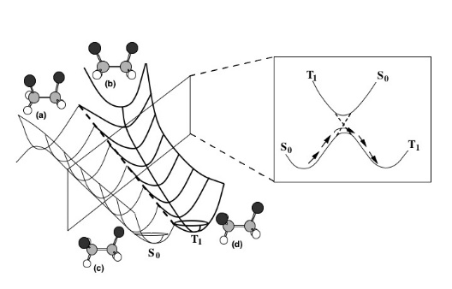
Supplementary information for Theoretical Chemistry for Electronic Excited States© The Royal Society of Chemistry 2018
Figure 2.36 The potential curves for ground and excited state triplets (C–C torsion vs. C–C dissociation).
Adapted from S. Wilsey, F. Bernardi, M. Olivucci, M. Robb, S. Murphy and W. Adam, J. Phys. Chem. A, 1999, 103, 1669–1677.⁷⁵ Copyright 1999 American Chemical Society.

Slide 38
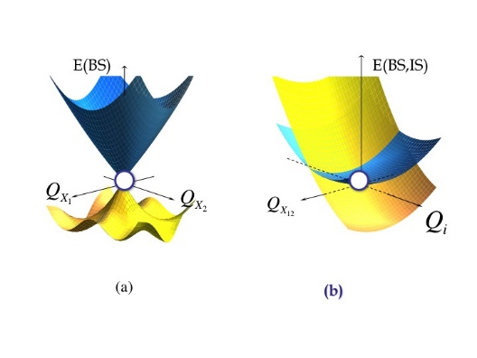
Supplementary information for Theoretical Chemistry for Electronic Excited States© The Royal Society of Chemistry 2018
Figure 2.37 First-order representation of a conical intersection: (a) in the branching space (BS) and (b) in the intersection space (E(BS,IS)).⁴⁴

Slide 39
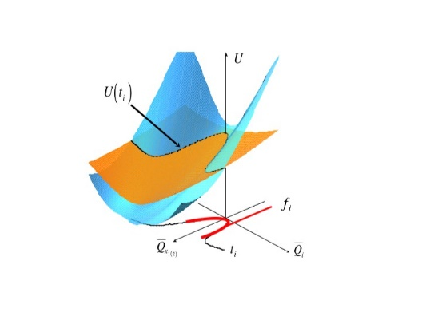
Supplementary information for Theoretical Chemistry for Electronic Excited States© The Royal Society of Chemistry 2018
Figure 2.38 Curvature of the intersection seam (U(t_{i}) vs. t_{i}).
Adapted from Theoretical Chemistry Accounts, An analytical second-order description of the S0/S1 intersection seam: fulvene revisited, 118, 2007, 241–251,⁴⁴ © Springer-Verlag 2007, with permission of Springer.

Slide 40
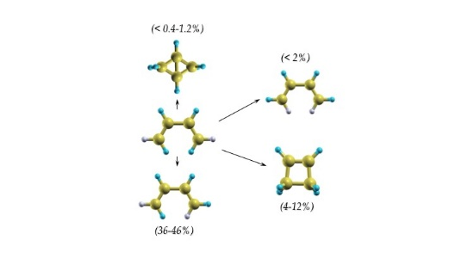
Supplementary information for Theoretical Chemistry for Electronic Excited States© The Royal Society of Chemistry 2018
Figure 2.39 Butadiene photochemistry cis trans isomerization Z-E isomerization Z,Z-E,E isomerization cyclobutene bicyclo[1.1.0]butane.^{80,81}
Adapted from Theoretical Chemistry Accounts, An analytical second-order description of the S0/S1 intersection seam: fulvene revisited, 118, 2007, 241–251,⁴⁴ © Springer-Verlag 2007, with permission
of Springer.

Slide 41
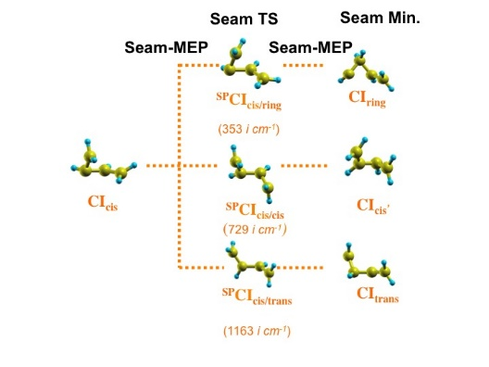
Supplementary information for Theoretical Chemistry for Electronic Excited States© The Royal Society of Chemistry 2018
Figure 2.40 Critical points on the conical intersection seam of butadiene.
Adapted from Theoretical Chemistry Accounts, An analytical second-order description of the S0/S1 intersection seam: fulvene revisited, 118, 2007, 241–251,⁴⁴ © Springer-Verlag 2007, with permission of
Springer.

Slide 42
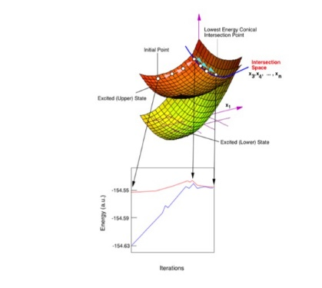
Supplementary information for Theoretical Chemistry for Electronic Excited States© The Royal Society of Chemistry 2018
Figure 2.41 Finding a minimum on a conical intersection seam.
Adapted from M. Robb, M. Garavelli, M. Olivucci and F. Bernardi, A Computational Strategy for Organic Photochemistry, Rev. Comp. Ch.,⁸ John Wiley and Sons, © 2000 by Wiley-VCH, Inc.

