Slide 1
Theoretical Chemistry for Electronic Excited States
Supplementary information for Theoretical Chemistry for Electronic Excited States© The Royal Society of Chemistry 2018
Supplementary File: Chapter 5

Slide 2
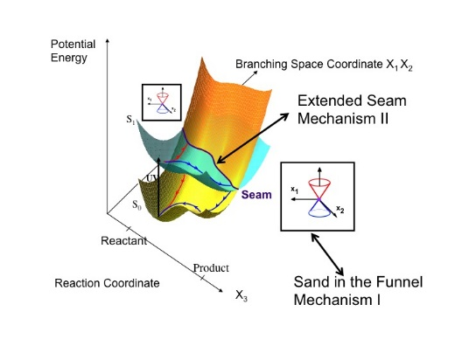
Supplementary information for Theoretical Chemistry for Electronic Excited States© The Royal Society of Chemistry 2018
Figure 5.1 Main mechanistic concepts for nonadiabatic events (adapted from Figure 2.10). Mechanism I: the sand in the funnel model (Figure 2.9). Mechanism II: the extended seam (Figures 2.10–2.13).

Slide 3
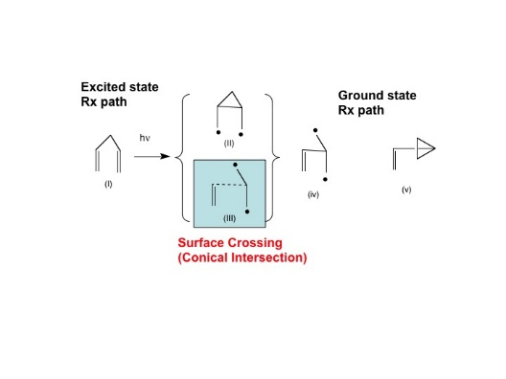
Supplementary information for Theoretical Chemistry for Electronic Excited States© The Royal Society of Chemistry 2018
Figure 5.2 The ‘‘mechanism’’ of the di-p-methane rearrangement mechanism.⁵ Excited state structures I and II; conical intersection structure III; ground state structures IV and V.

Slide 4
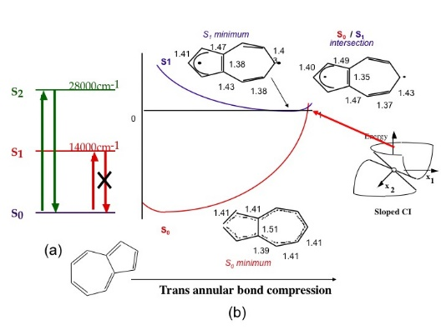
Supplementary information for Theoretical Chemistry for Electronic Excited States© The Royal Society of Chemistry 2018
Figure 5.3 Azulene photophysics: (a) spectroscopic transitions in azulene, (b) schematic potential curves for the decay of azulene S₁.³³

Slide 5
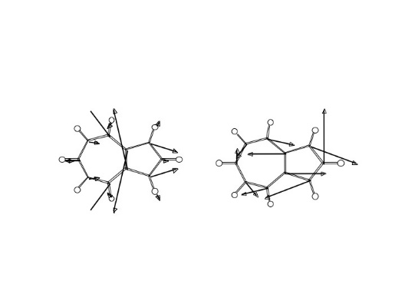
Supplementary information for Theoretical Chemistry for Electronic Excited States© The Royal Society of Chemistry 2018
Figure 5.4 Branching space (X₁X₂) of azulene S₁.³³

Slide 6
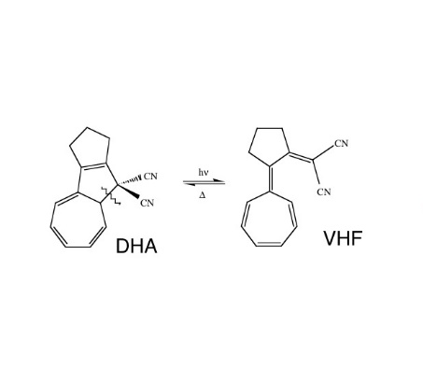
Supplementary information for Theoretical Chemistry for Electronic Excited States© The Royal Society of Chemistry 2018
Figure 5.5 DHA/VHF photochromism (reaction path X₃ indicated by a wavy line).

Slide 7
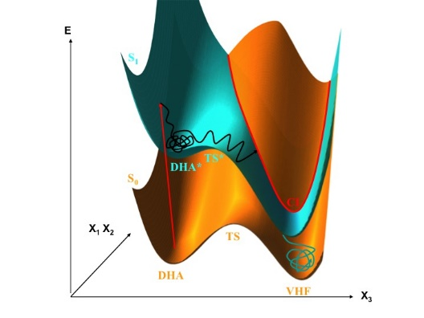
Supplementary information for Theoretical Chemistry for Electronic Excited States© The Royal Society of Chemistry 2018
Figure 5.6 Schematic cartoon for DHA/VHF photochemical transformation.
Adapted from M. Boggio-Pasqua, M. J. Bearpark, P. A. Hunt and M. A. Robb, J. Am. Chem. Soc., 2002, 124, 1456–1470.⁴⁰ Copyright 2002 American Chemical Society.

Slide 8
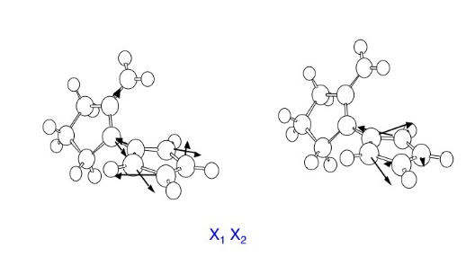
Supplementary information for Theoretical Chemistry for Electronic Excited States© The Royal Society of Chemistry 2018
Figure 5.7 Branching space for DHA/VHF conical intersection.

Slide 9
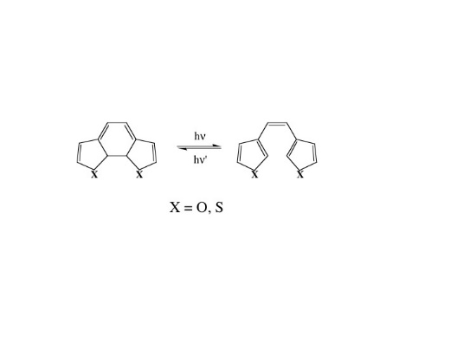
Supplementary information for Theoretical Chemistry for Electronic Excited States© The Royal Society of Chemistry 2018
Figure 5.8 Diarylethene photochemistry (X3 is a ring opening co-ordinate).

Slide 10
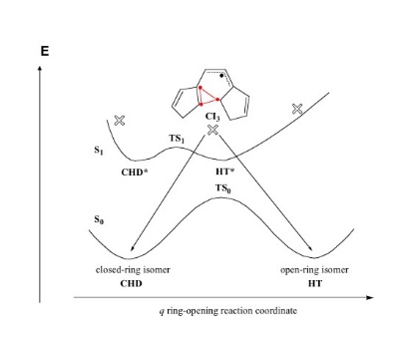
Supplementary information for Theoretical Chemistry for Electronic Excited States© The Royal Society of Chemistry 2018
Figure 5.9 Schematic two-dimensional view of the potential surface for diarylethene photochemistry along the X₃ ring opening co-ordinate. The open cross symbols indicate optimized conical intersections.
Adapted from M. Boggio-Pasqua, M. Ravaglia, M. J. Bearpark, M. Garavelli and M. A. Robb,
J. Phys. Chem. A, 2003, 107, 11139–11152.⁴² Copyright 2003 American Chemical Society.

Slide 11
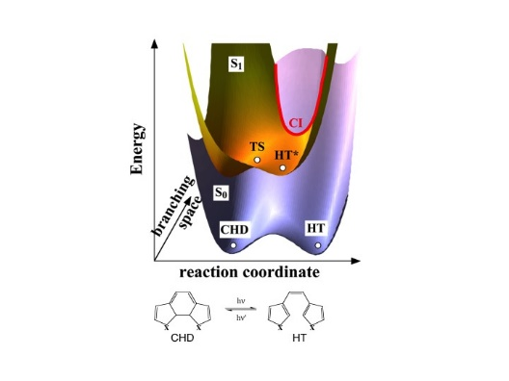
Supplementary information for Theoretical Chemistry for Electronic Excited States© The Royal Society of Chemistry 2018
Figure 5.10 Schematic 3D view of the potential surface for diarylethene photochemistry along the X₃ ring opening co-ordinate (reaction co-ordinate) and the X₁X₂ branching space co-ordinate.
Adapted from M. Boggio-Pasqua, M. Ravaglia, M. J. Bearpark, M. Garavelli and M. A. Robb,
J. Phys. Chem. A, 2003, 107, 11139–11152.⁴² Copyright 2003 American Chemical Society.

Slide 12
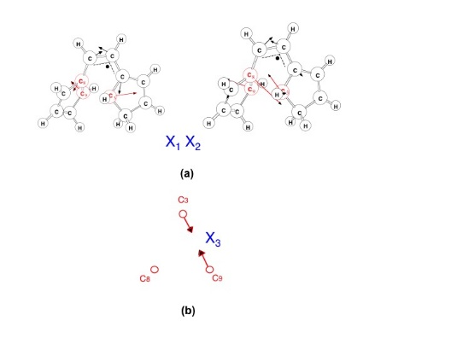
Supplementary information for Theoretical Chemistry for Electronic Excited States© The Royal Society of Chemistry 2018
Figure 5.11 Computed branching space co-ordinates X₁, X₂, and X₃ ring opening coordinate for diarylethene photochemistry: (a) computed branching space vectors, (b) X₃, the ring opening co-ordinate.
Adapted from M. Boggio-Pasqua, M. Ravaglia, M. J. Bearpark, M. Garavelli and M. A. Robb, J. Phys. Chem. A, 2003, 107, 11139–11152.⁴² Copyright 2003 American Chemical Society.

Slide 13
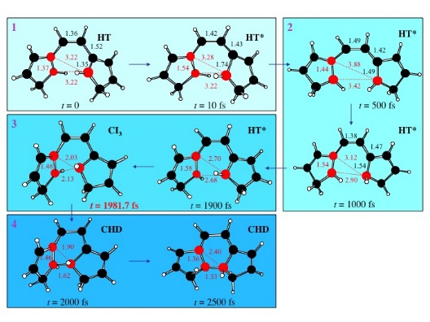
Supplementary information for Theoretical Chemistry for Electronic Excited States© The Royal Society of Chemistry 2018
Figure 5.12 Snapshots from an S₁ trajectory starting at HT (Figure 5.10) for diarylethene photochemistry.

Slide 14
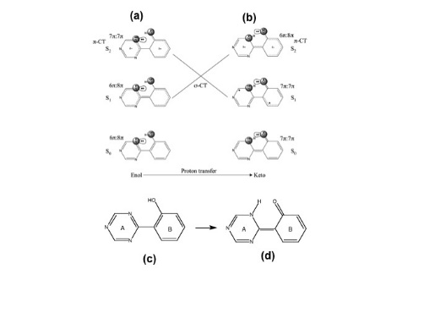
Supplementary information for Theoretical Chemistry for Electronic Excited States© The Royal Society of Chemistry 2018
Figure 5.13 (a) and (b) State correlation diagram for o-hydroxyphenyl-(1,3,5)-triazine ESIPT, (c) enol structure, (d) keto structure.
Adapted from M. J. Paterson, M. A. Robb, L. Blancafort and A. D. DeBellis, J. Phys. Chem. A, 2005, 109, 7527–7537.⁴⁴ Copyright 2005 American Chemical Society.

Slide 15
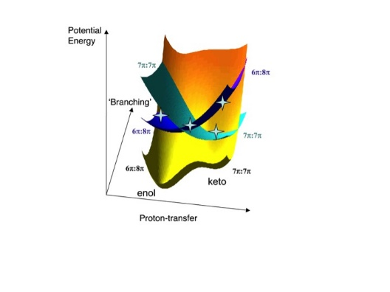
Supplementary information for Theoretical Chemistry for Electronic Excited States© The Royal Society of Chemistry 2018
Figure 5.14 Schematic potential surface for o-hydroxyphenyl-(1,3,5)-triazine photostabilization ESIPT. The three surfaces shown correspond to the 6π–8π and 7π–7π S₀, S₁ and S₂ paths shown in Figure 5.13. The stars indicate optimized critical points.
Adapted from M. J. Paterson, M. A. Robb, L. Blancafort and A. D. DeBellis, J. Phys. Chem. A, 2005, 109, 7527–7537.⁴⁴ Copyright 2005 American Chemical Society.

Slide 16
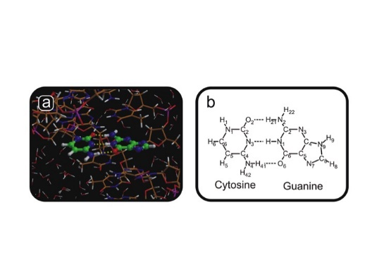
Supplementary information for Theoretical Chemistry for Electronic Excited States© The Royal Society of Chemistry 2018
Figure 5.15 (a) Simulation snapshot: ab initio and mixed QM/MM MD CASSCF(8,8)/3-21G force plus Amber99 (Gromacs)—B-DNA, 25627 atoms, 6045 TIP4P water, 42 Na⁺ ions. Calibration: CASSCF(8,8)/3-21G vs. RASSCF(20,15)/3-21G. (b) Hydrogen bonds in the gas phase base pair.
Adapted from G. Groenhof, L. V. Schaefer, M. Boggio-Pasqua, M. Goette, H. Grubmueller and M. A. Robb, J. Am. Chem. Soc., 2007, 129, 6812–6819.⁴⁷ Copyright 2007 American Chemical Society.

Slide 17
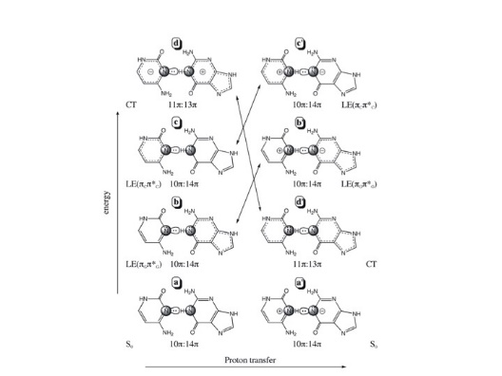
Supplementary information for Theoretical Chemistry for Electronic Excited States© The Royal Society of Chemistry 2018
Figure 5.16 Cytosine–guanine (C–G) base pair: electronic states along the PT co-ordinate. We have used the same type of labelling as in Figure 5.15.
Adapted from G. Groenhof, L. V. Schaefer, M. Boggio-Pasqua, M. Goette, H. Grubmueller and M. A. Robb, J. Am. Chem. Soc., 2007, 129, 6812–6819.⁴⁷ Copyright 2007 American Chemical Society.

Slide 18
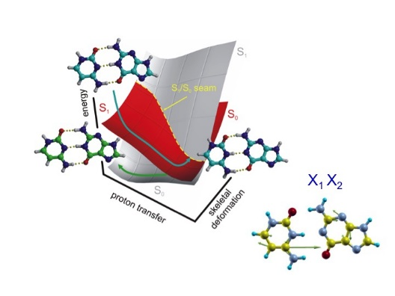
Supplementary information for Theoretical Chemistry for Electronic Excited States© The Royal Society of Chemistry 2018
Figure 5.17 Cytosine–guanine (C–G) base pair: cartoon of the potential surface extended seam: note X₁X₂ are parallel everywhere and do not correspond to PT (X₃).
Adapted from G. Groenhof, L. V. Schaefer, M. Boggio-Pasqua, M. Goette, H. Grubmueller and M. A. Robb,
J. Am. Chem. Soc., 2007, 129, 6812–6819.⁴⁷ Copyright 2007 American Chemical Society.

Slide 19
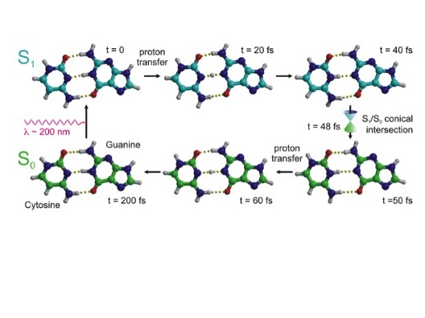
Supplementary information for Theoretical Chemistry for Electronic Excited States© The Royal Society of Chemistry 2018
Figure 5.18 Snapshots along the cytosine–guanine (C–G) base pair gas phase dynamics: t = 0 excitation of S₀ into the CT excited state, t = 20–40 fs, electron transfer induces PT, t = 48 fs non-radiative decay at CI after PT, t = 50 fs back PT transfer on GS without barrier.
Adapted from G. Groenhof, L. V. Schaefer, M. Boggio-Pasqua, M. Goette, H. Grubmueller and M. A. Robb, J. Am. Chem. Soc., 2007, 129, 6812–6819.⁴⁷ Copyright 2007 American Chemical Society.

Slide 20
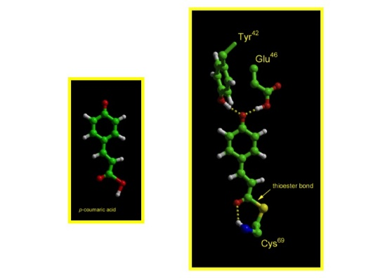
Supplementary information for Theoretical Chemistry for Electronic Excited States© The Royal Society of Chemistry 2018
Figure 5.19 PYP. Left: p-coumaric acid; right: p-coumaric acid showing binding to protein.
Adapted from G. Groenhof, M. Bouxin-Cademartory, B. Hess, S. De Visser, H. Berendsen, M.Olivucci, A. Mark and M. Robb, J. Am. Chem. Soc., 2004, 126, 4228–4233.²⁴ Copyright 2004 American Chemical Society.

Slide 21
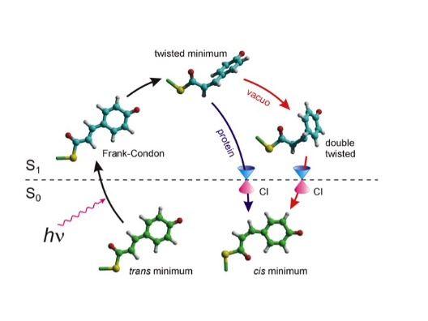
Supplementary information for Theoretical Chemistry for Electronic Excited States© The Royal Society of Chemistry 2018
Figure 5.20 Photochemical cycle in the p-coumaric acid moiety in PYP.
Adapted from G. Groenhof, M. Bouxin-Cademartory, B. Hess, S. De Visser, H. Berendsen, M.Olivucci, A. Mark and M. Robb, J. Am. Chem. Soc., 2004, 126, 4228–4233.²⁴ Copyright 2004 American Chemical
Society.

Slide 22
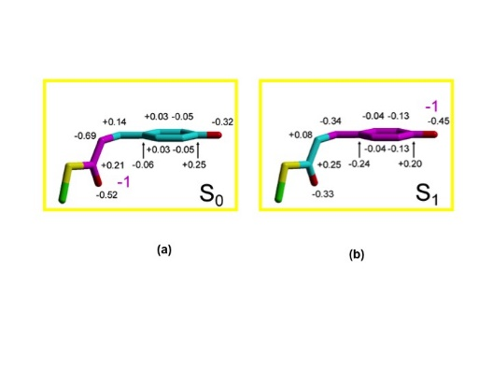
Supplementary information for Theoretical Chemistry for Electronic Excited States© The Royal Society of Chemistry 2018
Figure 5.21 Charge distribution in ground and excited state of in the p-coumaric acid moiety in PYP.
Adapted from G. Groenhof, M. Bouxin-Cademartory, B. Hess, S. De Visser, H. Berendsen, M. Olivucci, A. Mark and M. Robb, J. Am. Chem. Soc., 2004, 126, 4228–4233.²⁴ Copyright 2004 American Chemical
Society.

Slide 23
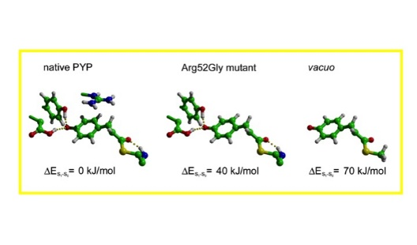
Supplementary information for Theoretical Chemistry for Electronic Excited States© The Royal Society of Chemistry 2018
Figure 5.22 The effect of the guanidium group of arginine 52 on the location of the CI. The energy differences between the excited and ground states at the geometries shown are indicated. The geometry was taken from simulation at the hopping time step. In the two left structures, all other
protein and solvent atoms were also present in the calculation but not shown, while in the far right structure there were no other atoms present. Mutating away only the arginine has almost the same effect as placing the chromophore in vacuo.
Adapted from G. Groenhof, M. Bouxin-Cademartory, B. Hess, S. De Visser, H. Berendsen, M.Olivucci, A. Mark and M. Robb, J. Am. Chem. Soc., 2004, 126, 4228–4233.²⁴ Copyright 2004 American Chemical Society.

Slide 24
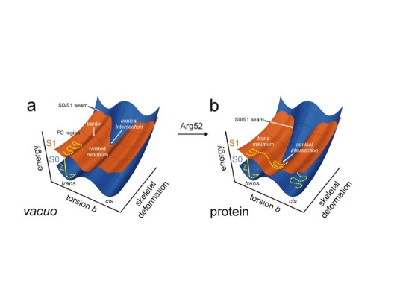
Supplementary information for Theoretical Chemistry for Electronic Excited States© The Royal Society of Chemistry 2018
Figure 5.23 Schematic representation of the extended seam in PYP isomerization.
Adapted from G. Groenhof, M. Bouxin-Cademartory, B. Hess, S. DeVisser, H. Berendsen, M.Olivucci, A. Mark and M. Robb, J. Am. Chem. Soc., 2004, 126, 4228–4233.²⁴ Copyright 2004 American Chemical Society.

Slide 25
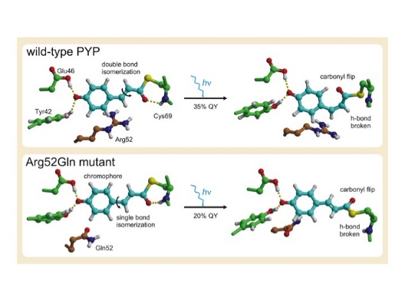
Supplementary information for Theoretical Chemistry for Electronic Excited States© The Royal Society of Chemistry 2018
Figure 5.24 Mutants in which the arginine has been replaced by an electronically neutral amino acid give a carbonyl oxygen flip, rather than the double bond isomerization.

Slide 26
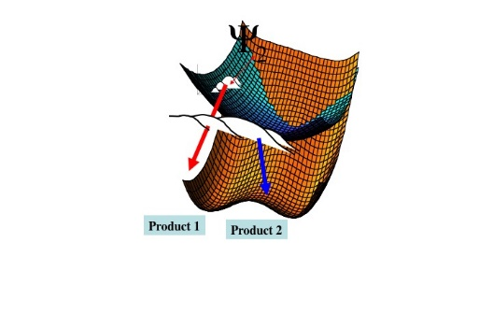
Supplementary information for Theoretical Chemistry for Electronic Excited States© The Royal Society of Chemistry 2018
Figure 5.25 Vibrational control with an extended seam.

Slide 27
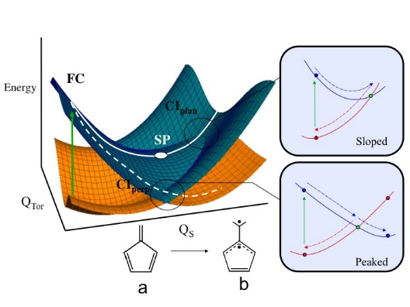
Supplementary information for Theoretical Chemistry for Electronic Excited States© The Royal Society of Chemistry 2018
Figure 5.26 Fulvene S₁ relaxation and decay via S₁/S₀ intersection. The reaction coordinate Qs (from the branching space) represents the movement from VB structure (a) to (b), and is the initial relaxation direction on S₁. Q_{Tor} corresponds to the methylene torsion coordinate. Note that the degeneracy between the crossing states exists for all values of the torsion coordinate, provided all of the other coordinates are allowed to relax.
Adapted from Ref. 80 with permission from the PCCP Owner Societies.

Slide 28
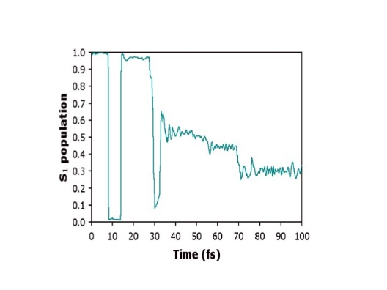
Supplementary information for Theoretical Chemistry for Electronic Excited States© The Royal Society of Chemistry 2018
Figure 5.27 Fulvene natural ultrafast S₁ decay. Total adiabatic population of the S₁ excited state.
Adapted from Ref. 80 with permission from the PCCP Owner Societies.

Slide 29
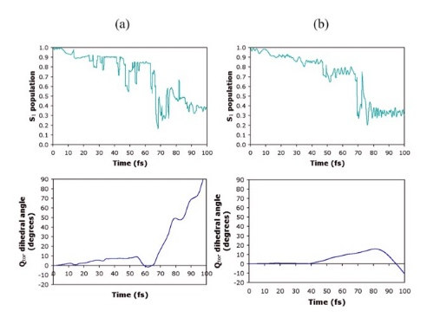
Supplementary information for Theoretical Chemistry for Electronic Excited States© The Royal Society of Chemistry 2018
Figure 5.28 Fulvene damped decay with an initial wavepacket displaced 50% along the Q_{s} coordinate (dotted line in Figure 5.26). Total adiabatic population of the S₁ excited state and the expectation value of Q_{tor} (Figure 5.26) using (a) reduced and (b) full dimensionality models.⁸⁰
Adapted from Ref. 80 with permission from the PCCP Owner Societies.

Slide 30
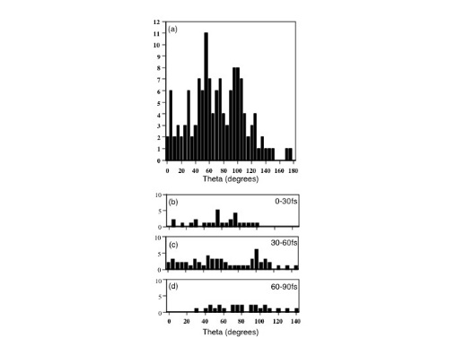
Supplementary information for Theoretical Chemistry for Electronic Excited States© The Royal Society of Chemistry 2018
Figure 5.29 Distribution of the angle theta when molecules pass through the CI seam (theta is the deviation from a trans conformation). The insets (b)–(d) show the angles theta associated with molecules passing through the CI seam over the time intervals: (a) 0–30 fs, (b) 30–60 fs and (d) 60–90 fs.
Adapted from P. Hunt and M. Robb, J. Am. Chem. Soc., 2005, 127, 5720–5726.²³ Copyright 2005 American Chemical Society.

Slide 31
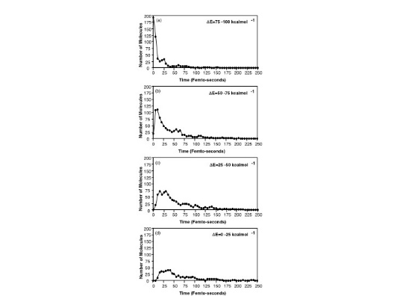
Supplementary information for Theoretical Chemistry for Electronic Excited States© The Royal Society of Chemistry 2018
Figure 5.30 Number of molecules on S₁ with a given energy gap E₁ - E₀ for (a) 75–100 kcal mol⁻¹, (b) 50–75 kcal mol⁻¹, (c) 25–50 kcal mol⁻¹ and 0–25 kcal mol⁻¹ plotted against the time.

Slide 32
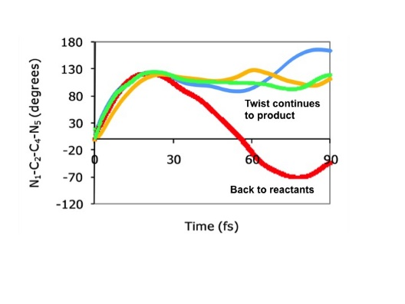
Supplementary information for Theoretical Chemistry for Electronic Excited States© The Royal Society of Chemistry 2018
Figure 5.31 Twisted conical intersection target: variation of the total dihedral angle (N₁–C₂–C₄–N₅) over time for each Gaussian basis function (blue: 1; red: 2; orange: 3; green: 4).
Adapted from C. S. M. Allan, B. Lasorne, G. A. Worth and M. A. Robb, J. Phys. Chem. A, 2010, 114, 8713–8729.⁸⁶ Copyright 2010 American Chemical Society.

Slide 33
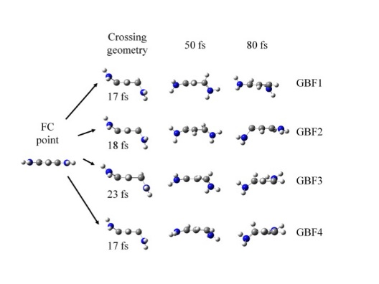
Supplementary information for Theoretical Chemistry for Electronic Excited States© The Royal Society of Chemistry 2018
Figure 5.32 Twisted conical intersection target: selected geometries of the four quantum trajectories over time.
Adapted from C. S. M. Allan, B. Lasorne, G. A. Worth and M. A. Robb, J. Phys. Chem. A, 2010, 114, 8713–8729.⁸⁶ Copyright 2010 American Chemical Society.

Slide 34
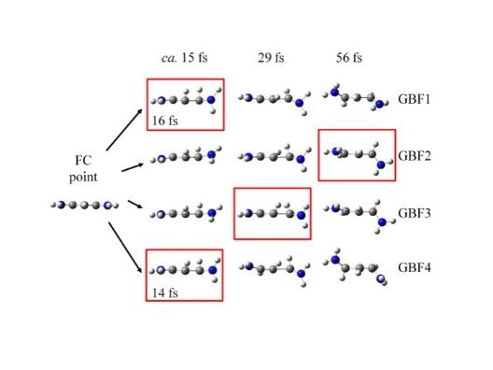
Supplementary information for Theoretical Chemistry for Electronic Excited States© The Royal Society of Chemistry 2018
Figure 5.33 ‘‘Quasi-planar conical intersection target’’: selected geometries of the four quantum trajectories over time. The time/geometry at which each basis function reaches the seam and transfers population to S₀ is highlighted.
Adapted from C. S. M. Allan, B. Lasorne, G. A. Worth and M. A. Robb, J. Phys. Chem. A, 2010, 114, 8713–8729.⁸⁶ Copyright 2010 American Chemical Society.

Slide 35
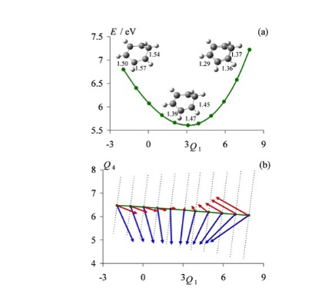
Supplementary information for Theoretical Chemistry for Electronic Excited States© The Royal Society of Chemistry 2018
Figure 5.34 Cross-section through the S₁/S₀ seam of the conical intersection, mapped out along coordinate Q₁ (totally symmetric ring expansion, x-axis) and Q₄ (the prefulvene co-ordinate as shown in Figure 2.16). (a) Geometries along the seam. (b) Arrows indicating the gradient. Notice the topology changes from sloped on the left to peaked on the right. See also Figure 2.16 that gives a schematic representation.
Adapted from B. Lasorne, M. J. Bearpark, M. A. Robb and G. A. Worth, J. Phys. Chem. A., 2008, 112, 13017–13027.⁸⁸ Copyright 2008 American Chemical Society.

Slide 36
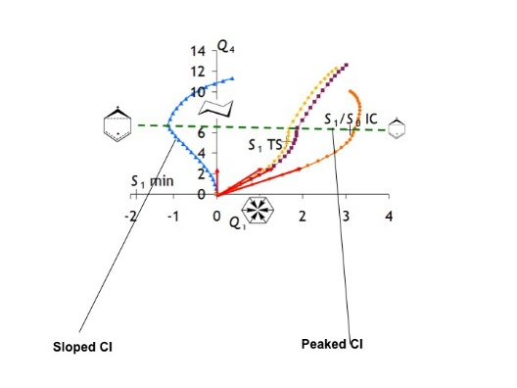
Supplementary information for Theoretical Chemistry for Electronic Excited States© The Royal Society of Chemistry 2018
Figure 5.35 Four quantum trajectories differing by the value of the initial momentum k₁ along coordinate Q₁. The initial momentum is shown as a vector at the origin.
Adapted with permission from B. Lasorne, M. J. Bearpark, M. A. Robb and G. A. Worth,
J. Phys. Chem. A, 2008, 112, 13017–13027.⁸⁸ Copyright 2008 American Chemical Society.

Slide 37
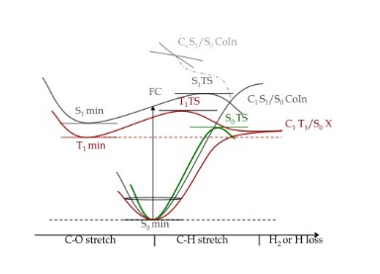
Supplementary information for Theoretical Chemistry for Electronic Excited States© The Royal Society of Chemistry 2018
Figure 5.36 S₀, S₁, and T₁ potential energy surfaces sketched along reaction coordinates leading either to radical or molecular or dissociation. The CAS (10,9) energies of the main stationary points are given
in kcal mol⁻¹. The only T₁/S₀ intersection is shown on the low-energy degenerate asymptote of the radical products.
Adapted from M. Araujo, B. Lasorne, A. L. Magalhaes, G. A. Worth, M. J. Bearpark and M. A. Robb,
J. Chem. Phys., 2009, 131, 144301.¹⁰⁰ Copyright 2008 American Chemical Society.

Slide 38
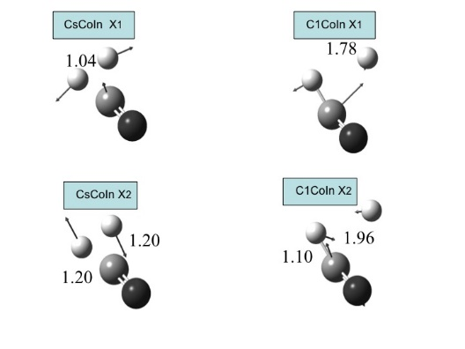
Supplementary information for Theoretical Chemistry for Electronic Excited States© The Royal Society of Chemistry 2018
Figure 5.37 C_{s} S₁/S₀ CoIn and C₁ S₁/S₀ CoIn with geometries and branching space vectors (X₁ X₂).
Adapted from M. Araujo, B. Lasorne, A. L. Magalhaes, G. A. Worth, M. J. Bearpark and M. A. Robb, J. Chem. Phys., 2009, 131, 144301.¹⁰⁰ Copyright 2008 American Chemical Society.

Slide 39
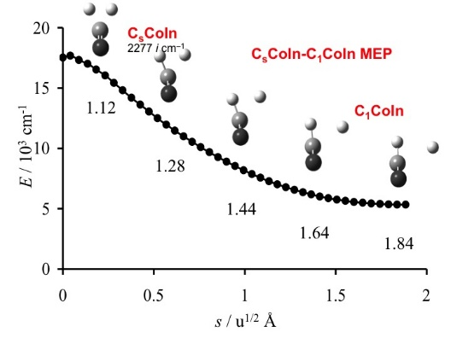
Supplementary information for Theoretical Chemistry for Electronic Excited States© The Royal Society of Chemistry 2018
Figure 5.38 Intersection seam MEP (minimum energy path) linking C_{s}CoIn to C₁CoIn. The H–H bondlength is given for five selected structures. Energies refer to the S₁ minimum.
Adapted from M. Araujo, B. Lasorne, M. J. Bearpark and M. A. Robb, J. Phys. Chem. A., 2008, 112, 7489–7491³² and F. Sicilia, L. Blancafort, M. J. Bearpark and M. A. Robb, J. Chem. Theory.
Comput., 2008, 4, 257–266,¹⁰¹ both Copyright 2008 American Chemical Society.

Slide 40
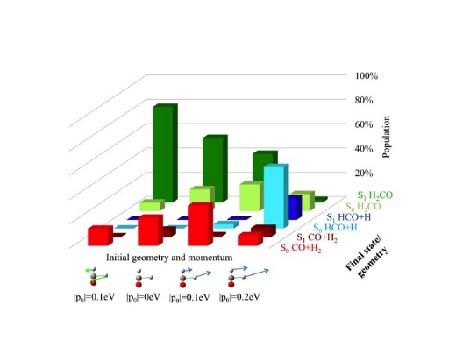
Supplementary information for Theoretical Chemistry for Electronic Excited States© The Royal Society of Chemistry 2018
Figure 5.39 Distribution of the population among geometries and electronic states for several global wavepackets (basis set: 8 GBF). The arrows indicate the initial momentum given along the transition vector towards the reactant, increasing the magnitude from left to right towards the products. The magnitude of the extra momentum is given in terms of the corresponding extra kinetic energy.
Adapted with permission from M. Araujo, B. Lasorne, A. L. Magalhaes, M. Bearpark and M. A. Robb,
J. Phys. Chem. A, 2010, 114, 12016–12020.⁹⁹ Copyright 2010 American Chemical Society.

Slide 41
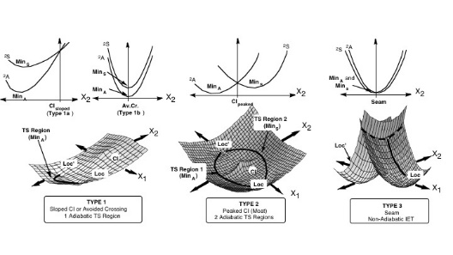
Supplementary information for Theoretical Chemistry for Electronic Excited States© The Royal Society of Chemistry 2018
Figure 5.40 Model potential energy surface topologies for intramolecular electron transfer in organic radical cations. The upper part of the figure shows a slice, at X₁ = 0, of the surface along the derivative coupling vector (X₂). These figures distinguish a sloped intersection, an avoided crossing (Av.Cr.), a peaked intersection and a seam. In the central part, only the lower part of the conical intersection (ground state of the potential energy surface) is shown.
Adapted from L. Blancafort, F. Jolibois, M. Olivucci and M. A. Robb, J. Am. Chem. Soc., 2001, 123, 722–732.¹⁰³ Copyright 2001 American Chemical Society.

Slide 42
Supplementary information for Theoretical Chemistry for Electronic Excited States© The Royal Society of Chemistry 2018
Figure 5.41 Two orbital, one electron wavefunctions along (a) a cross section along X₂, (b) cross section along X₁ (between Loc and Loc’ in Figure 5.40) The symbols A and S in Figure 5.40 correspond to the symmetric and antisymmetric wavefunctions in Figure 5.41.

Slide 43
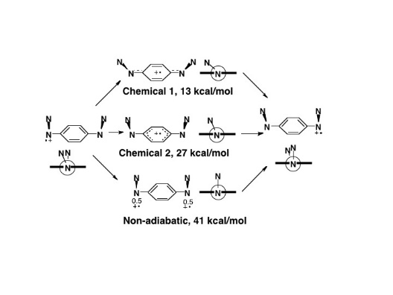
Supplementary information for Theoretical Chemistry for Electronic Excited States© The Royal Society of Chemistry 2018
Figure 5.42 Three electron transfer pathways in bis(hydrazine) radical cations.¹⁰⁴

Slide 44
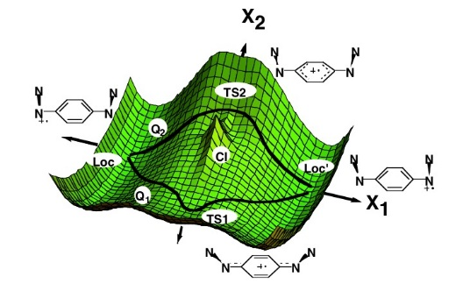
Supplementary information for Theoretical Chemistry for Electronic Excited States© The Royal Society of Chemistry 2018
Figure 5.43 Type 2 (Figure 5.40) electron transfer in in bis(hydrazine) radical.¹⁰⁴

Slide 45
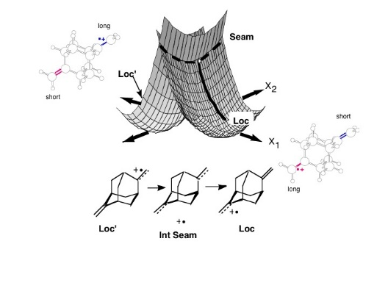
Supplementary information for Theoretical Chemistry for Electronic Excited States© The Royal Society of Chemistry 2018
Figure 5.44 Three-dimensional cartoon of the potential energy surface for nonadiabatic, ground-state electron transfer (type 3, Figure 5.40) in BMA in the seam region (projection in the branching space of the gradient difference, X₁, and interstate coupling, X₂, coordinates). Note that relaxed geometries have been used. Thus on the right-hand side the ‘‘reactants’’ correspond to a BMA structure with one
short and one long bond.
Adapted from L. Blancafort, F. Jolibois, M. Olivucci and M. A. Robb, J. Am. Chem. Soc.,
2001, 123, 722–732.¹⁰⁵ Copyright 2001 American Chemical Society.

Slide 46
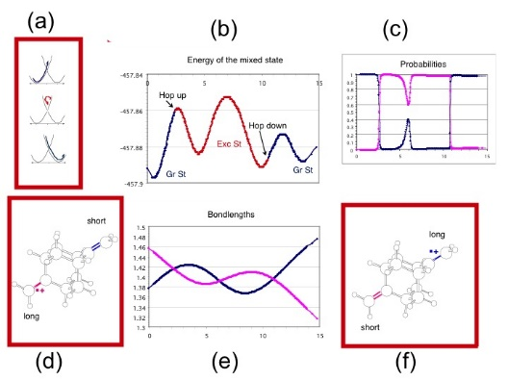
Supplementary information for Theoretical Chemistry for Electronic Excited States© The Royal Society of Chemistry 2018
Figure 5.45 BMA: a reactive Ehrenfest trajectory: (a) cartoon showing an excursion on excited state, (b) the nature of the mixed state along a trajectory, (c) weights (probabilities) of the ground and excited states as a function of time, (d) minimum with long and short bonds, (e) bond lengths as a function of time, and (f) minimum with short and long bonds.
Adapted from Quantum Chemistry at Work, Chemical Reactivity: from Classical Problems to Nonadiabatic Dynamics, Lluis Blancafort and M. A. Robb, lecture notes from the European
School in Quantum Chemistry, 2005, original data from Blancafort et al.¹⁰⁵

Slide 47
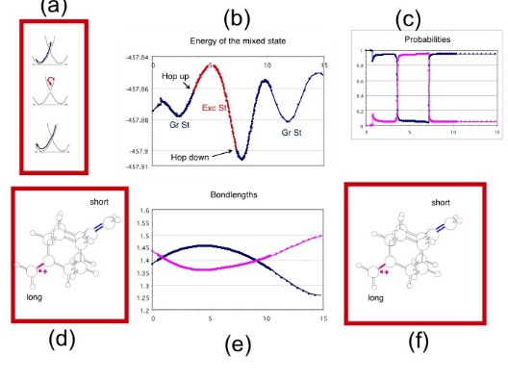
Supplementary information for Theoretical Chemistry for Electronic Excited States© The Royal Society of Chemistry 2018
Figure 5.46 BMA: an unreactive Ehrenfest trajectory: (a) cartoon showing an excursion on excited state, (b) the nature of the mixed state along a trajectory, (c) weights (probabilities) of the ground and excited states as a function of time, (d) minimum with long and short bonds, (e) bond lengths as a function of time, and (f) minimum with short and long bonds.
Adapted from Quantum Chemistry at Work, Chemical Reactivity: from Classical Problems to Nonadiabatic Dynamics, Lluis Blancafort and M. A. Robb, Lecture notes from the European School in Quantum Chemistry, 2005, original data from Blancafort et al.¹⁰⁵

Slide 48
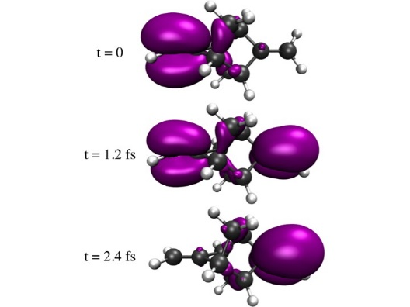
Supplementary information for Theoretical Chemistry for Electronic Excited States© The Royal Society of Chemistry 2018
Figure 5.47 Snapshots of the spin density after the ionization of the π system in the BMA[5,5] molecule. Simulation with fixed nuclei at the equilibrium geometry of the neutral species.
Adapted from ref. 106 with permission from the Royal Society of Chemistry.

Slide 49
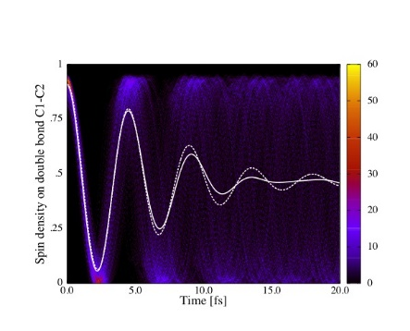
Supplementary information for Theoretical Chemistry for Electronic Excited States© The Royal Society of Chemistry 2018
Figure 5.48 Time evolution of the sum of partitioned spin densities on the of the left methylene group, upon ionization of the π system in the BMA[5,5] molecule, for an ensemble of 500 fixed geometries sampled from a Wigner distribution. The solid white line indicates the spin density averaged over the ensemble of 500 sampled geometries when the nuclei are kept fixed. Also given is the spin density averaged over the ensemble of 500 trajectories (with initially
sampled geometries and velocities) when the nuclei are allowed to move, indicated by
the dashed white line.
Adapted from Ref. 106 with permission from the Royal Society of Chemistry.

Slide 50
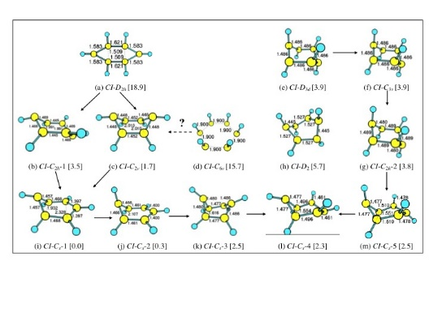
Supplementary information for Theoretical Chemistry for Electronic Excited States© The Royal Society of Chemistry 2018
Figure 5.49 Optimized benzene conical intersection critical points of various point group symmetries (relative energy is given in eV in square brackets). Arrows reflect mapped connections between the points.
Adapted from Chemical Physics, 377, Q. Li, D. Mendive-Tapia, M. J. Paterson, A. Migani, M. J. Bearpark, M. A. Robb and L. Blancafort, A global picture of the S1/S0 conical intersection
seam of benzene, 60–65,¹¹² Copyright 2010, with permission from Elsevier.

Slide 51
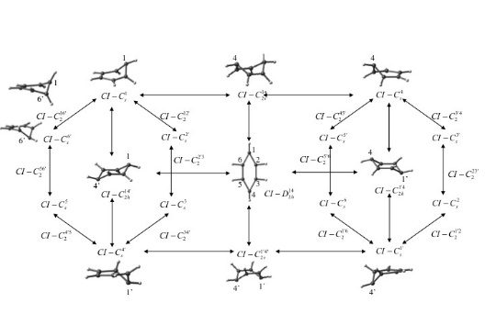
Supplementary information for Theoretical Chemistry for Electronic Excited States© The Royal Society of Chemistry 2018
Figure 5.50 Connectivity scheme for the stationary points on the A/B conical intersection seam of benzene containing all permutational isomers of the prefulvene conical intersection (CI–C_{s}) with the same connectivity. The label superscripts refer to the carbon atoms that lie out of the plane; unprimed superscripts refer to atoms bent up with respect to the plane of the ring and primed ones to downward bent atoms. Some representative structures are included to illustrate the connectivity and the labelling.
Adapted from L. Blancafort and M. A. Robb, J. Chem. Theory Comput., 2012, 8,
4922–4930.¹¹³ Copyright 2012 American Chemical Society.

Slide 52
Supplementary information for Theoretical Chemistry for Electronic Excited States© The Royal Society of Chemistry 2018
Figure 5.51 The five benzene resonance structures.

Slide 53
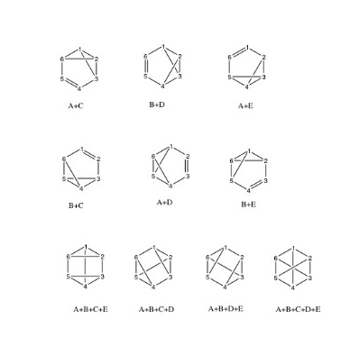
Supplementary information for Theoretical Chemistry for Electronic Excited States© The Royal Society of Chemistry 2018
Figure 5.52 Benzene resonance structures with crossed lines (i.e. linear combinations of the structures of Figure 5.51.
Adapted from L. Blancafort and M. A. Robb, J. Chem. Theory Comput., 2012, 8, 4922–4930.¹¹³
Copyright 2012 American Chemical Society.

Slide 54
Supplementary information for Theoretical Chemistry for Electronic Excited States© The Royal Society of Chemistry 2018
Figure 5.53 Branching space vectors for a (A + B)/(A - B) conical intersection (a) and
(A + B)/(A - B) + (C - E).
Adapted from L. Blancafort and M. A. Robb, J. Chem. Theory Comput., 2012, 8, 4922–4930.¹¹³ Copyright 2012 American Chemical Society.

Slide 55
Supplementary information for Theoretical Chemistry for Electronic Excited States© The Royal Society of Chemistry 2018
Figure 5.54 VB analysis of conical intersection structures of benzene part A.
Adapted from L. Blancafort and M. A. Robb, J. Chem. Theory Comput., 2012, 8, 4922–4930.¹¹³ Copyright 2012 American Chemical Society.

Slide 56
Supplementary information for Theoretical Chemistry for Electronic Excited States© The Royal Society of Chemistry 2018
Figure 5.55 VB analysis of conical intersection structures of benzene part B.
Adapted with permission from L. Blancafort and M. A. Robb, J. Chem. Theory Comput., 2012, 8, 4922–4930.¹¹³ Copyright 2012 American Chemical Society.

