Slide 1
The Chemical Biology of Human Vitamins
Supplementary information for The Chemical Biology of Human Vitamins
© The Royal Society of Chemistry 2019
Chapter 1 Figures and Schemes

Slide 2
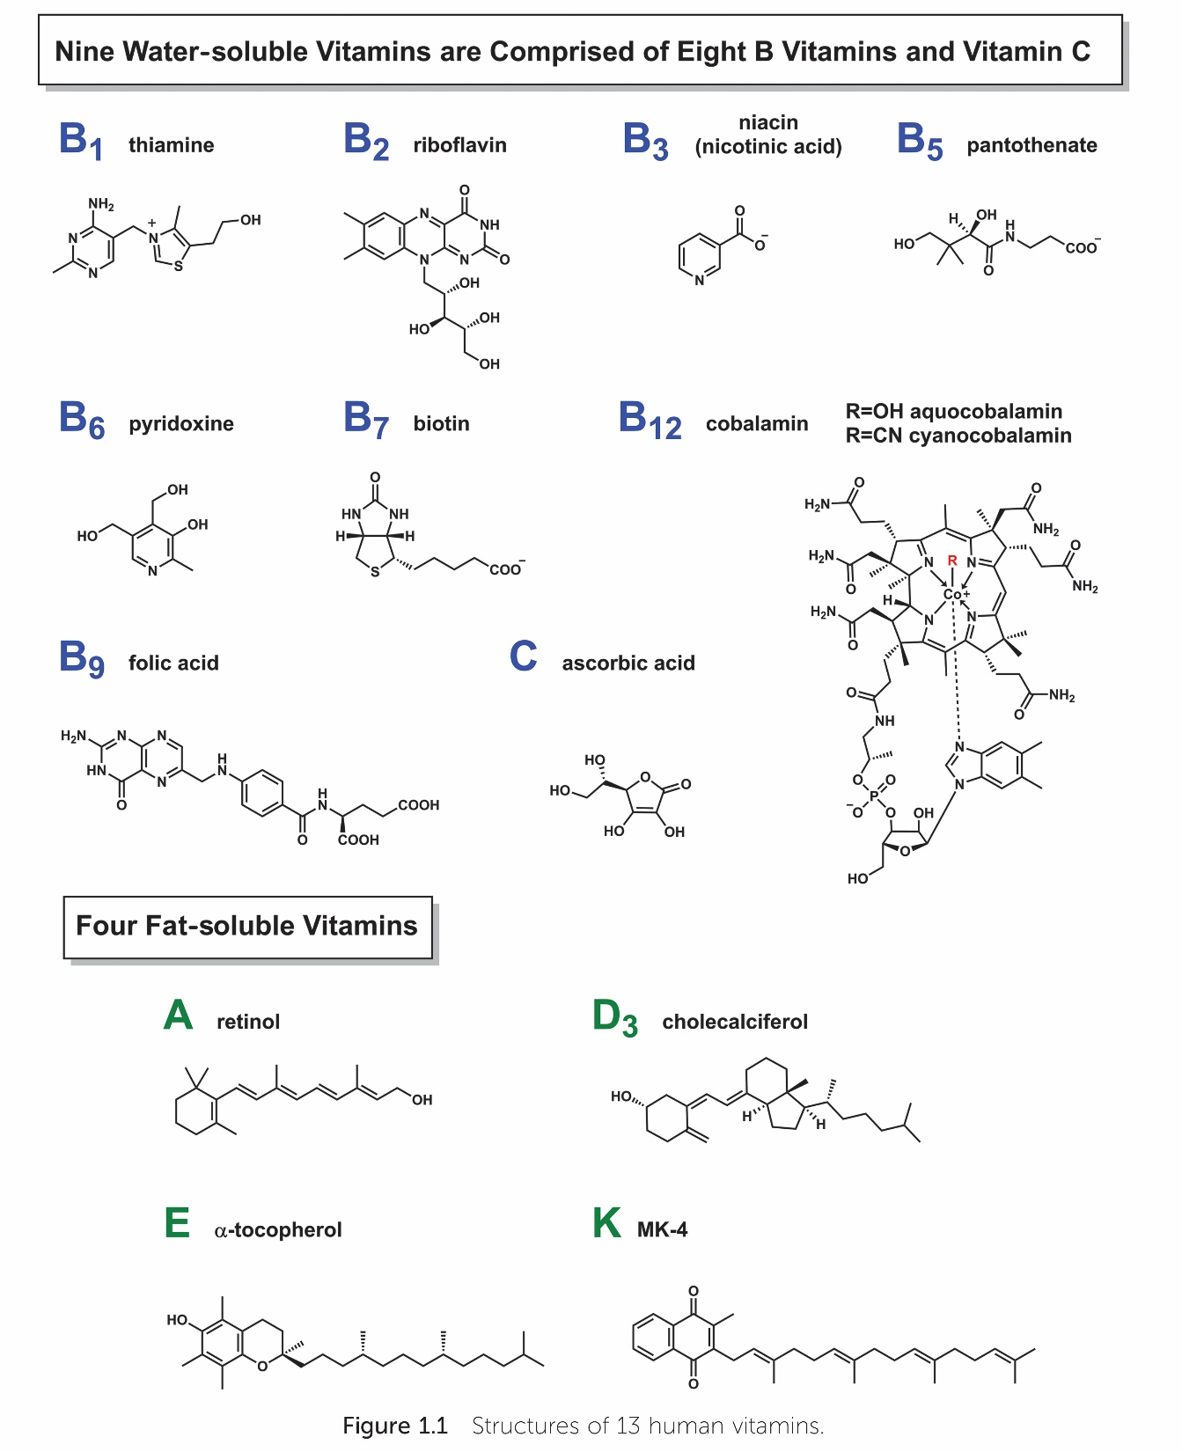
Supplementary information for The Chemical Biology of Human Vitamins
© The Royal Society of Chemistry 2019

Slide 3
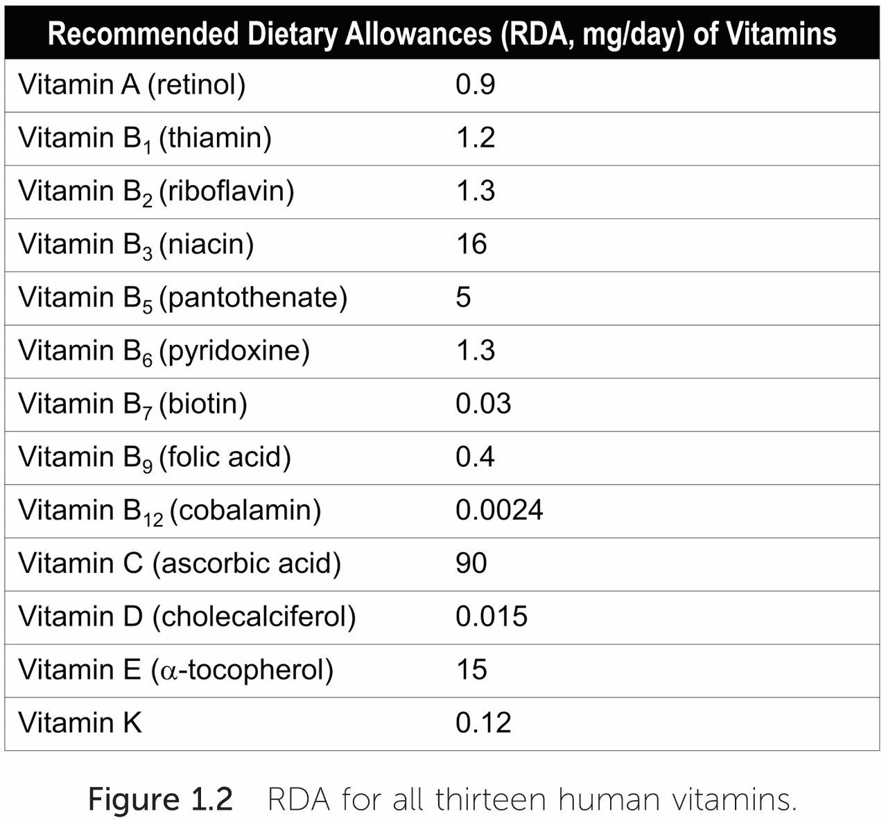
Supplementary information for The Chemical Biology of Human Vitamins
© The Royal Society of Chemistry 2019

Slide 4
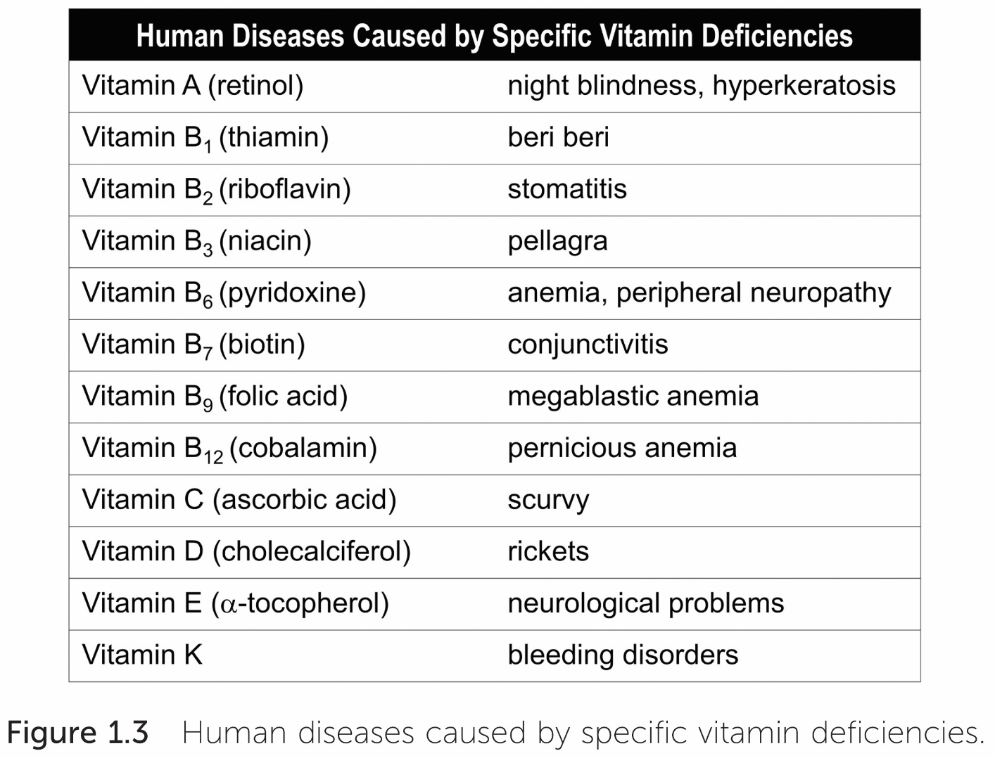
Supplementary information for The Chemical Biology of Human Vitamins
© The Royal Society of Chemistry 2019

Slide 5
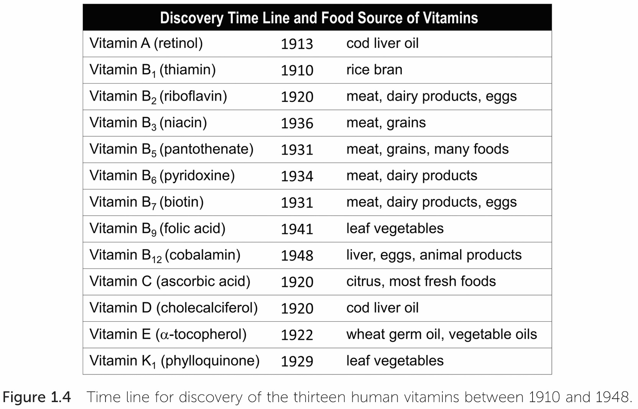
Supplementary information for The Chemical Biology of Human Vitamins
© The Royal Society of Chemistry 2019

Slide 6
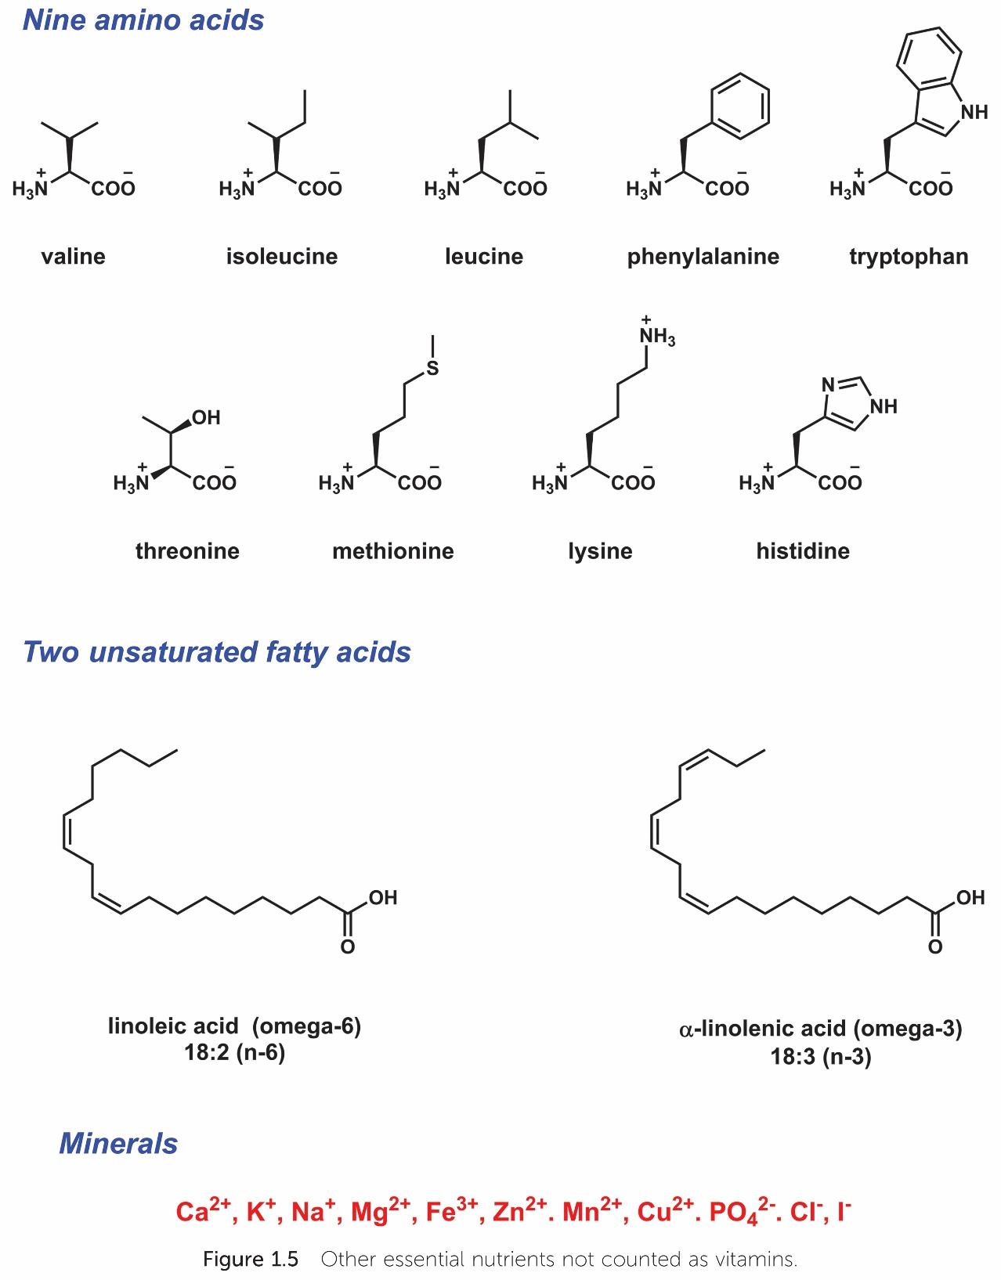
Supplementary information for The Chemical Biology of Human Vitamins
© The Royal Society of Chemistry 2019

Slide 7
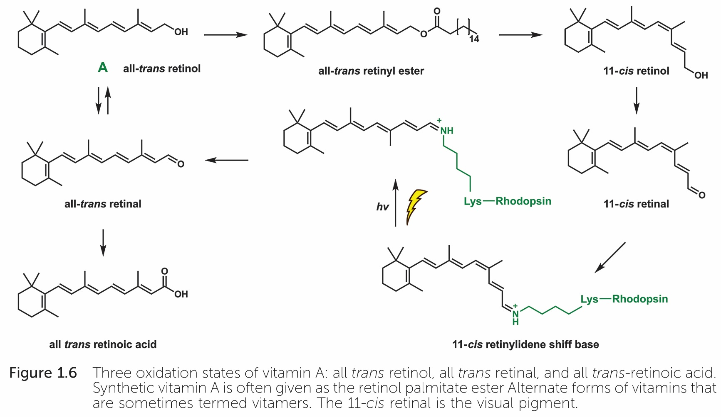
Supplementary information for The Chemical Biology of Human Vitamins
© The Royal Society of Chemistry 2019

Slide 8
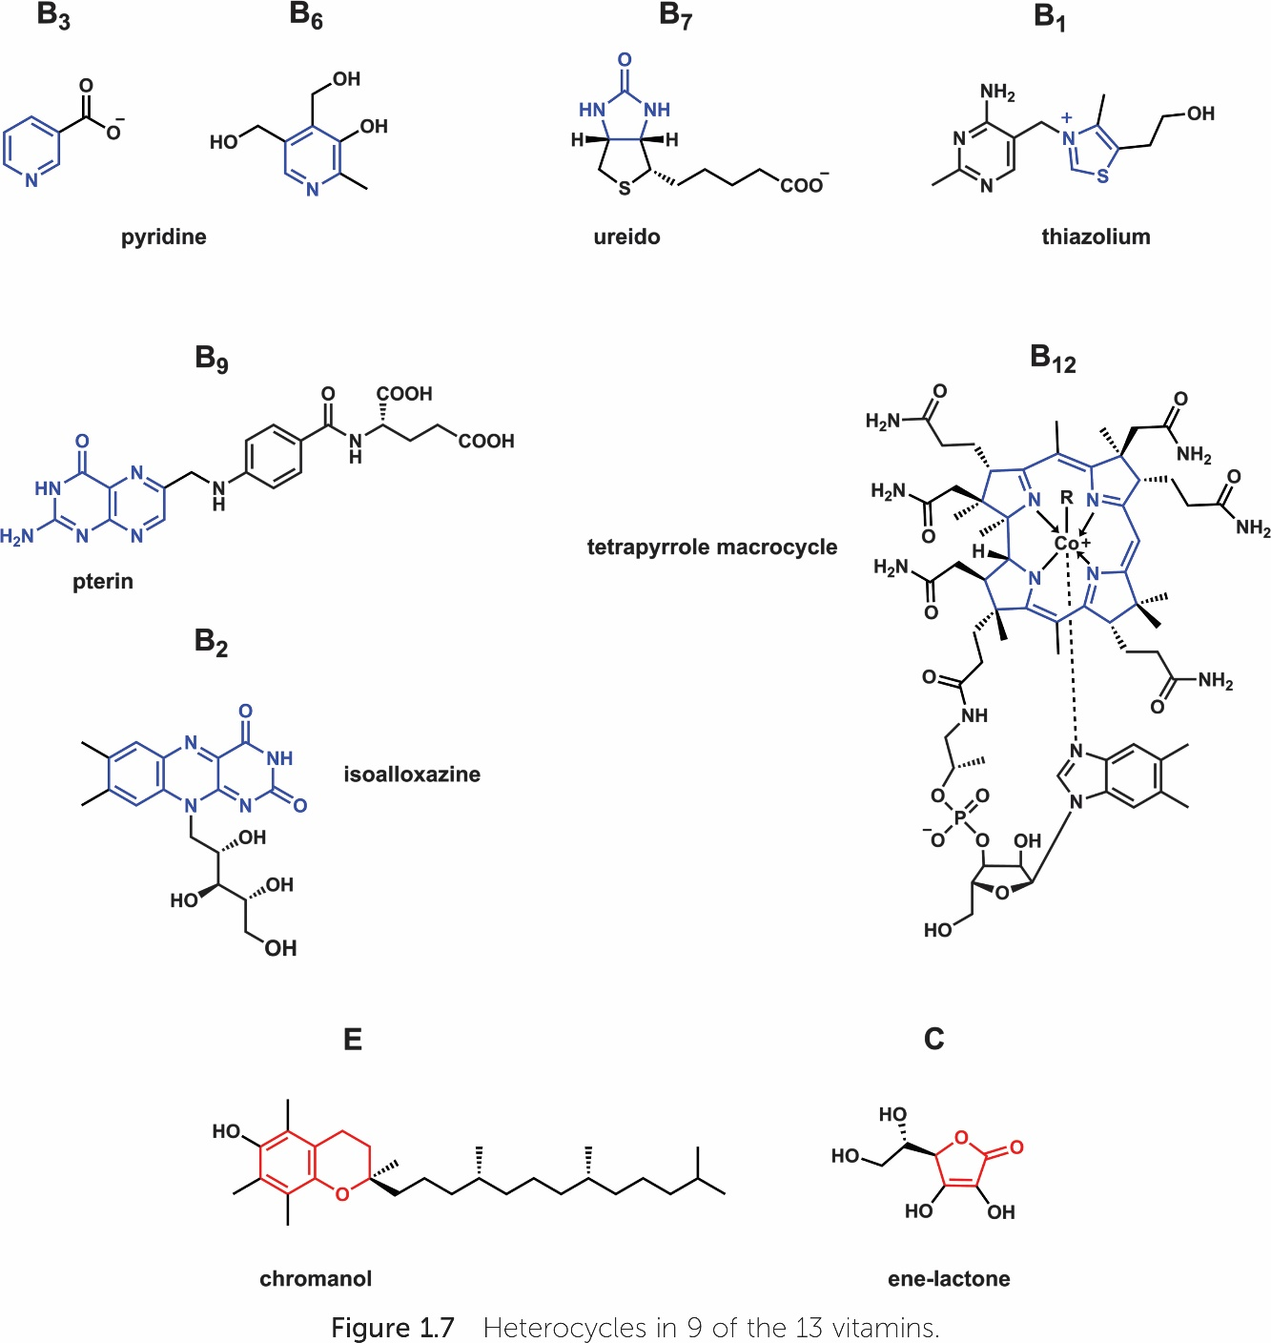
Supplementary information for The Chemical Biology of Human Vitamins
© The Royal Society of Chemistry 2019

Slide 9
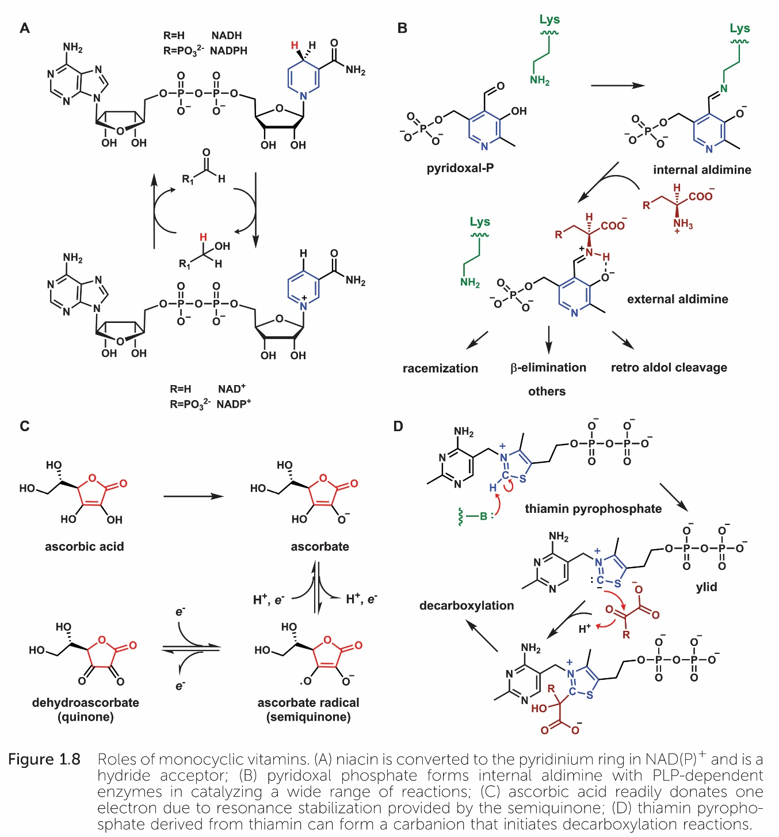
Supplementary information for The Chemical Biology of Human Vitamins
© The Royal Society of Chemistry 2019

Slide 10
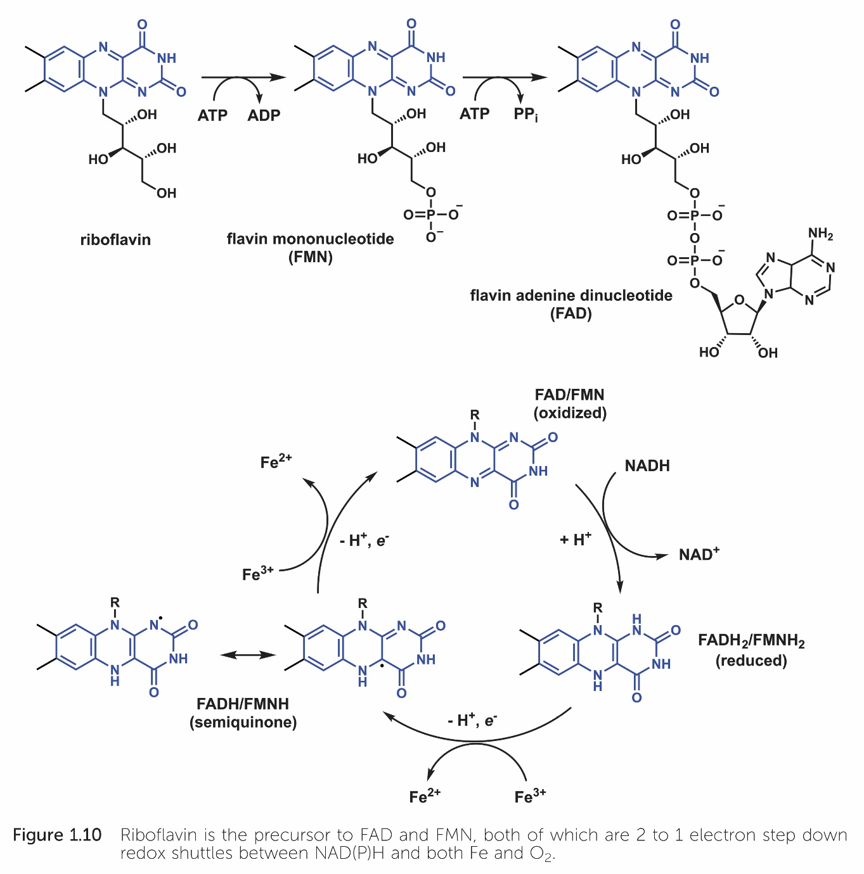
Supplementary information for The Chemical Biology of Human Vitamins
© The Royal Society of Chemistry 2019

Slide 11
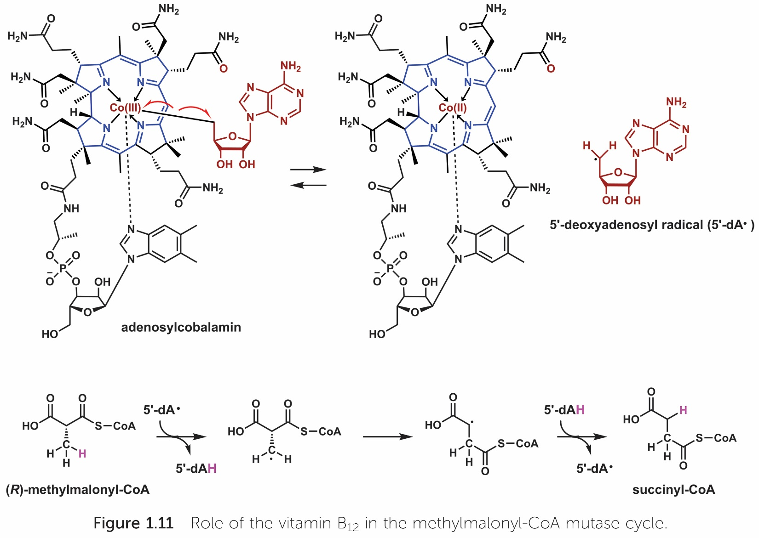
Supplementary information for The Chemical Biology of Human Vitamins
© The Royal Society of Chemistry 2019

Slide 12
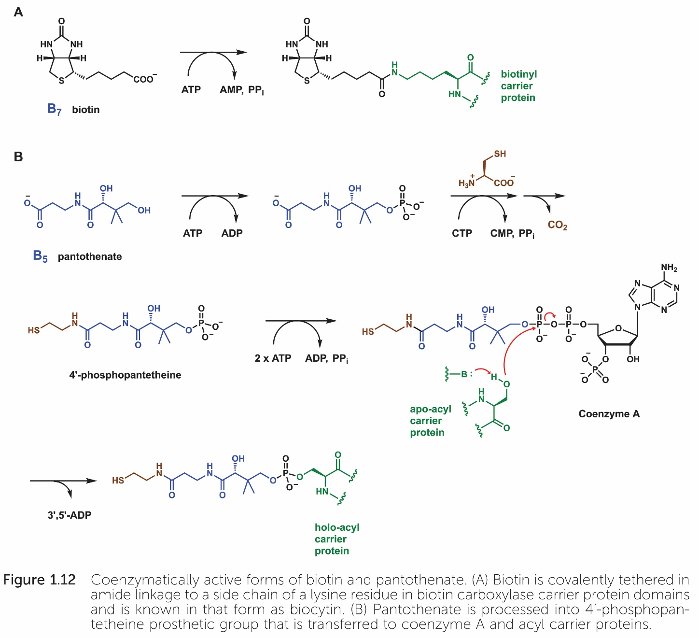
Supplementary information for The Chemical Biology of Human Vitamins
© The Royal Society of Chemistry 2019

Slide 13
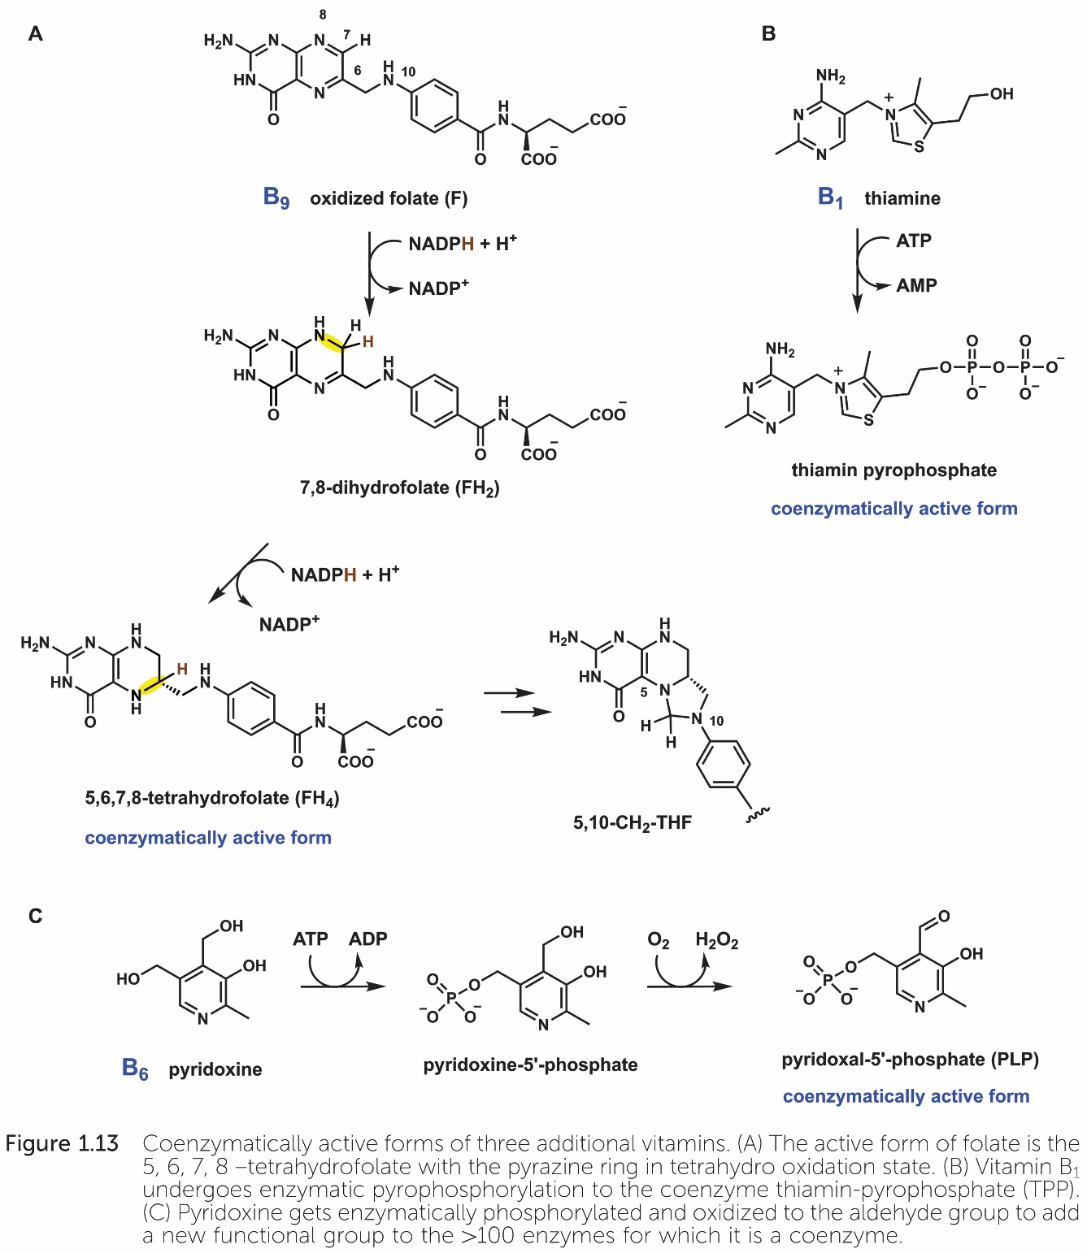
Supplementary information for The Chemical Biology of Human Vitamins
© The Royal Society of Chemistry 2019

Slide 14
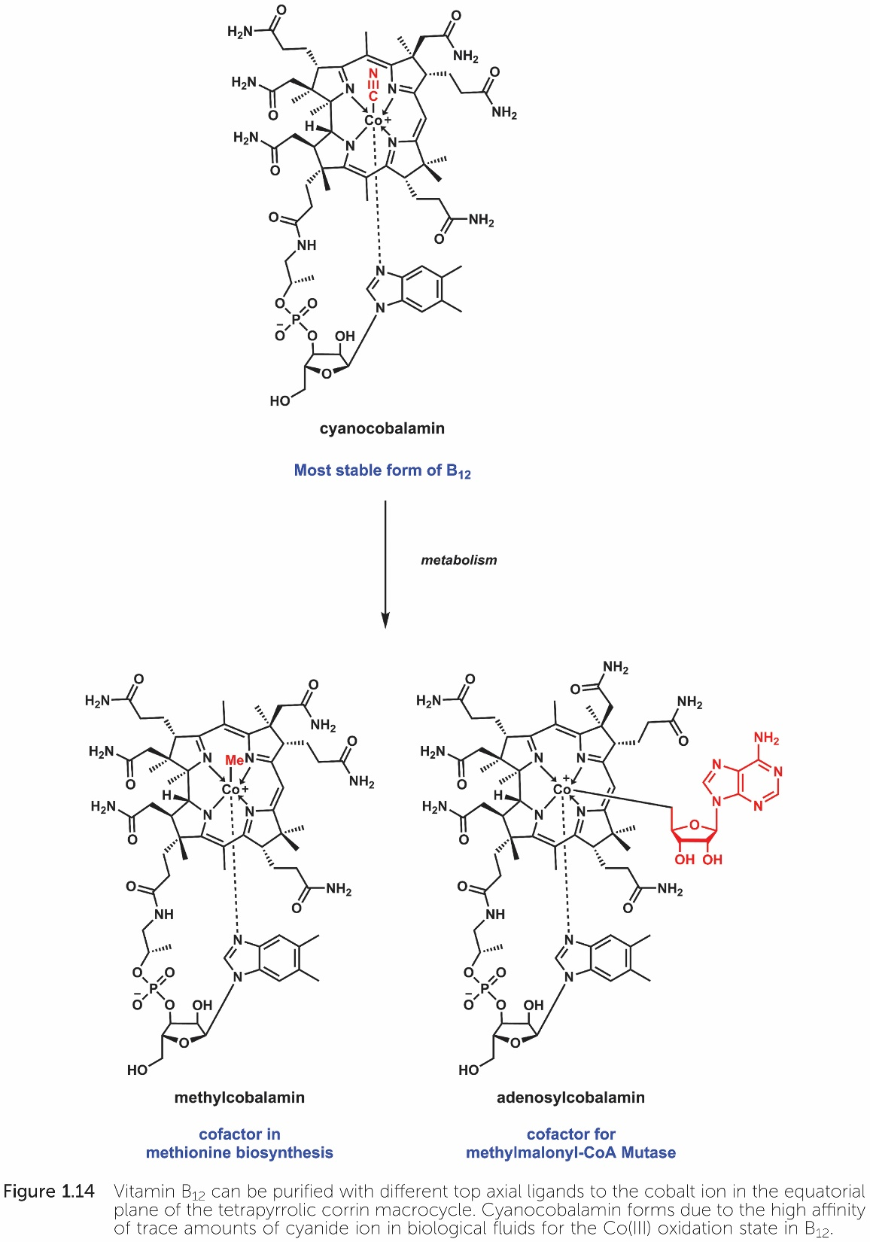
Supplementary information for The Chemical Biology of Human Vitamins
© The Royal Society of Chemistry 2019

Slide 15
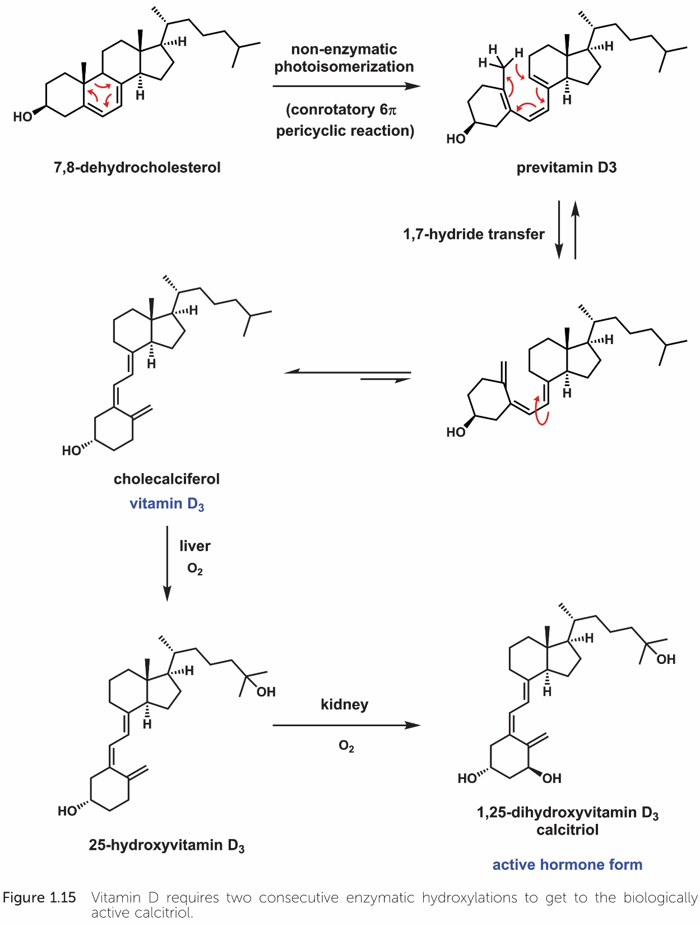
Supplementary information for The Chemical Biology of Human Vitamins
© The Royal Society of Chemistry 2019

Slide 16
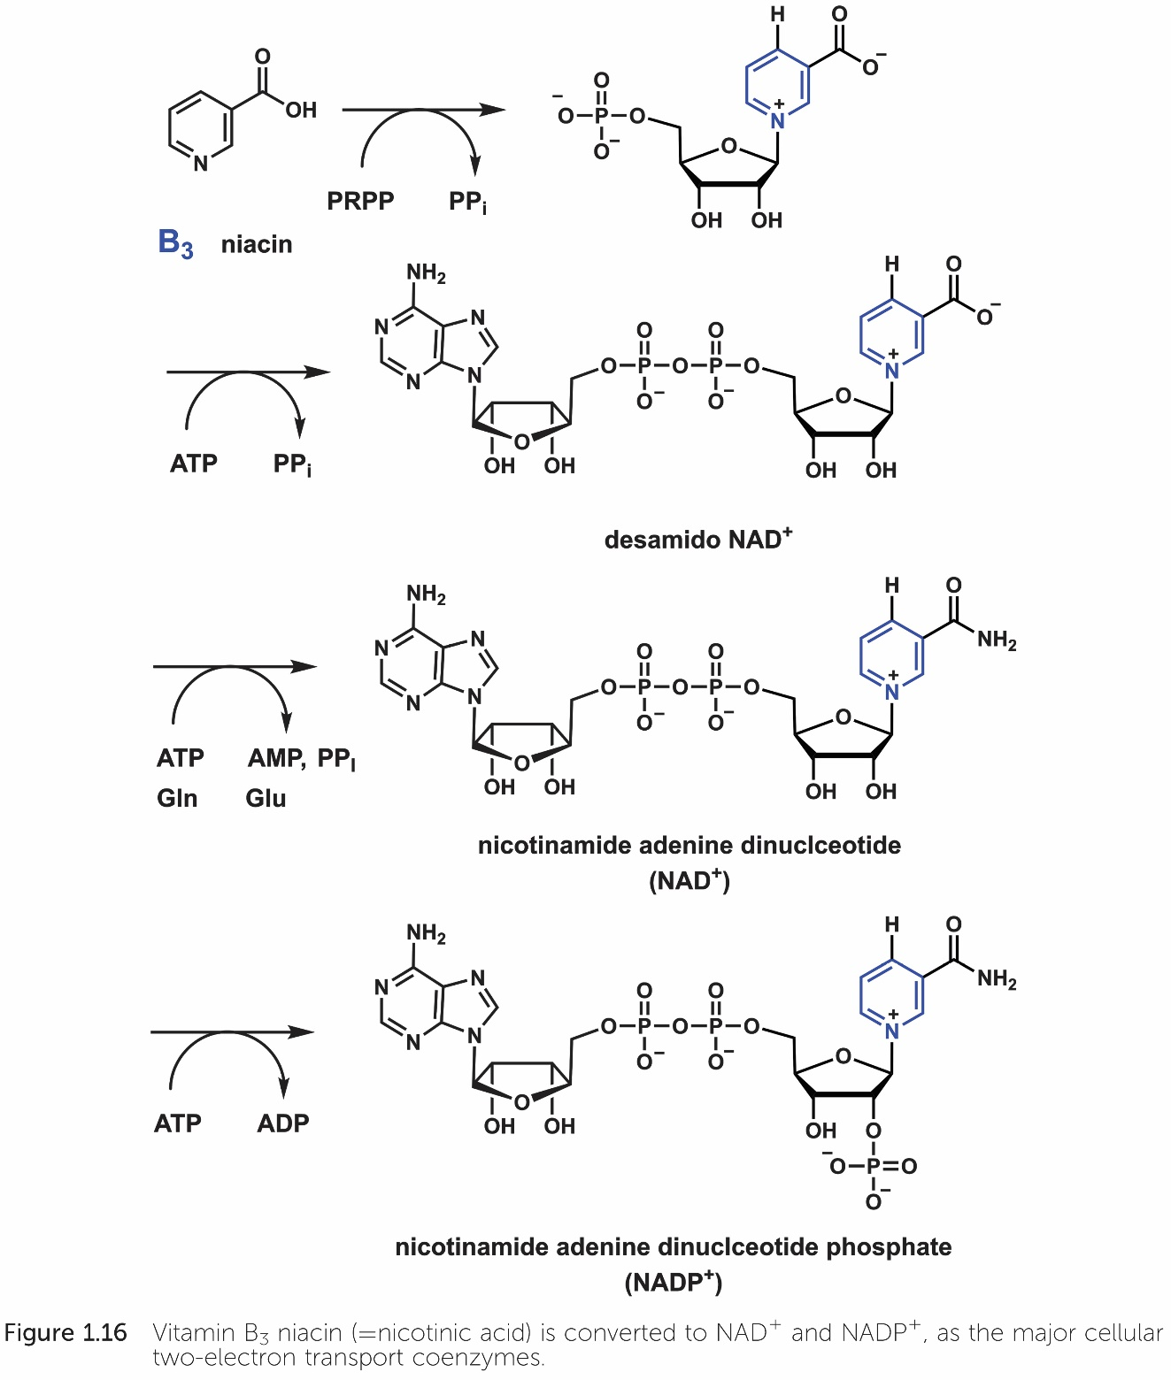
Supplementary information for The Chemical Biology of Human Vitamins
© The Royal Society of Chemistry 2019

Slide 17
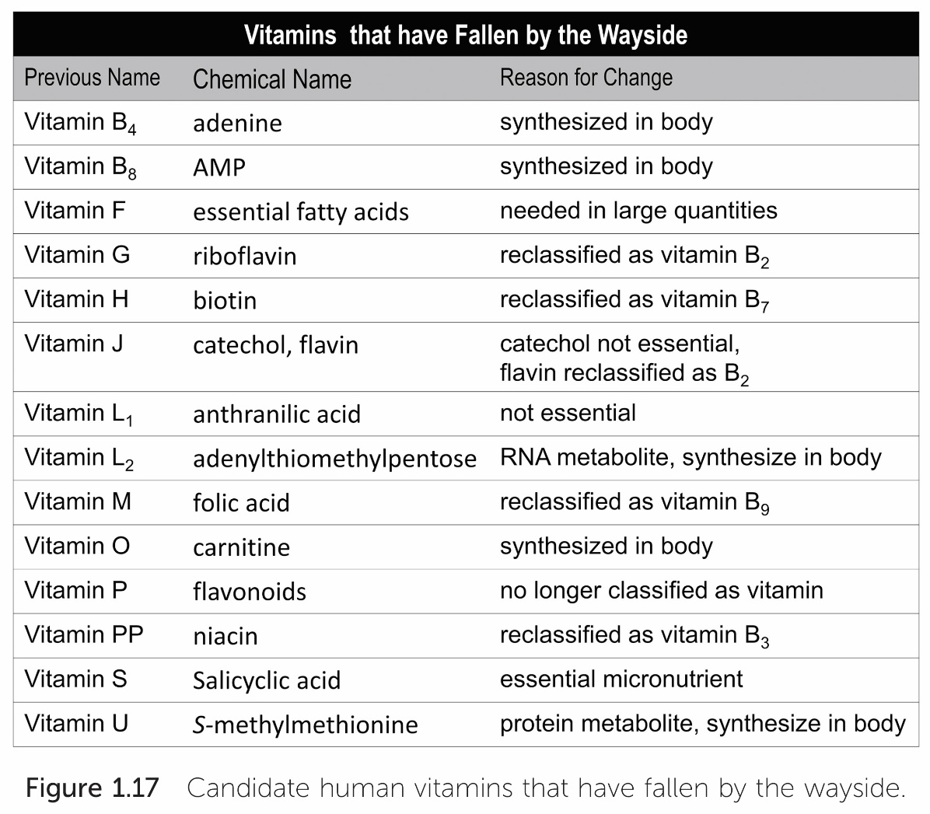
Supplementary information for The Chemical Biology of Human Vitamins
© The Royal Society of Chemistry 2019

Slide 18
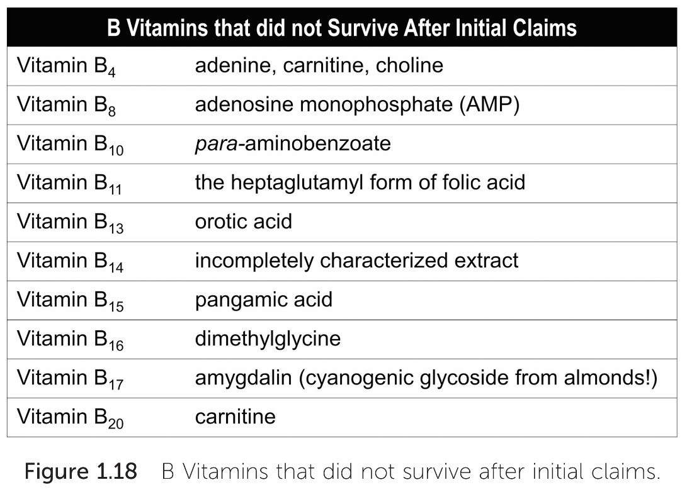
Supplementary information for The Chemical Biology of Human Vitamins
© The Royal Society of Chemistry 2019

Slide 19
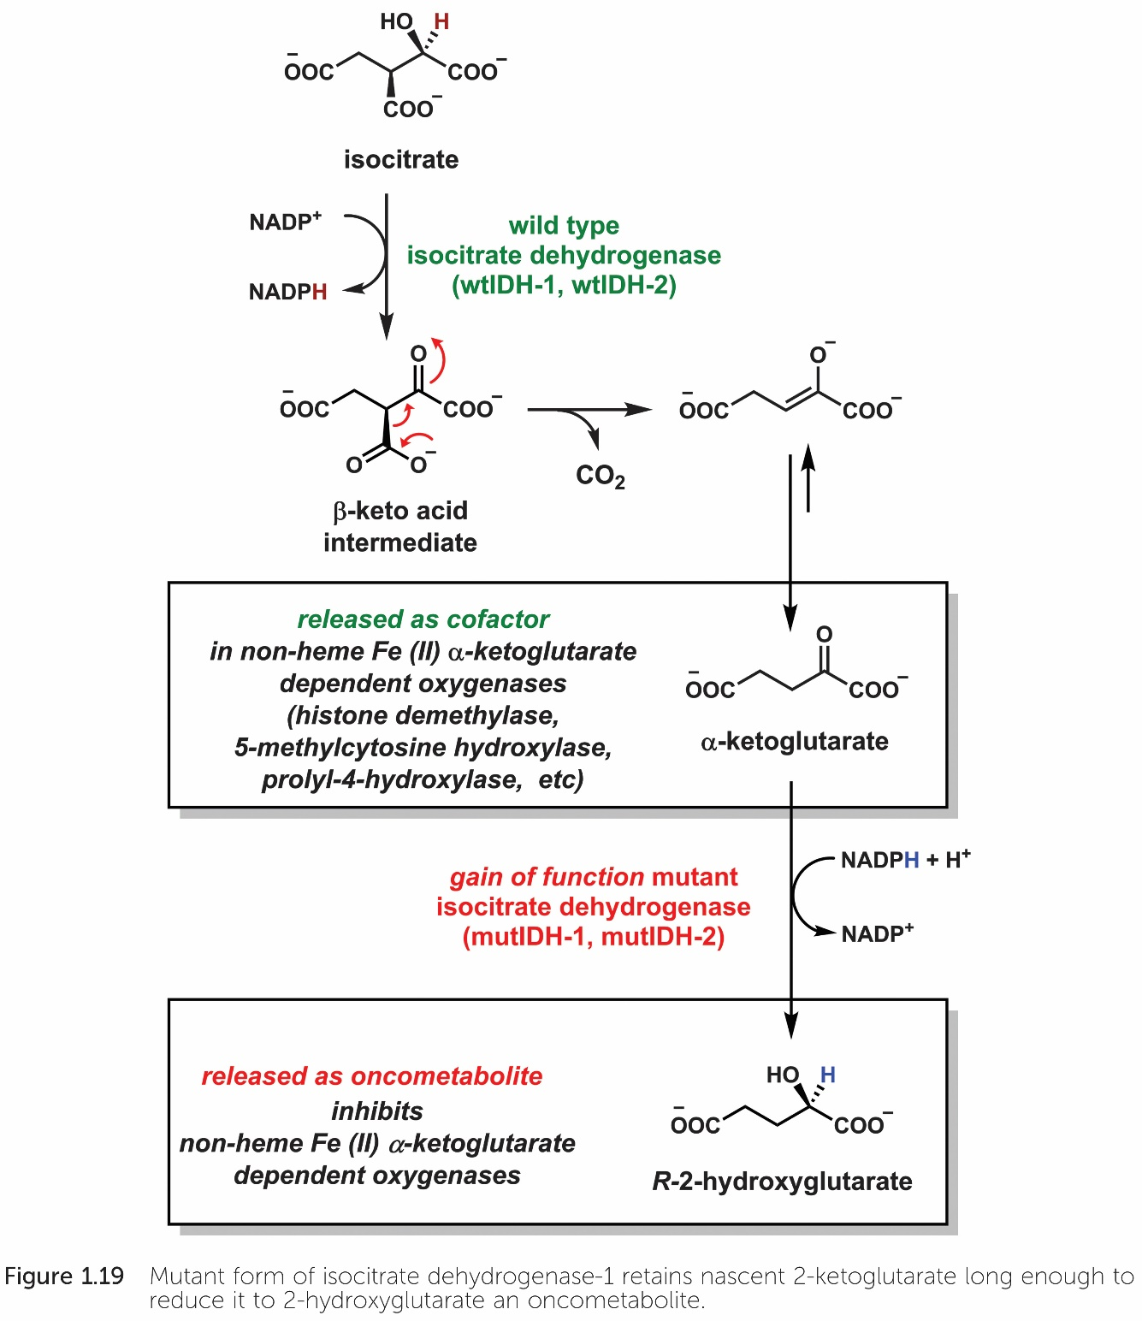
Supplementary information for The Chemical Biology of Human Vitamins
© The Royal Society of Chemistry 2019

Slide 20
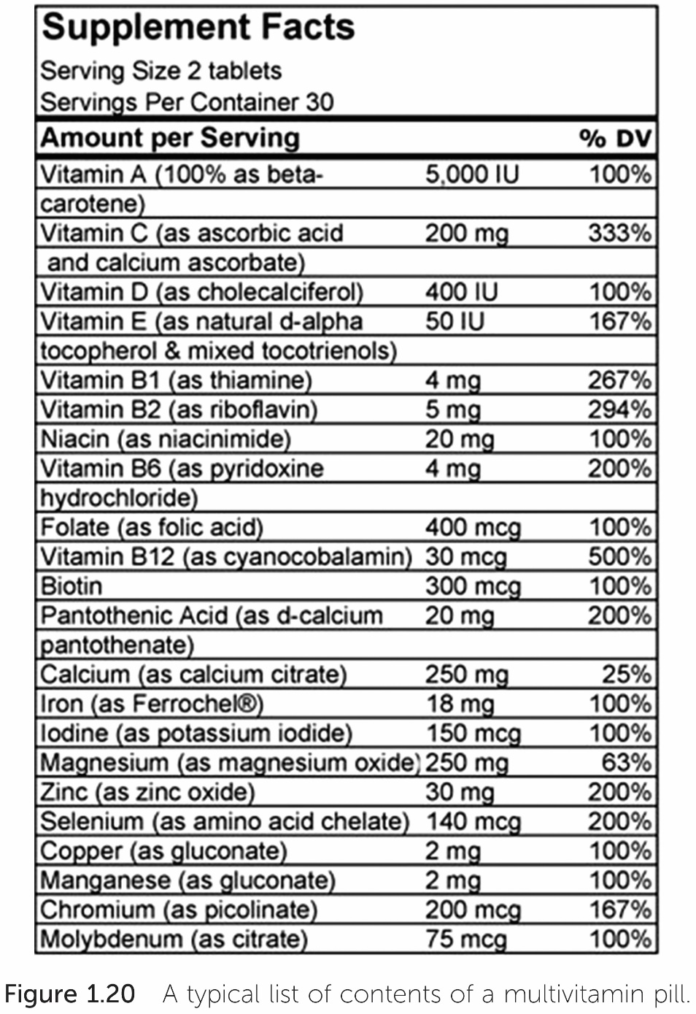
Supplementary information for The Chemical Biology of Human Vitamins
© The Royal Society of Chemistry 2019

