Slide 1
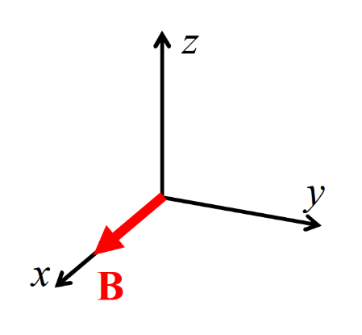
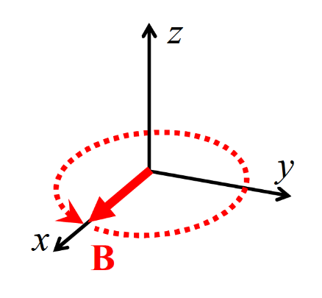
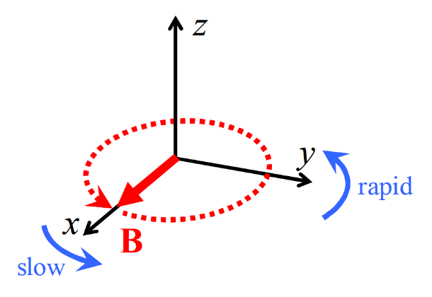
(a)
(b)
(c)
(d)
χ₃
χ₂
χ₁
Fig. 3 Various types of applied magnetic fields and resultant magnetic orientations of biaxial microcrystals. (a) random orientation (no magnetic field) and the definition of three magnetic axes, χ₁, χ₂, and χ₃ (χ₁ > χ₂ > χ₃). (b) the χ₁ axes align uniaxially (||x-axis) under a static magnetic field (B, 0, 0), (c) the χ₃ axes align uniaxially (||z-axis) under a rotating magnetic field (B cos ωt, B sin ωt, 0) applied in the xy plane, and (d) the three axes align three-dimensionally (χ₁||x-axis, χ₂||y-axis, and χ₃||z-axis) under a frequency modulated magnetic field (FMMF). By clicking on each item, its orientation image can be viewed from different view angles.

