Slide 1


Infinite answers
One place
Advance your research with access to leading multidisciplinary content.
Custom URL here

Slide 2


Infinite answers
One place
Advance your research with access to leading multidisciplinary content.
Custom URL here

Slide 3
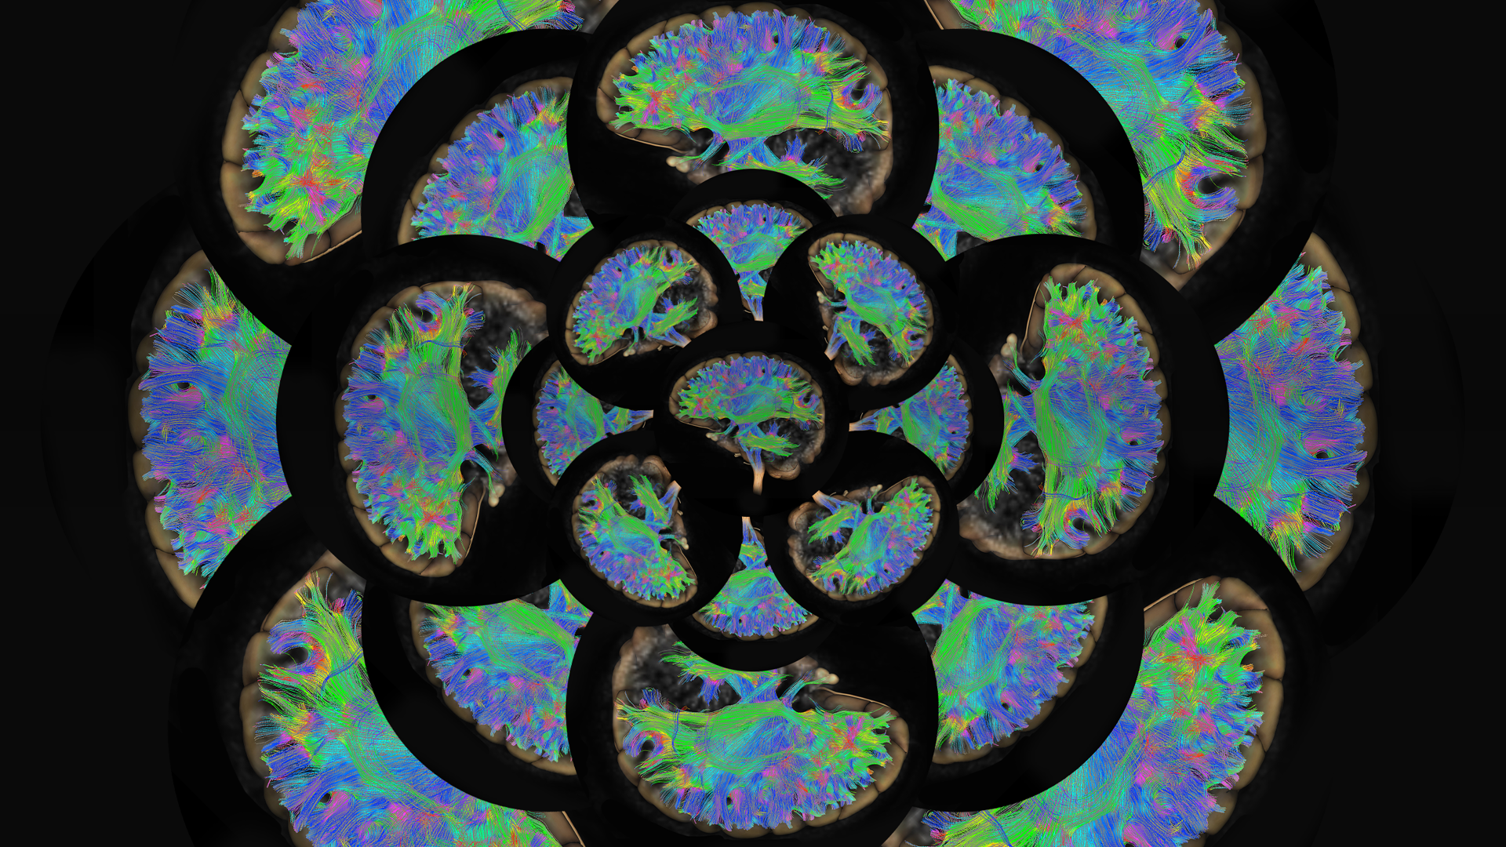

Infinite answers
One place
Advance your research with access to leading multidisciplinary content.
Custom URL here

Slide 4
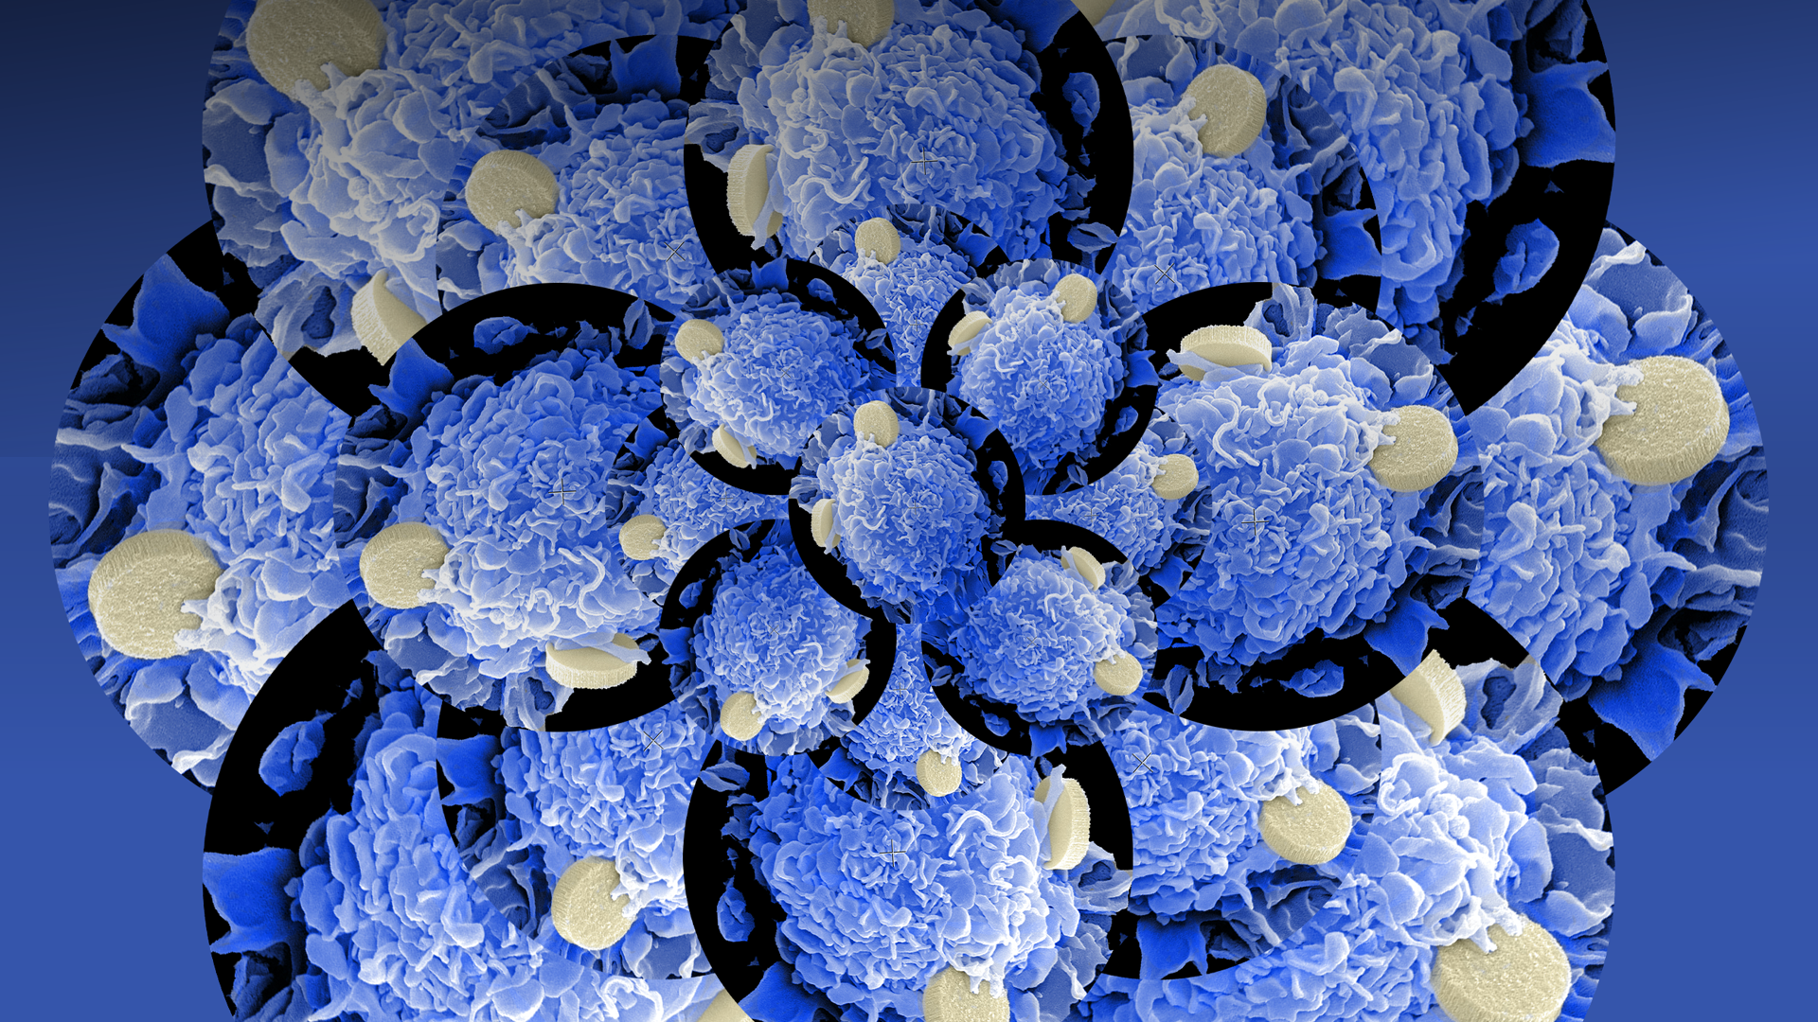

Infinite answers
One place
Advance your research with access to leading multidisciplinary content.
Custom URL here

