Slide 1
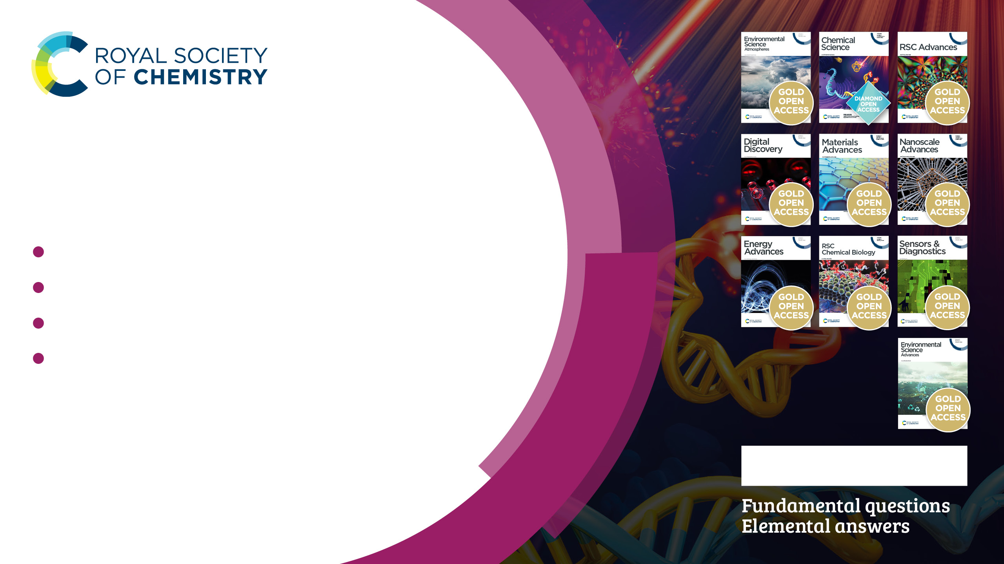
Free resources
Take your research to the next level with our free to access resources:
diamond and gold open access journals
the first chapter of every eBook
the first two volumes of all RSC journals
ChemSpider and Education in Chemistry
Ask us about access for your institution.
rsc.li/get-free-access

Slide 2
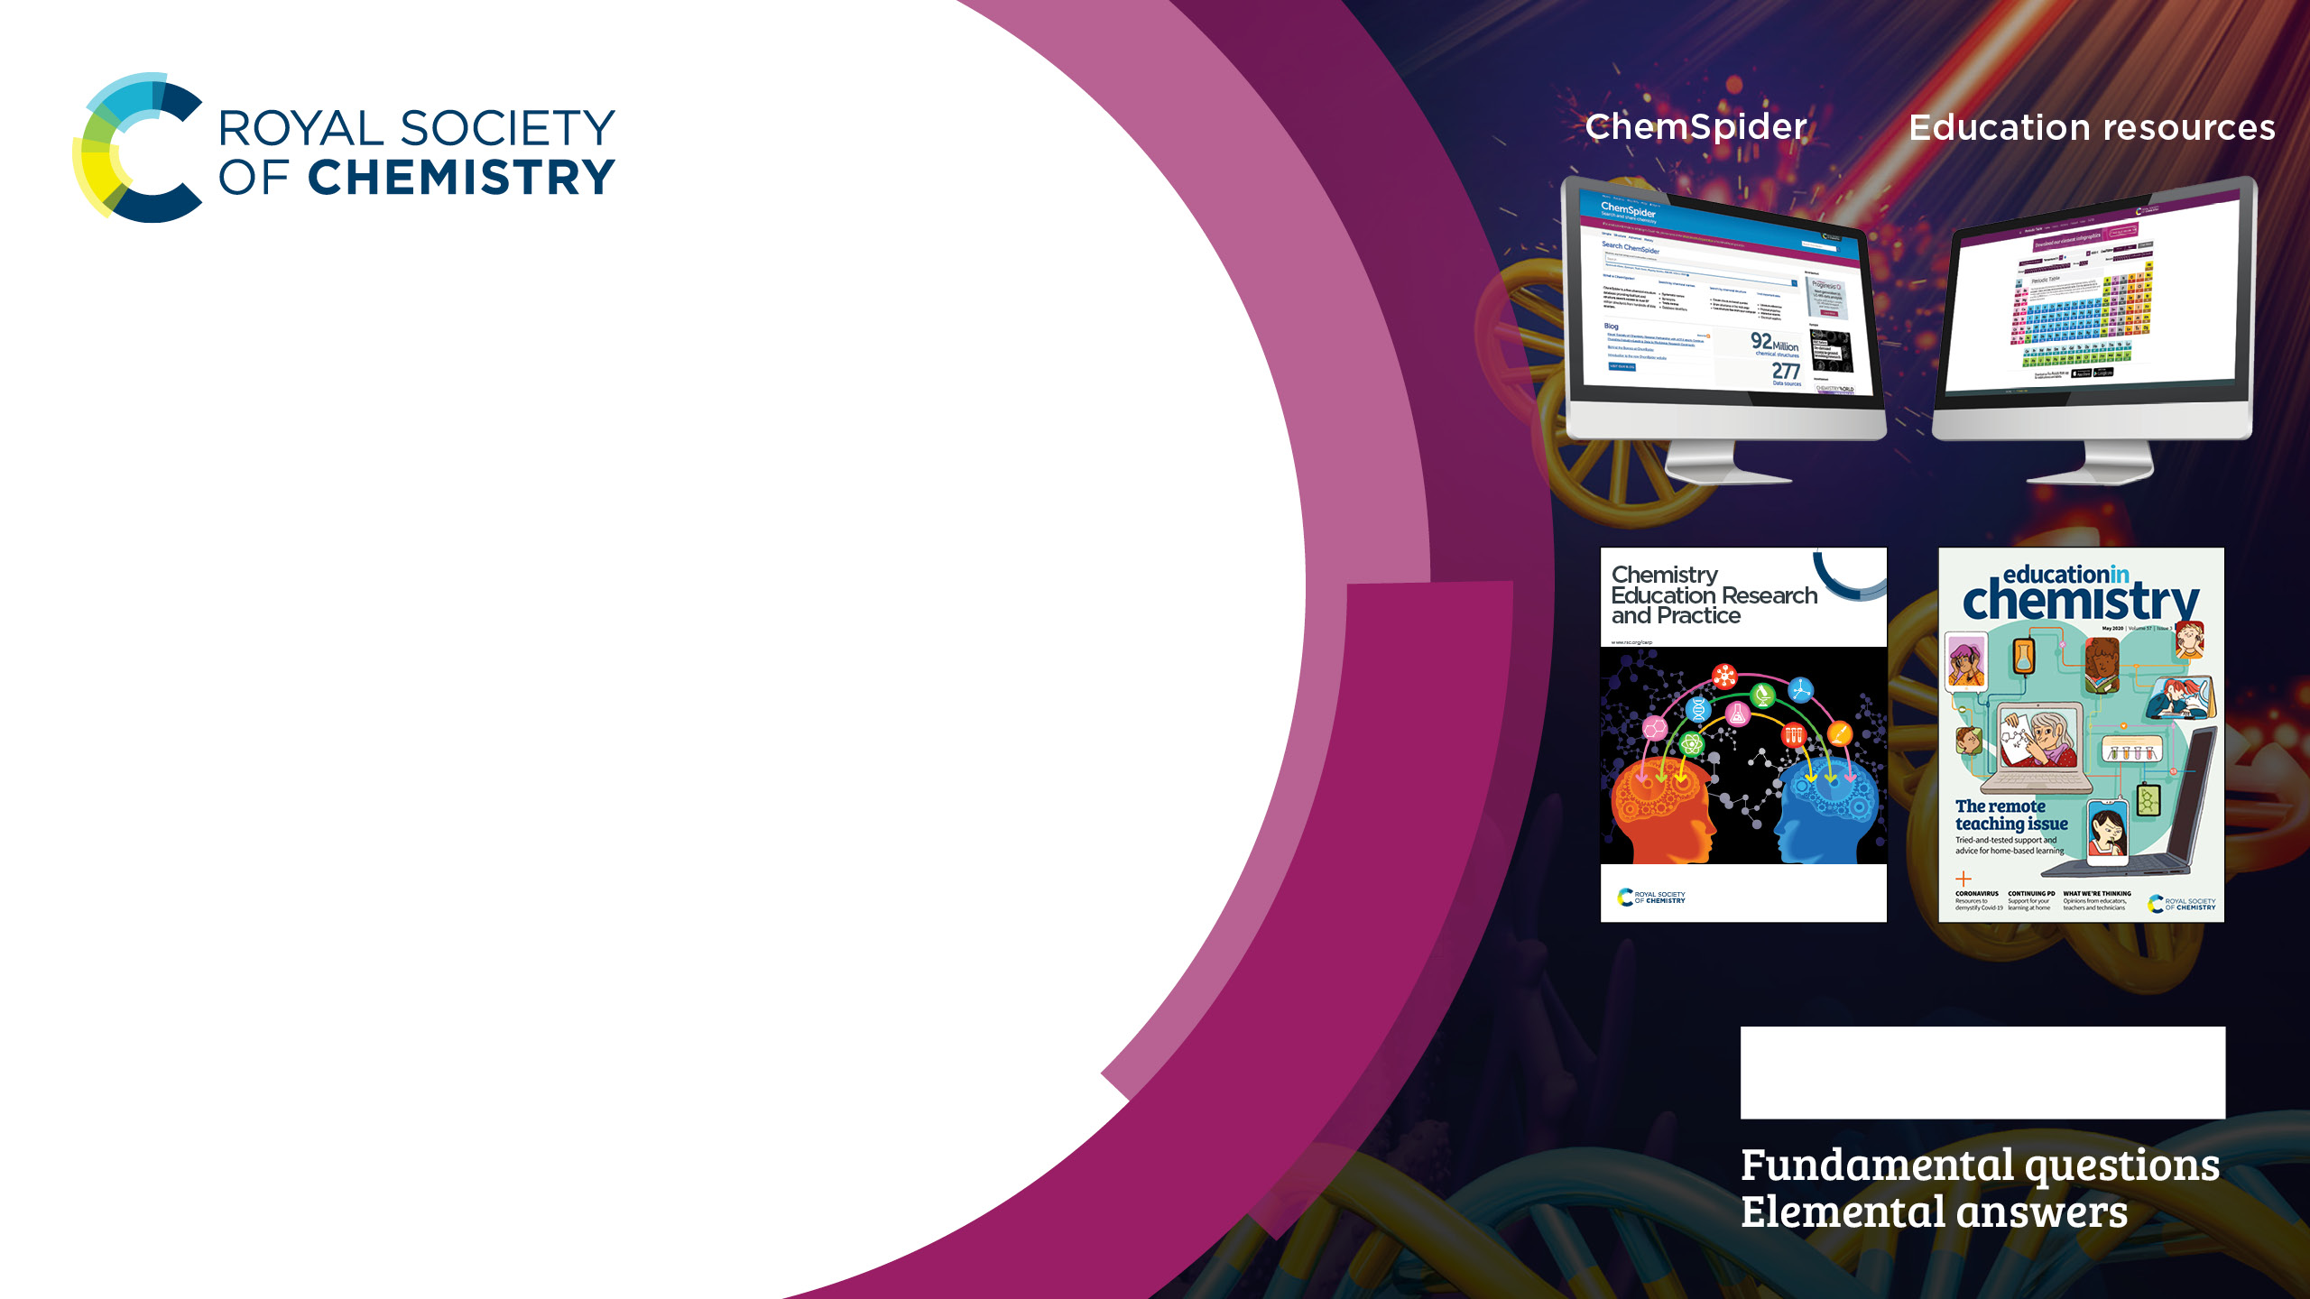
Free resources
Looking for an extra boost?
Explore more free-to-access content
ChemSpider
ChemSpider is a chemical structure database offering a comprehensive view of freely available chemical
data. Your research has the potential to go that bit further with fast
access to over 92 million structures, properties and associated information.
Target your research.
Start searching and sharing.
www.chemspider.com
Education resources
Delve into Chemistry Education Research and Practice, our dedicated journal for chemistry teachers, and Education in Chemistry, our magazine covering all areas of chemistry education.
Fuel your work.
Get exploring.
edu.rsc.org
rsc.li/get-free-access

Slide 3
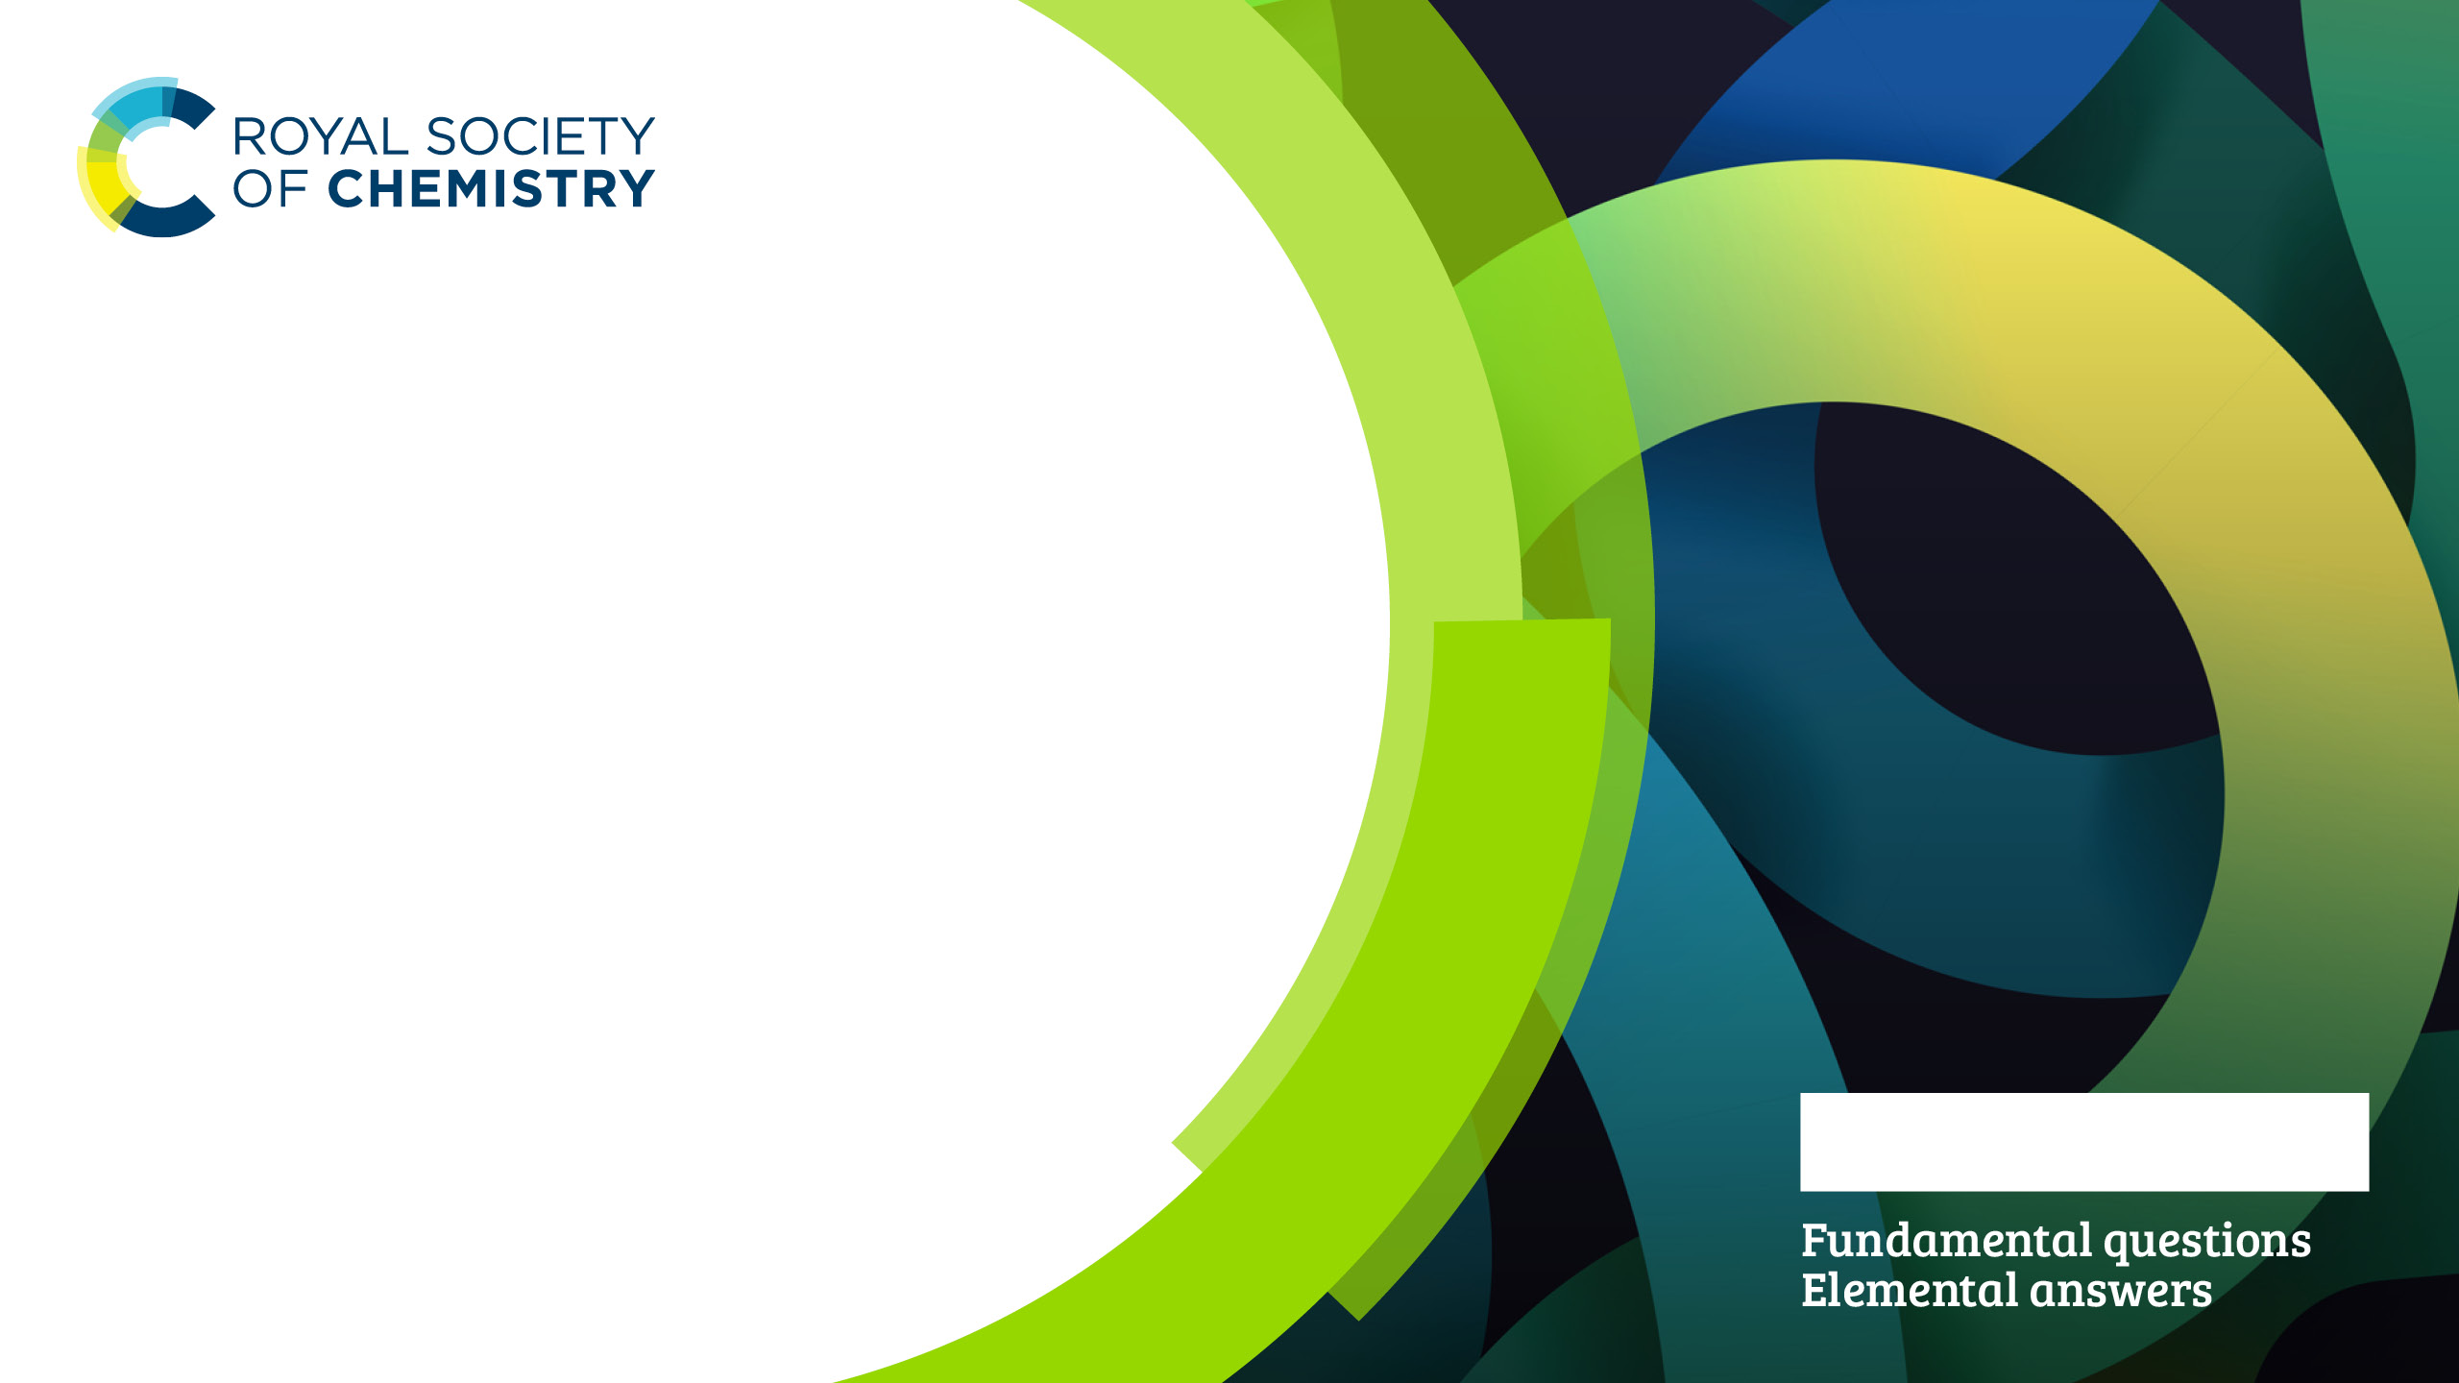
Read and Publish
The Royal Society of Chemistry’s Read & Publish scheme helps both authors and institutions gradually tip the balance of their publishing output towards open access, making the process easier, more sustainable, and financially viable.
rsc.li/read-and-publish

Slide 4

Read and Publish benefits
For researchers
Publishing OA maximises the visibility of your work
Choose either a CC-BY or CC-BY NC licence
All extra costs for publishing in hybrid journals covered
For institutions
Makes publishing open access the default choice
for authors
Automatic identification of corresponding
authors means reduced admin
Perpetual access rights to our entire
journal portfolio
rsc.li/read-and-publish

Slide 5

Can Read & Publish create a sustainable
flow of quality open research?
Learn more about the scheme that supports,
protects and transforms open access publishing
in the chemical sciences
Researchers at institutions with Read & Publish can:
read – any paper published in an RSC journal
publish – gold open access in all hybrid RSC journals
Our community is growing:
170+ – Read & Publish agreements with
institutions and consortia
20+ – countries now have
links to the scheme
rsc.li/read-and-publish

Slide 6

Can Read & Publish create a sustainable
flow of quality open research?
Learn more about the scheme that supports,
protects and transforms open access publishing in
the chemical sciences
In 2020, institutions with a Read & Publish agreement:
published 2009 OA articles
made up of 75% of OA articles published in RSC
hybrid journals
Read & Publish helps both researchers and
institutions gradually tip the balance of their publishing output towards open access
rsc.li/read-and-publish

Slide 7

Where our customers are
We have transformative Read & Publish deals in the following countries
rsc.li/read-and-publish

Slide 8

The Publish And Read (PAR) model
What is it?
The PAR model is a sub-category of Read & Publish (R&P).
It offer institutions with low historic prices the opportunity to
get on the OA ladder, by limiting the number of OA Articles and scaling the cost increases gradually over several years.
Products covered for reading access
All RSC hybrid Journals.
All journals content produced during the time of the agreement will be automatically included.
Disclaimer
All information within this offer and about the PAR model is confidential and should not be delivered to any third party except groups and persons involved in the decision-making process.

Slide 9
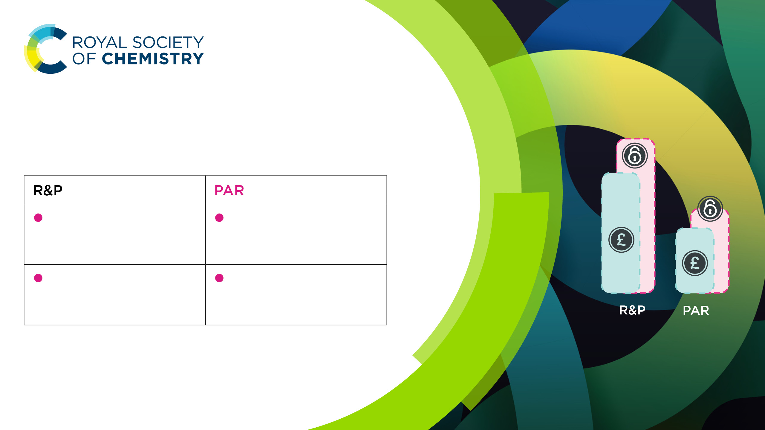
The Publish And Read (PAR) model
What is it?
100%
£xx
x%
Price is based on the number of articles published
Price increases
are controlled and gradual
£xx
OA Articles are unlimited for hybrid journals
OA Articles are
limited and increase gradually
The OA coverage of the total publishing output depends on the funds available

Slide 10

The Publish And Read (PAR) fee
The PAR fee is set following a standard grid with a differentiation by country
The current
subscription price
00
Number of OA Articles
00
[optional]
25% buffer
00
PAR fee
00
[optional] 25% buffer of additional articles at no extra cost is offered by the RSC
The difference between PAR fee and APC
The per-article PAR fee differs from the APC (Article Processing Charge) because it simultaneously covers the publication of a single article and a portion of the reading costs (access to articles not OA)

Slide 11

The Publish And Read (PAR) fee
The PAR fee is set following a standard grid with a differentiation by country
The current
subscription price
00
Number of OA Articles
00
PAR fee
00
The difference between PAR fee and APC
The per-article PAR fee differs from the APC (Article Processing Charge) because it simultaneously covers the publication of a single article and a portion of the reading costs (access to articles not OA)

Slide 12
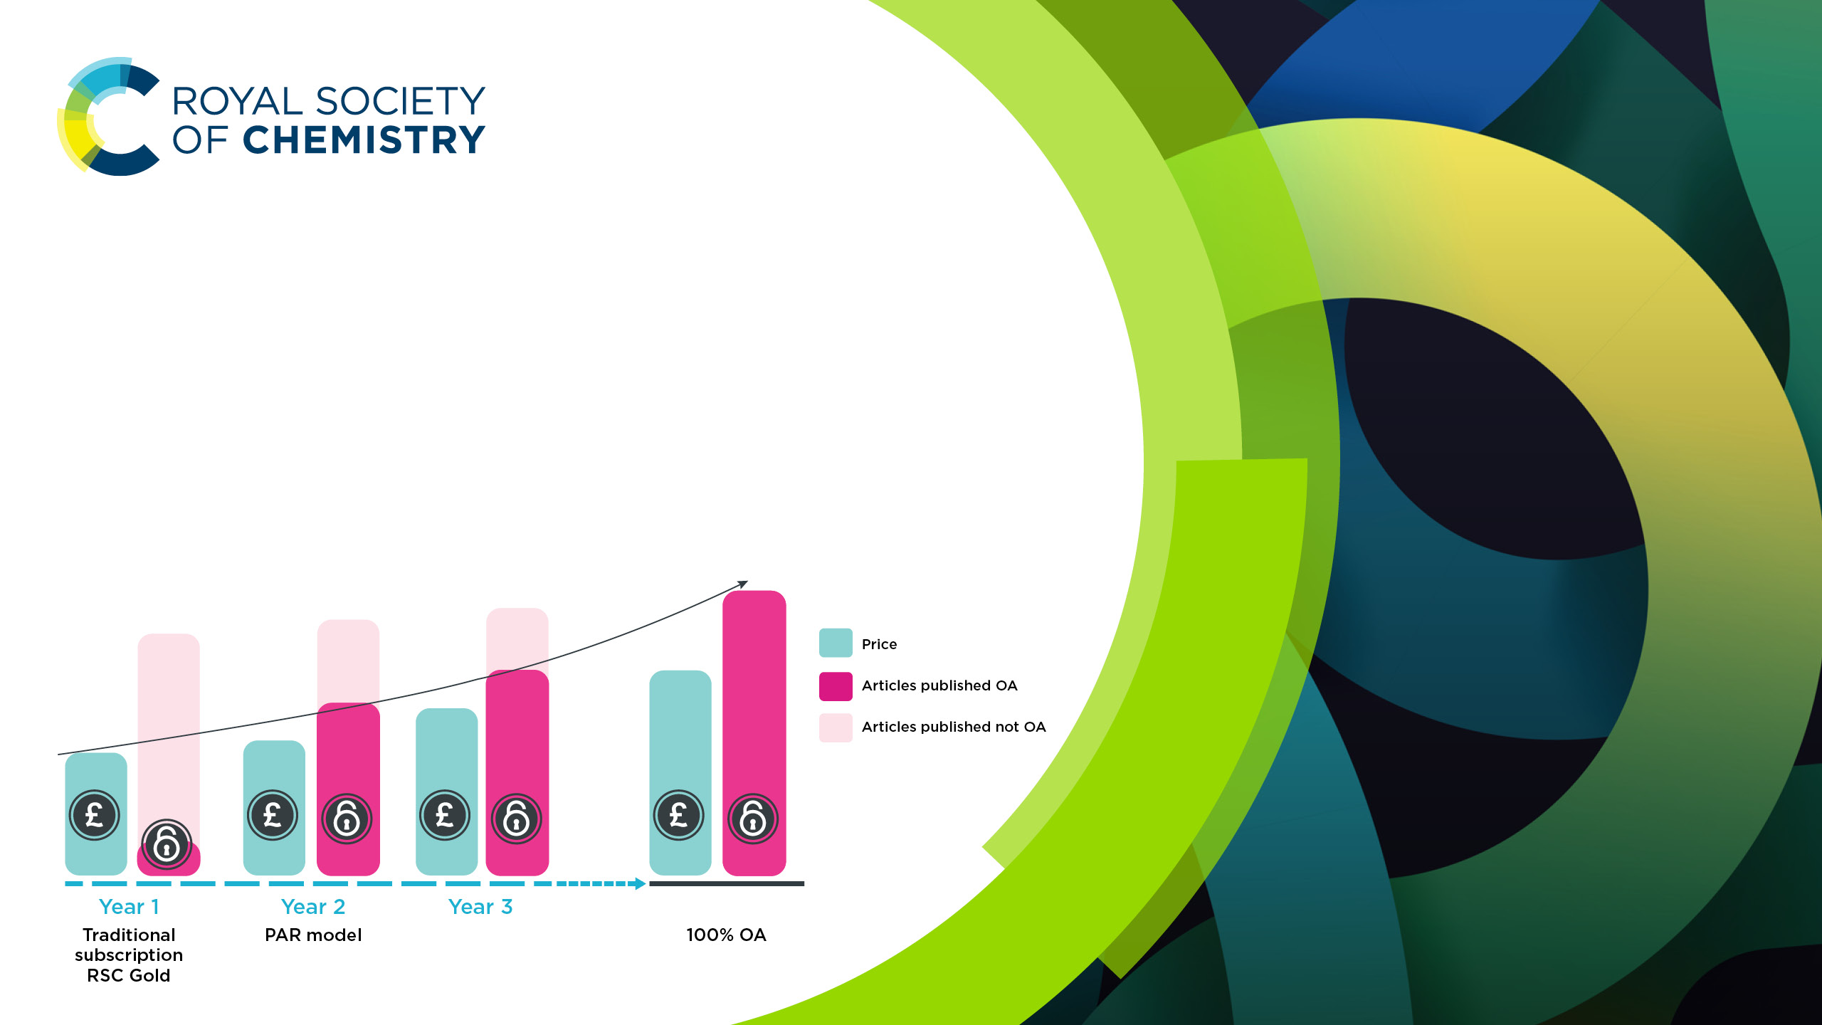
The PAR model as
transition to 100% OA
You can now publish a large part of your yearly output in
Open Access, with no substantial price increase or extra APC.
The PAR model allows a progressive transition towards 100% Open Access publishing output.

Slide 13

R&P and PAR models comparison
Read & Publish model
Price is based on the number of
articles published
The price increases or decreases
yearly based on the publishing
output variations
OA Articles are unlimited for
hybrid journals

Slide 14

R&P and PAR models comparison
PAR model
Price is based on the current price paid by the institution(s)
The price increases yearly in a controlled and gradual way
OA Articles are limited for hybrid journals and increase gradually*
Progressive transition to R&P
*Once the yearly allowance limit is reached, authors can publish their articles in OA at a 15% discount on APCs

Slide 15
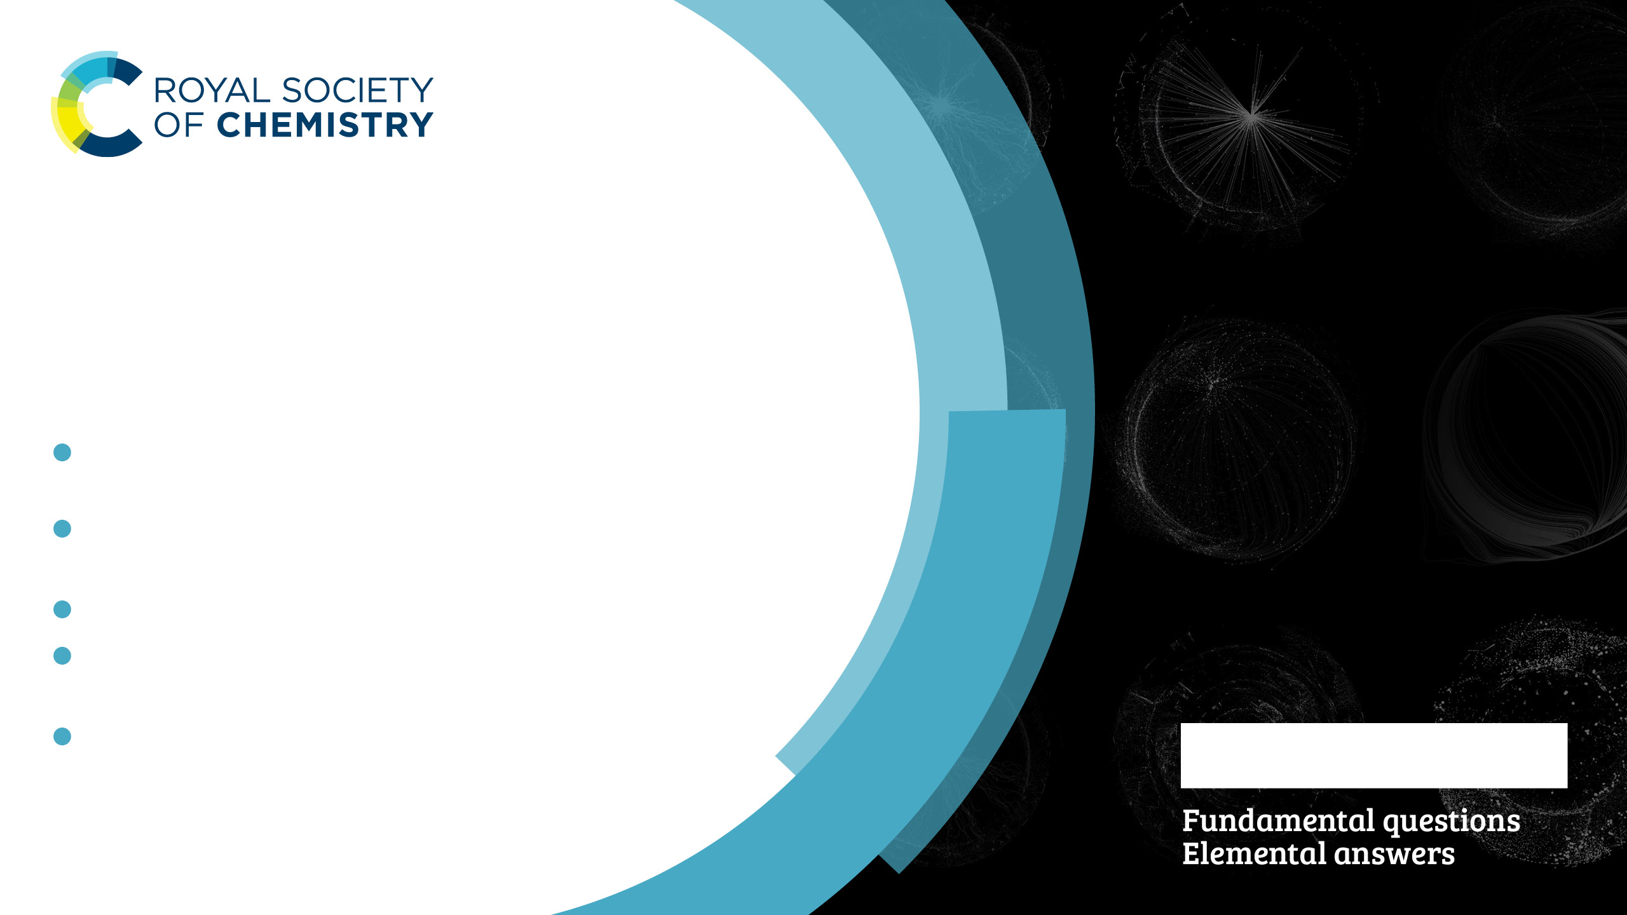
RSC Select
RSC Select gives you on-demand access to ground-breaking research without being tied
to a subscription:
One token = one article download from our collection of cutting-edge research
Download the exact articles your researchers need to find the next scientific advance
Track usage with monthly download reports
Prices are tailored to your unique circumstances
Replenish your tokens at any time
Learn more: rsc.li/select

Slide 16

Text and Data Mining
We have made our full journals catalogue, comprising thousands of high quality, rigorously reviewed articles available for us with TDM
and machine learning applications. This helps businesses to make rapid breakthroughs and to build new knowledge.
Visit rsc.li/TDM

Slide 17

RSC Gold
The most comprehensive collection of
Royal Society of Chemistry content.
RSC Gold gives library users access to
40 online journals of exciting and innovative scientific research.
High profile, chemistry-led journals
166 years of valuable discoveries
Handpicked significant scientific research
International perspective
Dedicated to chemistry education
rsc.li/xxxxxx

