Slide 1
Diagnostic segregation of human brain tumours using Fourier-transform infrared and/or Raman spectroscopy coupled with discriminant analysis
Ketan Gajjar^{1,2}, Lara Heppenstall¹, Weiyi Pang¹, Katherine Ashton², Júlio Trevisan¹, Imran I Patel¹, Valon Llabjani¹, Helen Stringfellow², Pierre Martin-Hirsch^{1,2}, Timothy Dawson², Francis L. Martin¹
¹Centre for Biophotonics, Lancaster Environment Centre, Lancaster University, Lancaster, United Kingdom; ²Lancashire Teaching Hospitals NHS Trust, Royal Preston Hospital, Sharoe Green Lane North, Preston, Lancashire, United Kingdom
Summary
Number of pages: 10
Number of Figures: 9
Number of Tables: 3

Slide 2
A
B
ATR-FTIR Spectroscopy
C
D
Raman Spectroscopy
Figure S1 (A & C) shows mean spectra for each tissue type in the biochemical-cell fingerprint region for IR (1,800 cm⁻¹ to 900 cm⁻¹) and Raman (1,750 cm⁻¹ to 800 cm⁻¹) spectra respectively; and, (B & D) shows the spectra per individual (20 spectra for IR and 50 spectra for Raman) averaged with baseline correction.

Slide 3
A
C
ATR-FTIR Spectroscopy
Coefficient
B
D
Wavenumber (cm⁻¹)
Raman Spectroscopy
Coefficient
Wavenumber (cm⁻¹)
Figure S2 (A & B) shows 1-D PCA-LDA scores plot of IR and Raman spectra respectively comparing the Meningioma to normal brain tissue with the corresponding loadings plots; and, (C & D) showing top 6 discriminating wavenumbers associated with molecular alterations responsible for segregation of meningioma from normal brain.

Slide 4
A
C
ATR-FTIR Spectroscopy
Coefficient
B
D
Wavenumber (cm⁻¹)
Raman Spectroscopy
Coefficient
Wavenumber (cm⁻¹)
Figure S3 (A & B) shows 1-D PCA-LDA scores plot of IR and Raman spectra respectively comparing the low-grade astrocytoma (WHO grade II glioma) to normal brain tissue with the corresponding loadings plots; and, (C & D) showing top 6 discriminating wavenumbers.

Slide 5
A
C
ATR-FTIR Spectroscopy
Coefficient
B
D
Wavenumber (cm⁻¹)
Raman Spectroscopy
Coefficient
Wavenumber (cm⁻¹)
Figure S4 (A & B) shows 1-D PCA-LDA scores plot of IR and Raman spectra respectively comparing the anaplastic astrocytoma (WHO grade III glioma) to normal brain tissue with the corresponding loadings plots; and, (C & D) showing top 6 discriminating wavenumbers.

Slide 6
A
C
ATR-FTIR Spectroscopy
Coefficient
B
Wavenumber (cm⁻¹)
D
Coefficient
Raman Spectroscopy
Wavenumber (cm⁻¹)
Figure S5 (A & B) shows 1-D PCA-LDA scores plot of IR and Raman spectra respectively comparing glioblastoma multiforme (WHO grade IV glioma) to normal brain tissue with the corresponding loadings plots; and, (C & D) showing top 6 discriminating wavenumbers.

Slide 7
A
C
ATR-FTIR Spectroscopy
Coefficient
B
Wavenumber (cm⁻¹)
D
Raman Spectroscopy
Coefficient
Wavenumber (cm⁻¹)
Figure S6 (A & B) shows 1-D PCA-LDA scores plot of IR and Raman spectra respectively comparing metastatic brain tumours to normal brain tissue with the corresponding loadings plots; and, (C & D) showing top 6 discriminating wavenumbers.

Slide 8
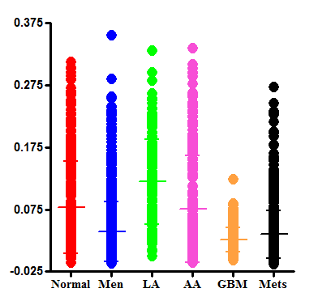
Ratio of phospholipids (1,745 cm⁻¹) to proteins (1,335 cm⁻¹) in Raman spectra
*
*
*
Ratio of 1,745 cm⁻¹ /1,335 cm⁻¹
Wave number intensity ratio
Normal vs. Tumour type | P-value
Normal vs. Men | P < 0.01
Normal vs. LA | P < 0.01
Normal vs. AA | P > 0.05
Normal vs. GBM | P < 0.01
Normal vs. Mets | P < 0.01
*
Figure S7 Wavenumber intensity ratio of phospholipids (1,745 cm⁻¹) to proteins (1,335 cm⁻¹) in Raman spectra of all brain tissues.

Slide 9
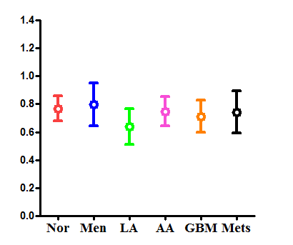
Ratio of cholesterol esters (1,670 cm⁻¹) to phenylalanine (1,001 cm⁻¹) in Raman spectra
*
**
*
Ratio of 1,670 cm⁻¹ to 1,001 cm⁻¹
*
Wavenumber intensity ratio
Normal vs. Tumour type | P-value
Normal vs. Men | P < 0.01
Normal vs. LA | P < 0.01
Normal vs. AA | P > 0.05
Normal vs. GBM | P < 0.01
Normal vs. Mets | P < 0.05
Figure S8 Wavenumber intensity ratio of cholesterol esters (1,670 cm⁻¹) to phenylalanine (1,001 cm⁻¹) in Raman spectra of all brain tissues.

Slide 10
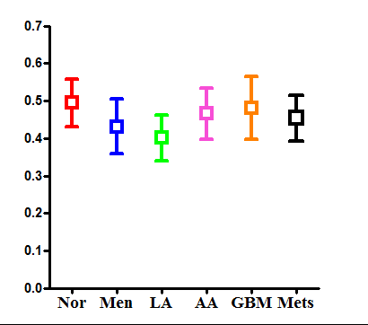
1,654 cm⁻¹ (Amide 1 μ-helix)/1,446 cm⁻¹ (CH₂ bending mode of proteins and lipids) ratio in Raman spectra
*
*
*
*
Ratio of 1,654 cm⁻¹ /1,446 cm⁻¹
Normal vs. Tumour type | P-value
Normal vs. Men | P < 0.01
Normal vs. LA | P < 0.01
Normal vs. AA | P < 0.01
Normal vs. GBM | P > 0.05
Normal vs. Mets | P < 0.01
Wavenumber intensity ratio
Figure S9 Wavenumber intensity ratio of 1,654 cm⁻¹ (Amide 1 μ-helix) to 1,446 cm⁻¹ (CH₂ bending mode of proteins and lipids) Raman spectra comparing different tissue types.

